Slide 1
Prerequisite Packages Sanity Check
15ITWCVP
Accra, Ghana, 11 – 20 September 2023

Slide 2
1. System Requirements
HARDWARE: Windows (64 bit, Updated version of Windows 10 or above)
MEMORY: 4GB or more (if possible)
Free DISK SPACE: 50GB or more
Internet Connection
SOFTWARE (to be installed):
WSL (ubuntu)
xming
Anaconda
xcast
GNU precision calculator (bc),
wget
curl
Image Magick
GrADS
R
QGIS

Slide 3
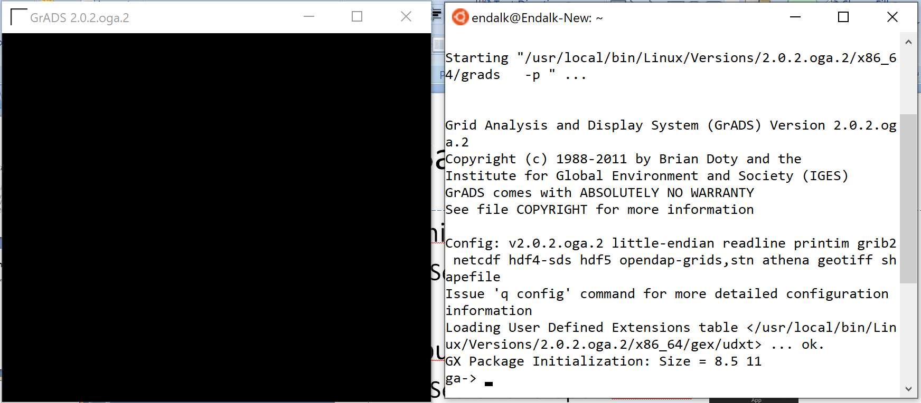
2. Sanity Check
Xming
Search and open Xming
Ubuntu
Search and open Ubuntu
GrADS
Type grads -p
Type quit to exit from GrADS

Slide 4
2. Sanity Check (cont.)
Installed Linux libraries
Type which bc to get /usr/bin/bc
Type which curl to get /usr/bin/curl
Type which wget to get /usr/bin/wget
Type which convert to get /usr/bin/convert
Xcast conda environment
Type conda deactivate
Type conda activate xcast_env
Type which python to get something that looks like: /home/endalk/anaconda3/envs/xcast_env/bin/python

Slide 5
2. Sanity Check (cont.)
R conda environment
Type conda deactivate
Type conda activate renv
Type which ncl to get something that looks like: /home/endalk/anaconda3/envs/renv/bin/ncl
Type which grib_to_netcdf to get something that looks like
/home/endalk/anaconda3/envs/renv/bin/ grib_to_netcdf
Launch R by typing R then type and enter library()
You should see list of libraries including:
ncdf4 Interface to Unidata netCDF (Version 4 or Earlier) Format Data Files
RNetCDF Interface to 'NetCDF' Datasets

