Slide 1
REGIONAL HAZARDS outlooks process and drought indices
Miliaritiana Robjhon NOAA CPC/INNOVIM, INC.

Slide 2
FEWS NET regional hazards outlook process
Focus on areas vulnerable to food security
In-depth monitoring of the climate
Model Guidance tools
Teleconference
Hazard Outlook initial draft
Finalize Hazards Outlooks
Disseminate through web and distribution list
FEWSNET issues food security outlook
USAID begins Humanitarian response planning

Slide 3
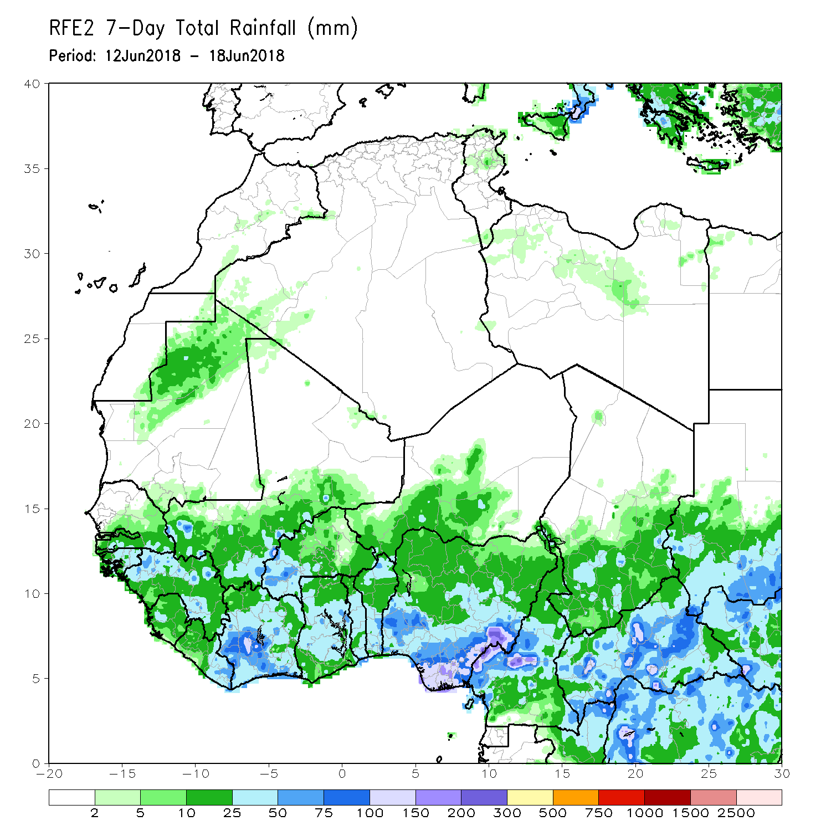
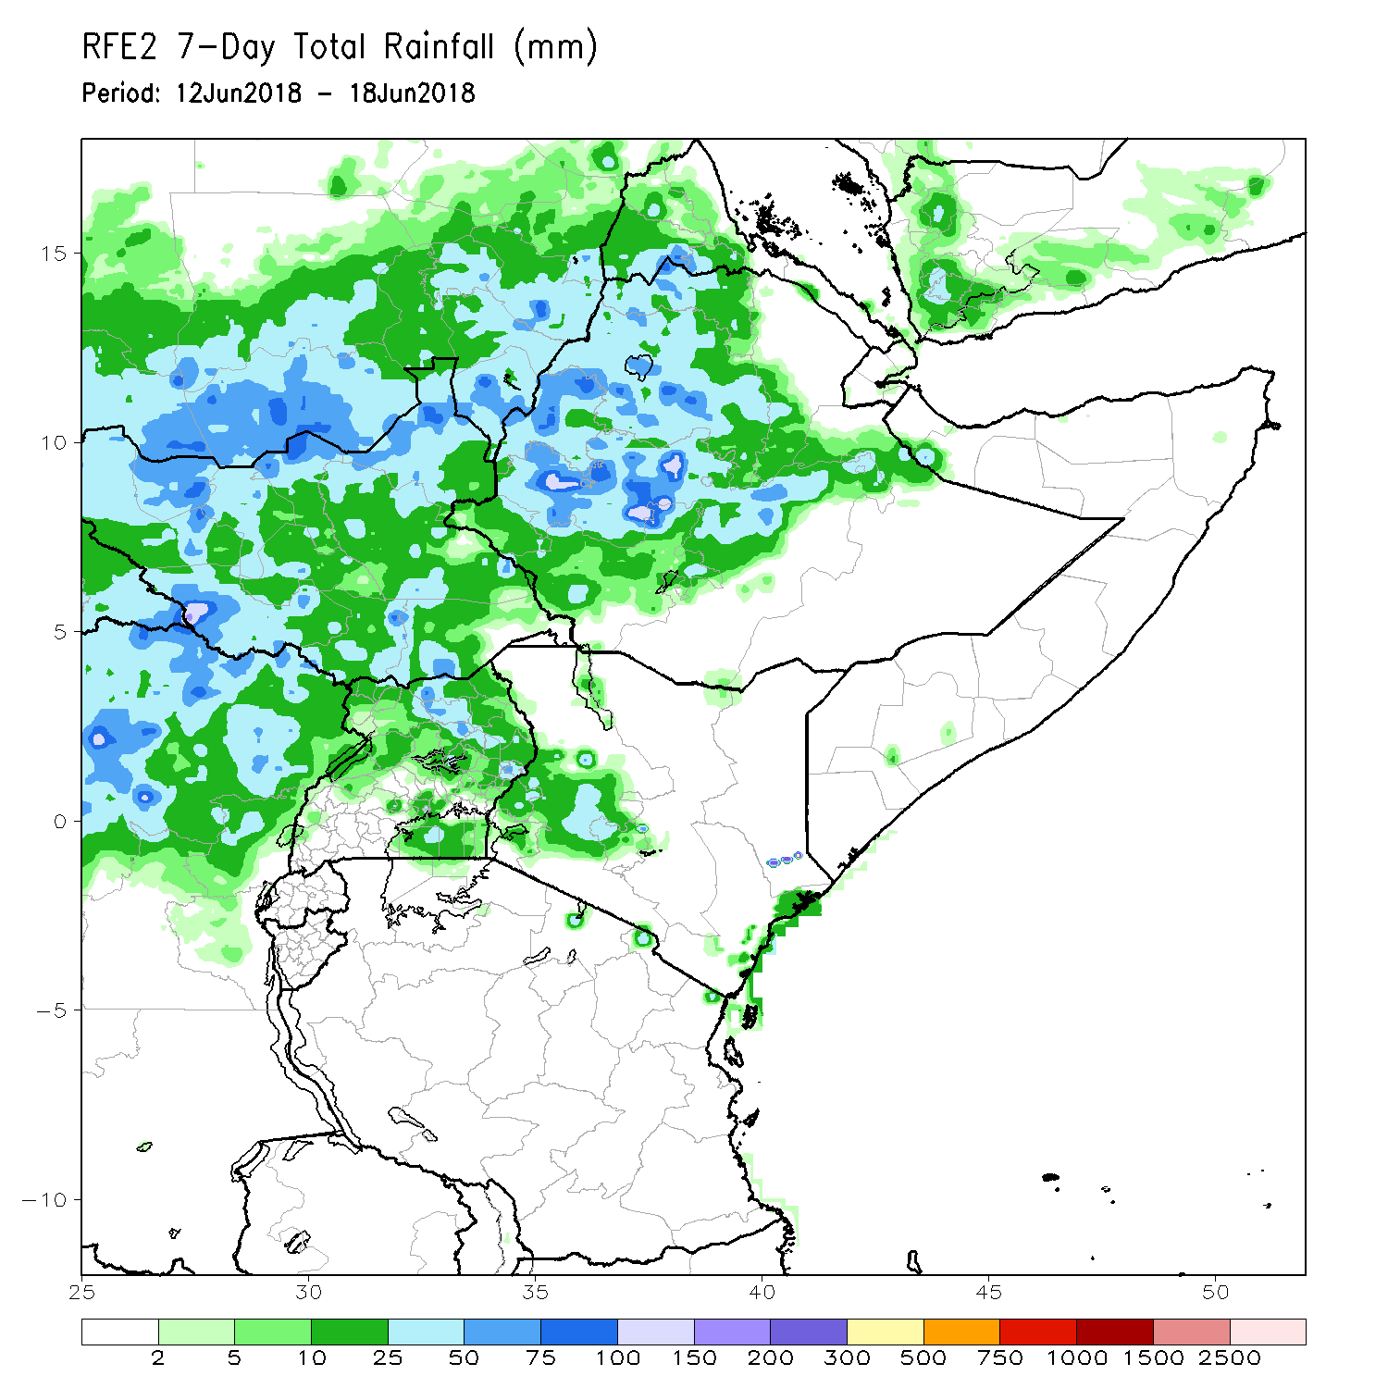
Weather and climate monitoring
Look into the spatial distribution of satellite-derived weekly rainfall totals
Present – past – future

Slide 4
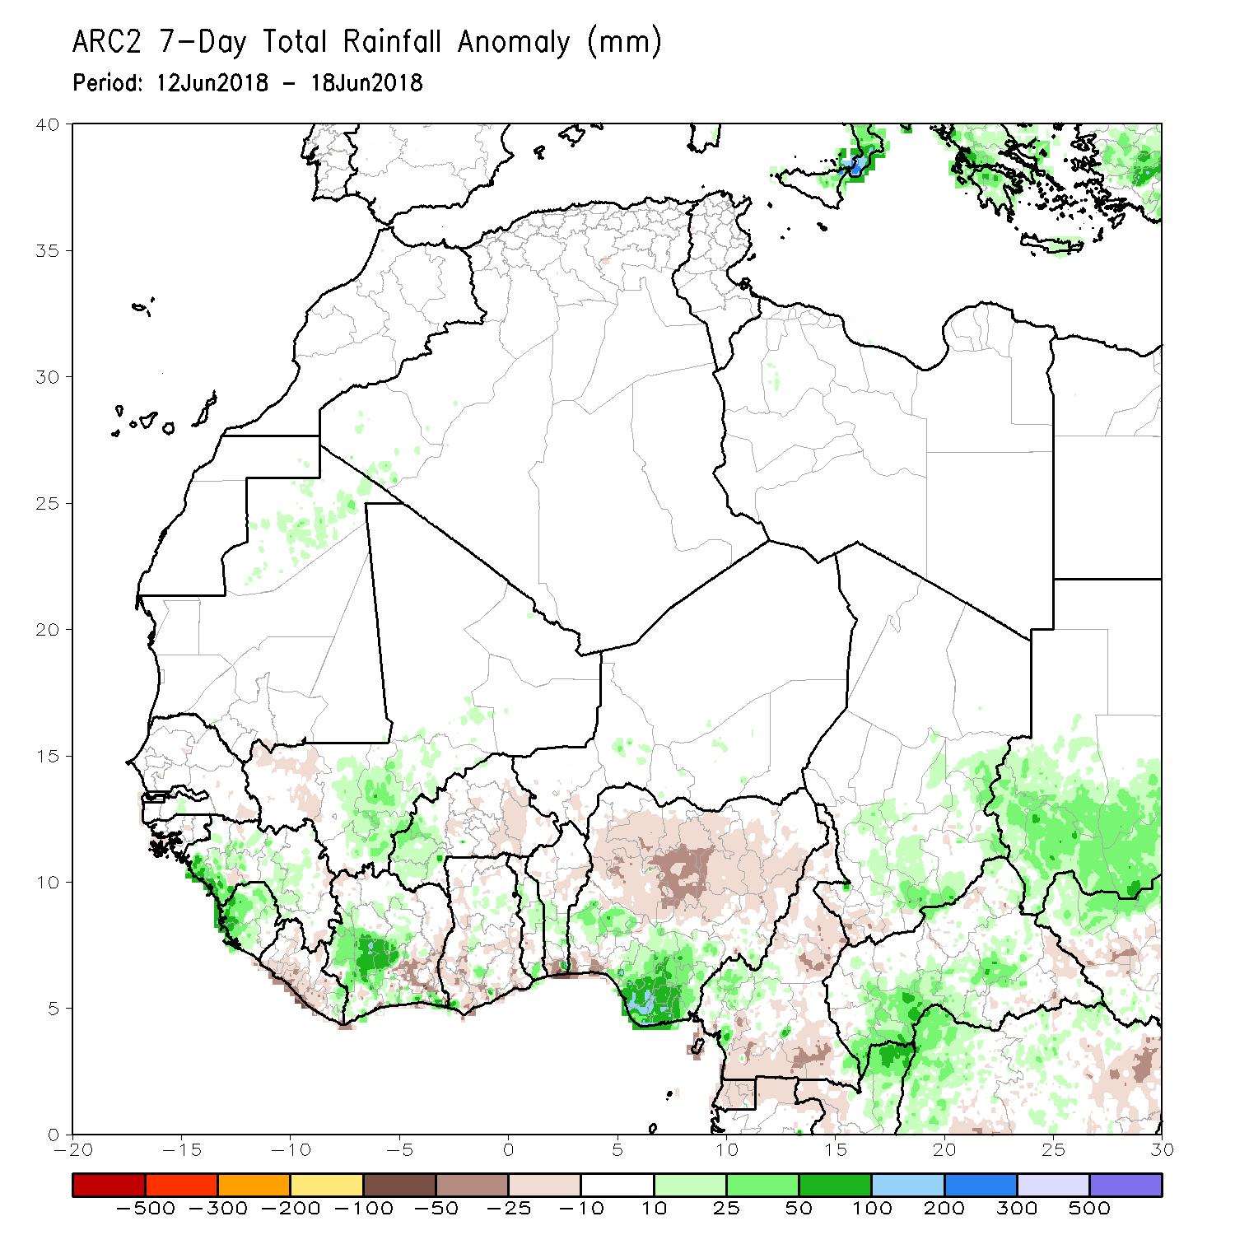
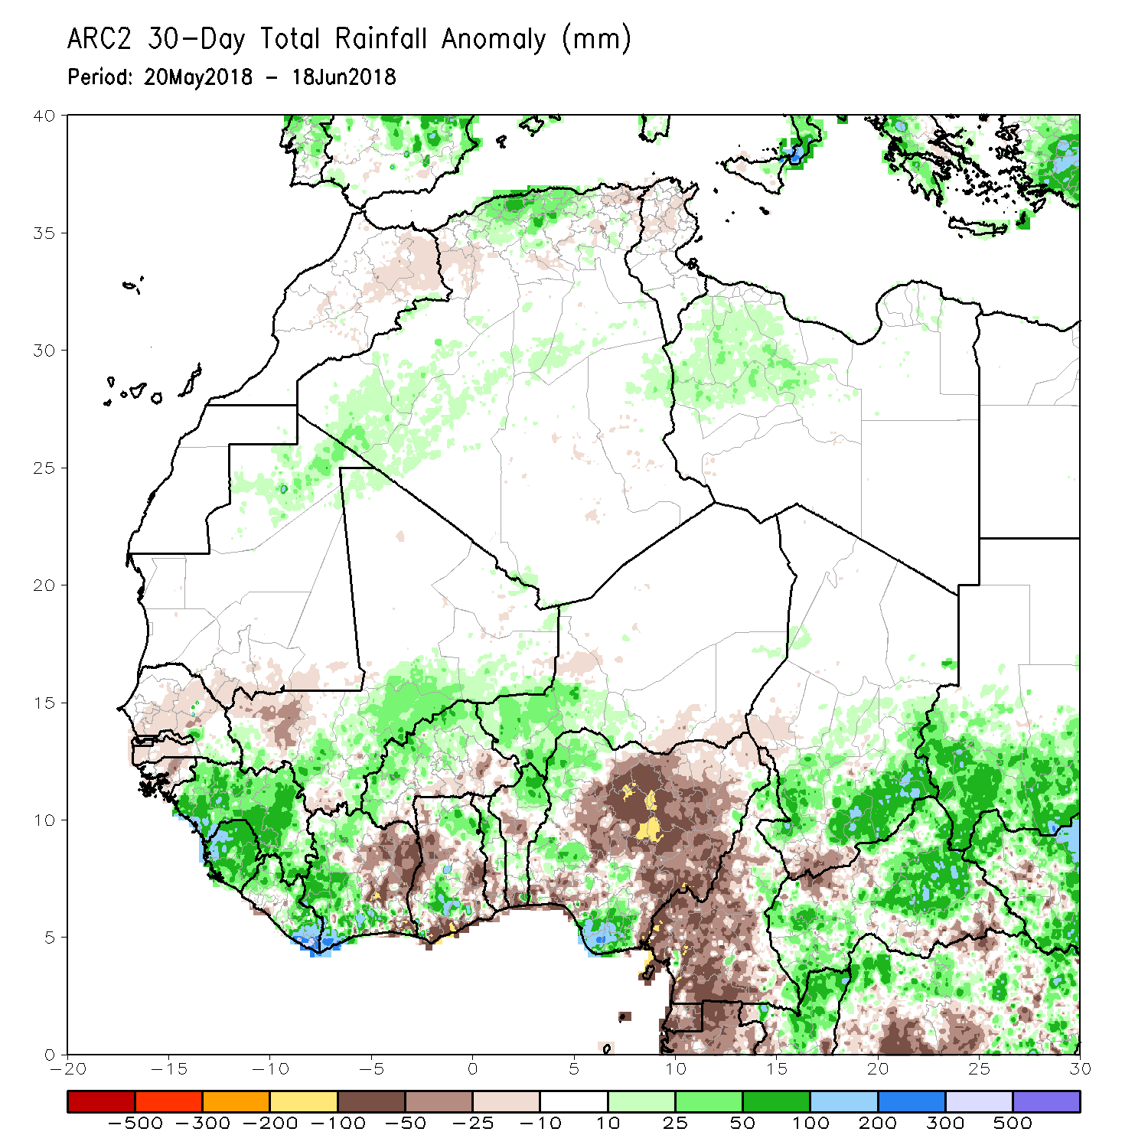
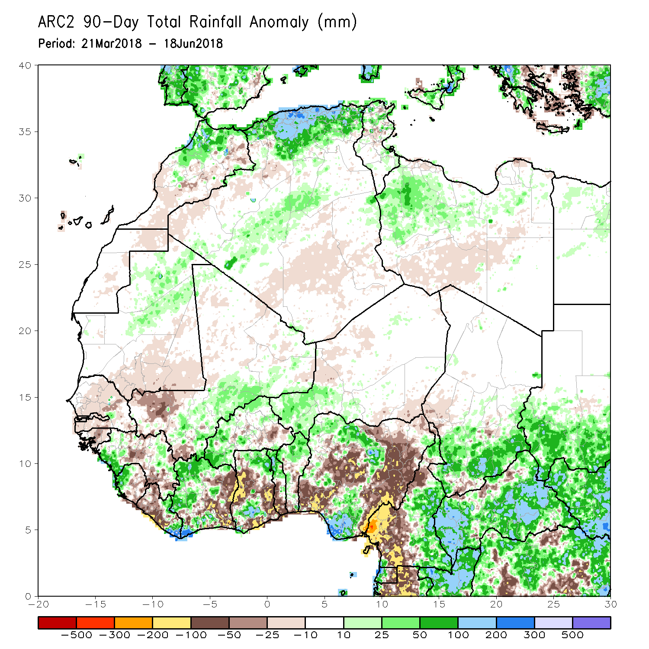
Climate diagnostics
Use tools such as 7-day, 30-day, and 90-day rainfall anomaly to identify regions that experienced wetter (drier) than average conditions at various time scales
Anomaly: obs. – clim.

Slide 5
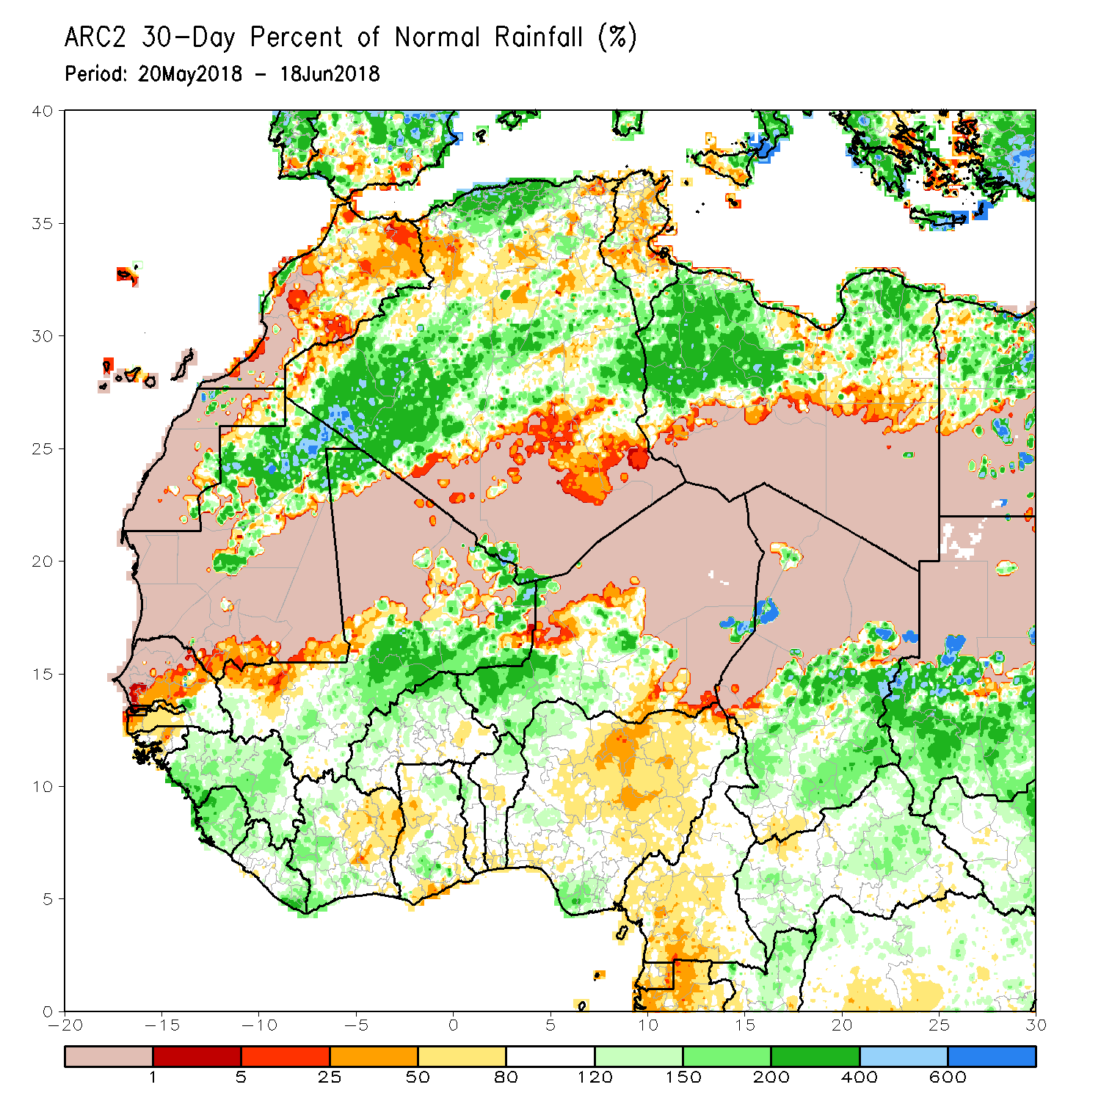
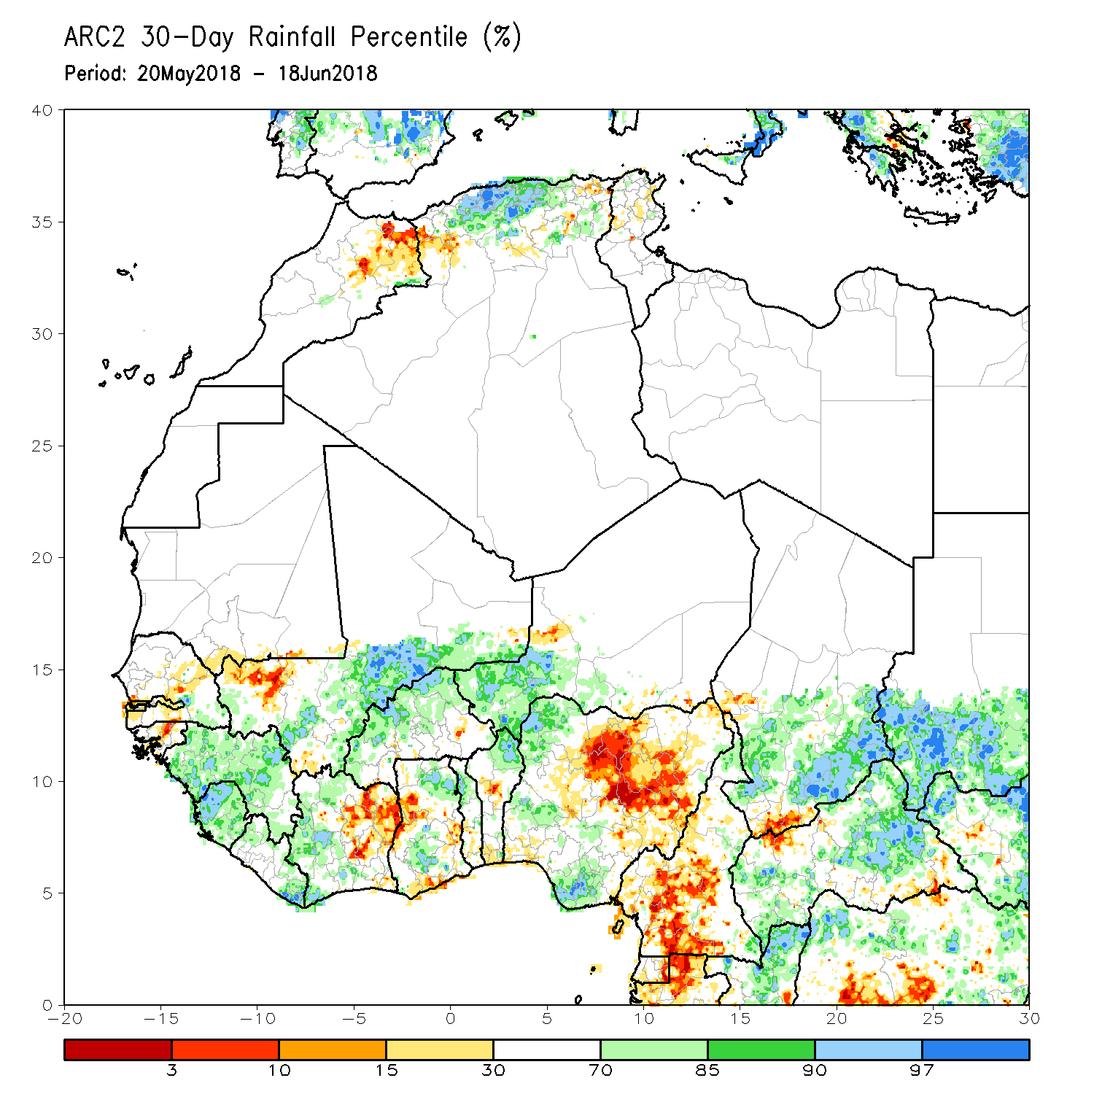
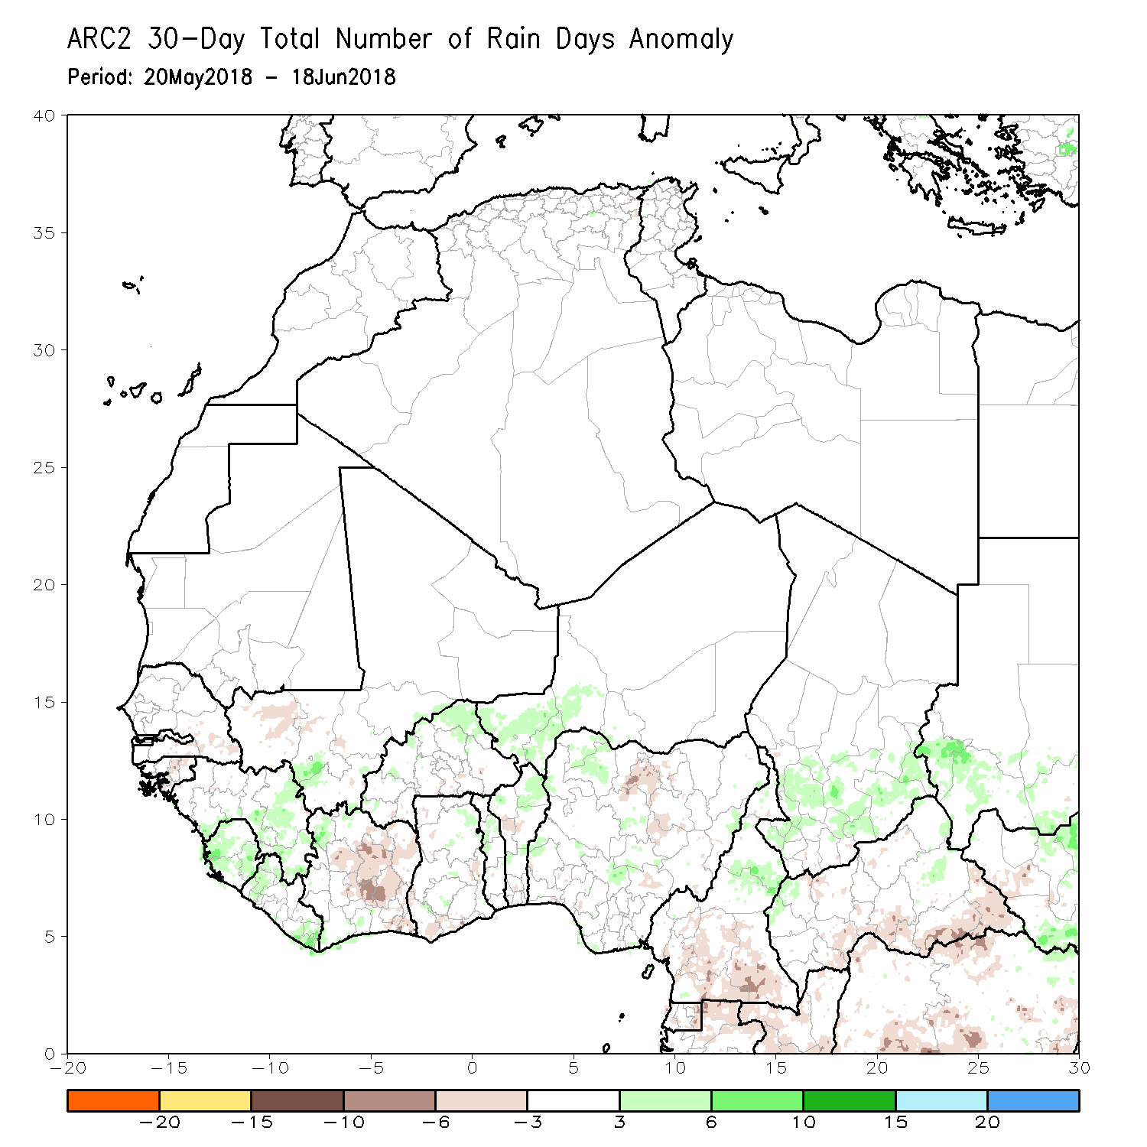
Other types of anomaly
Percent of normal rainfall: 100 * obs./ clim.
Percentile: Ranking (%) from driest to wettest in record
# of rain days anomaly: # days with rain >= 1 mm w.r.t. climatology. This is about rainfall frequency

Slide 6
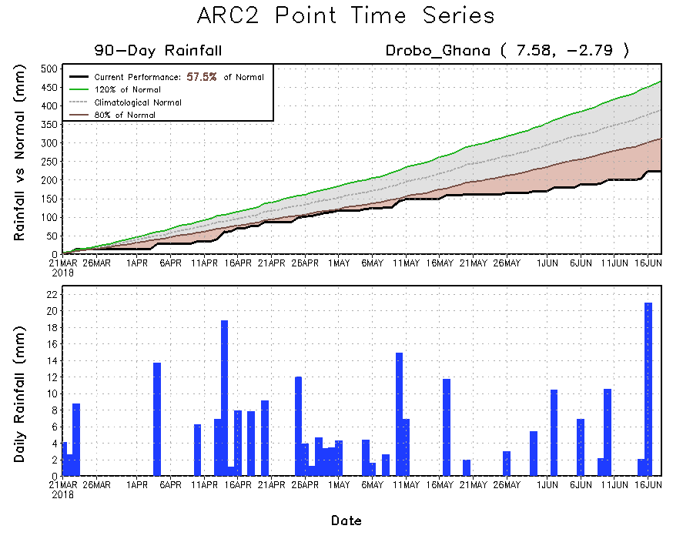
Rainfall time series analysis
Temporal distribution of rainfall and associated anomalies over a point location

Slide 7
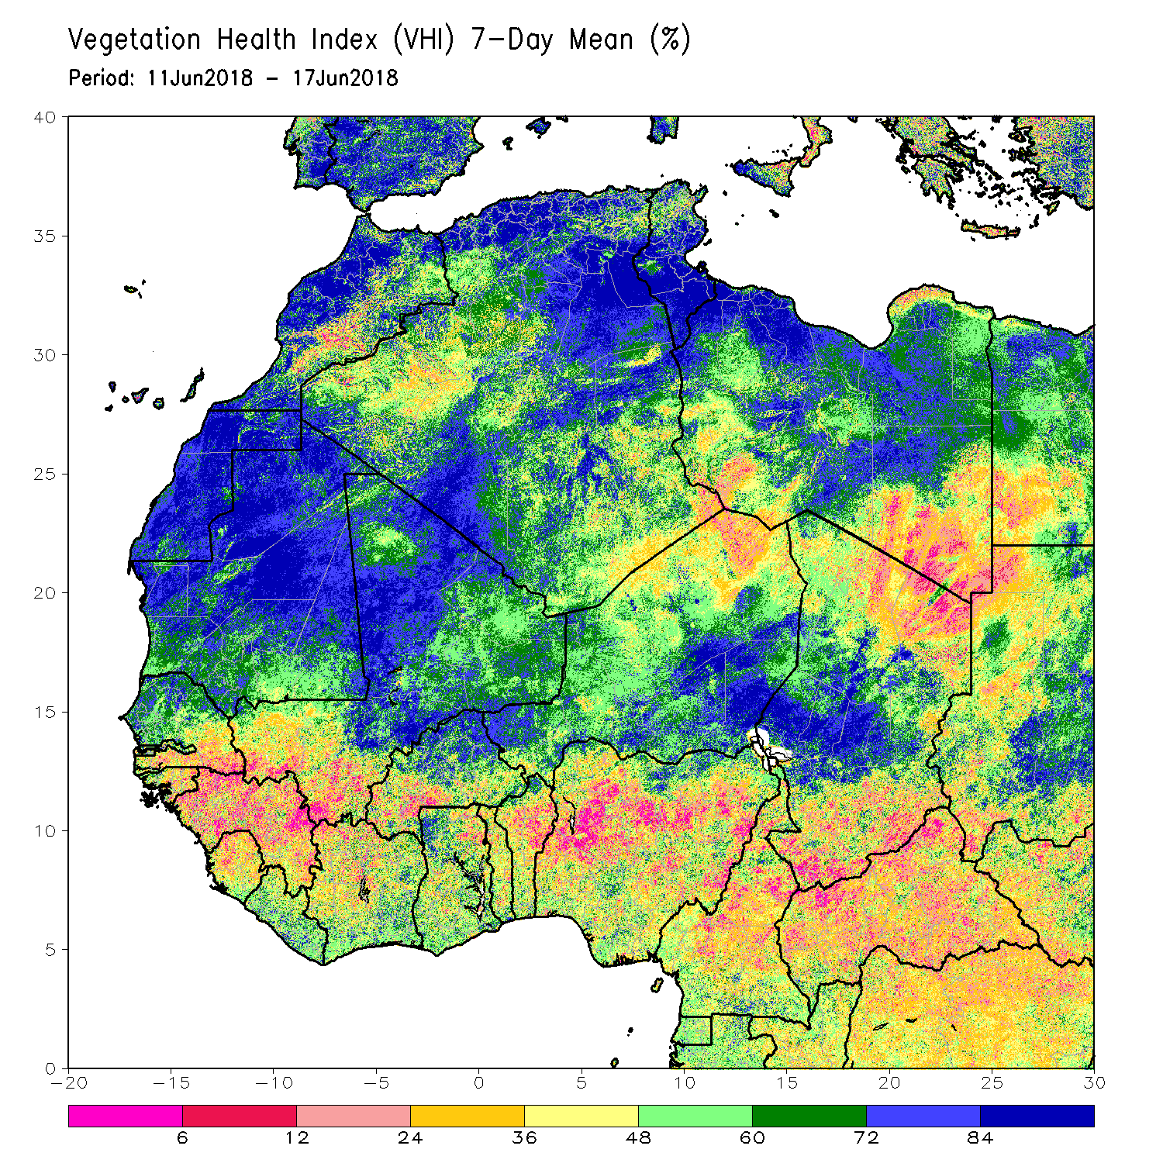
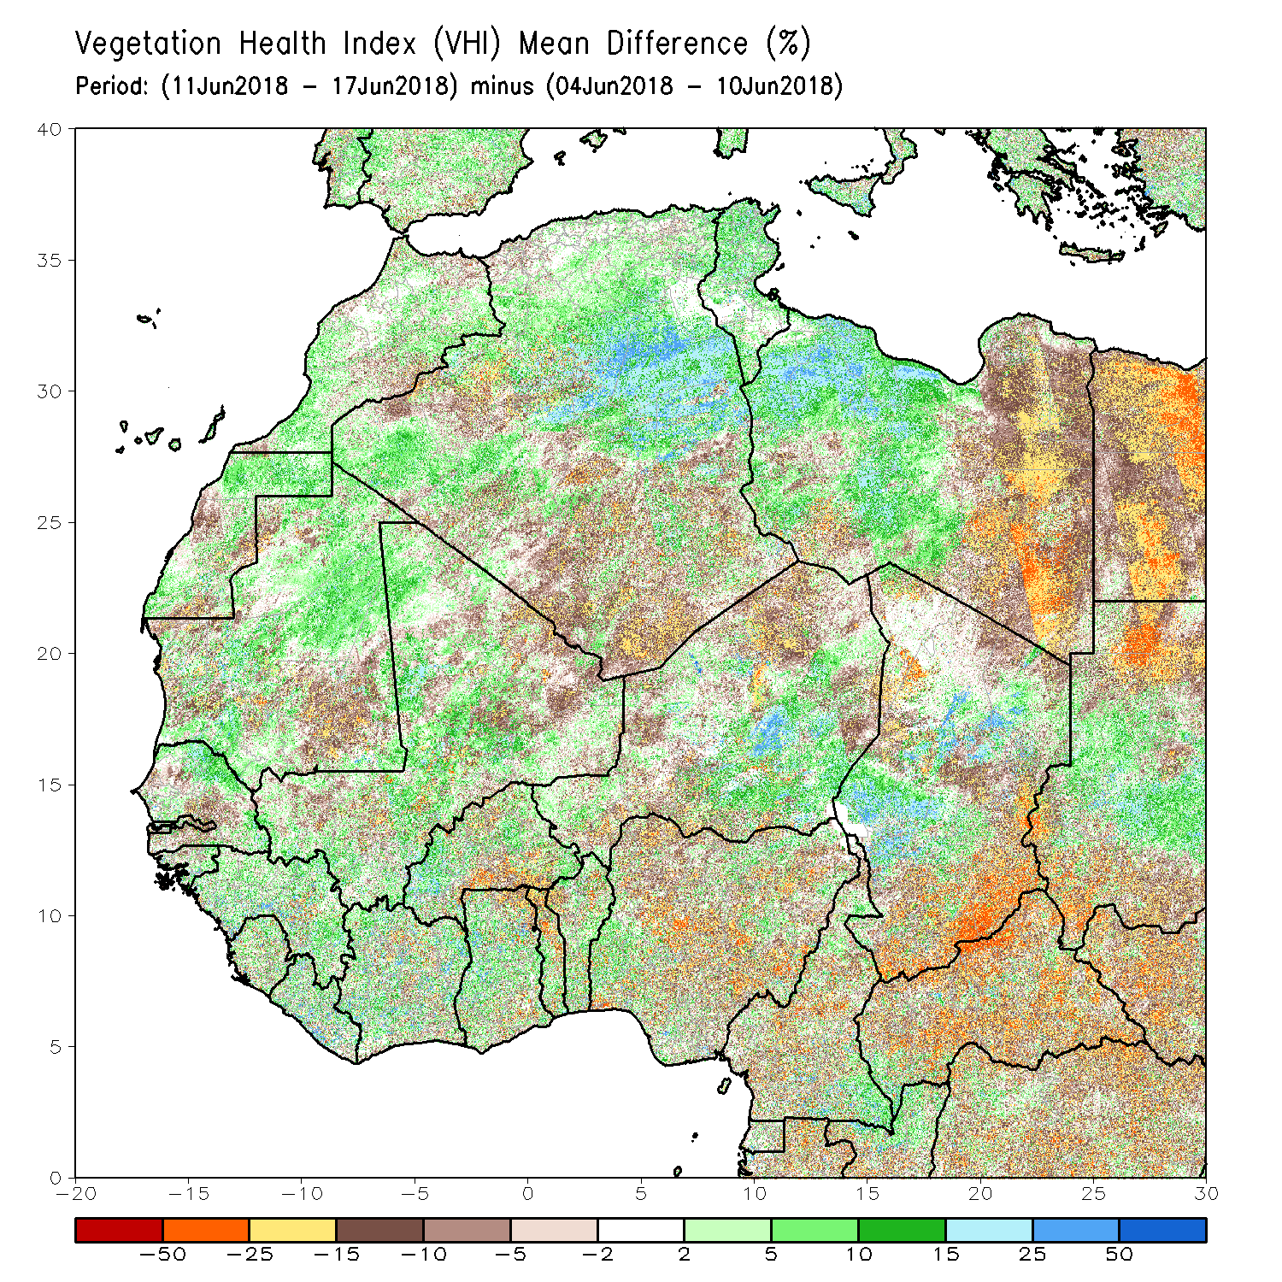
Monitoring land surface information
Potential impacts of climate anomalies can be detected by the Vegetation Health Index (VHI).
Low values indicate stress
High values mean favorable
Tendency – improvement vs. worsening

Slide 8
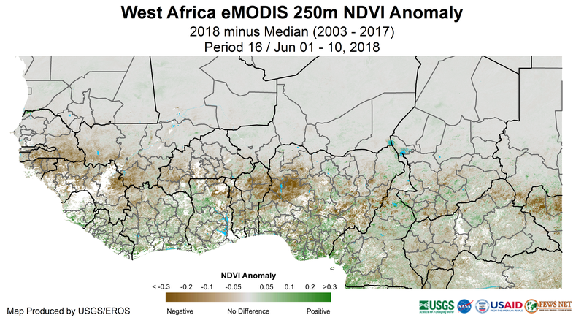
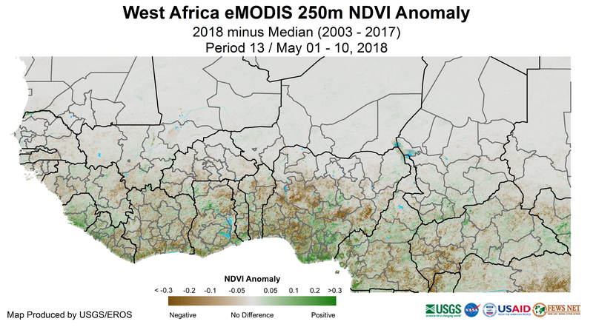
Normalized Difference Vegetation Index (NDVI) anomaly
Negative anomalies indicate below-average conditions
Positive anomalies mean above-average conditions
Convergence with other products reduce uncertainties

Slide 9
What is Standardized Precipitation Index (SPI)?
A probabilistic index to measure the severity of drought
Commonly used to monitor drought
Recommended by the WMO
Based only on precipitation
Can be computed at different time scales (e.g. 1, 3, 6, 12, and 24 month(s))

Slide 10
How is SPI calculated?
Requires a long history of precipitation (30+)
Fit the data with a gamma distribution
Transform probability distribution into a standardized normal distribution
Compute inverse probability to obtain index
Negative values indicate droughts
More negative values mean more intense and rare drought

Slide 11
Example for SPI 6 Calculation
Compare precipitation over the past 6 months with that of the same period over the historical record
Fit data with a probability density function
Transform distribution into standardized normal distribution
Determine inverse probability to derive index
SPI 6 may be associated with anomalous groundwater, streamflow, and reservoir levels

Slide 12
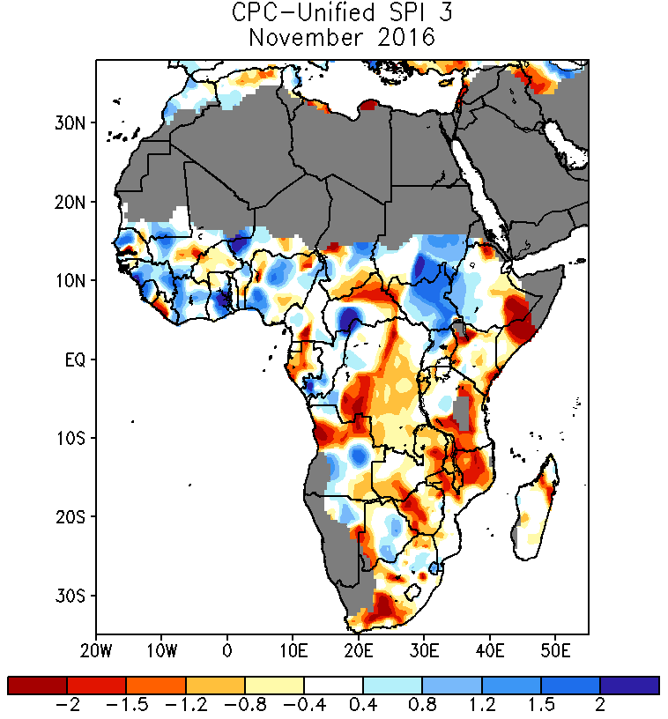
2016-2017 Southern Africa Season
From September-November 2016, drought-like conditions were observed over portions of Tanzania, Zambia, Mozambique, Zimbabwe, and South Africa

Slide 13
What is Soil Moisture Percentile?
Another index in drought monitoring
Ranking of soil moisture content relative to historical record
Relates to agricultural production
Low values may indicate moisture-stressed crops and (agricultural) droughts

Slide 14
How is Soil Moisture Percentile calculated?
Order soil moisture values from highest to lowest over the climatological period (1981-2010)
Find ranking or percentage of observations falling below or equal to current value
Rankings < 30th percentile may indicate drought

Slide 15
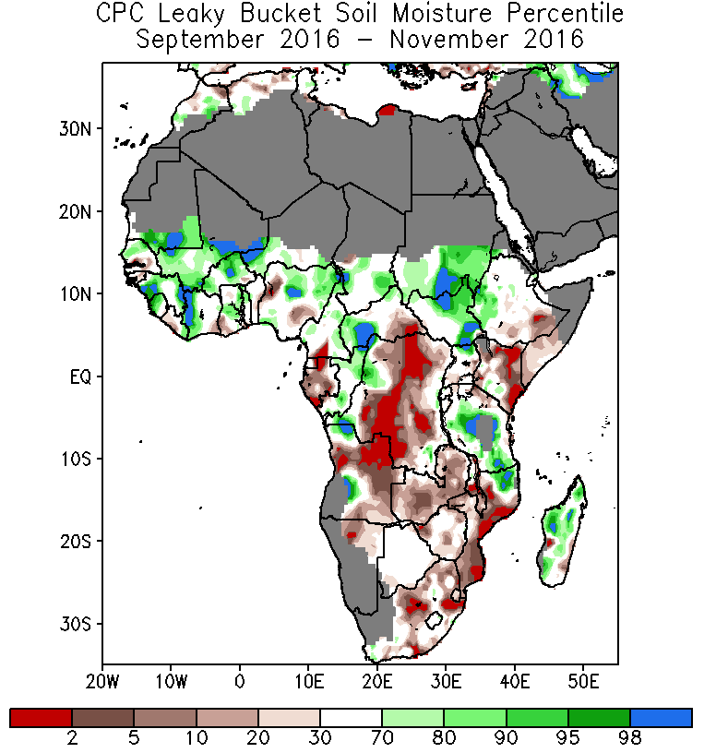
2016-2017 Southern Africa Season
From September-November 2016, driest soil in record was observed over portions of Mozambique, Malawi, Angola, and South Africa

Slide 16
What is Runoff Percentile?
Another index in drought monitoring
Ranking of runoff relative to historical record
Relates to the flow of water on the surface and hydrology
Low values could indicate droughts

Slide 17
How is Runoff Percentile Calculated?
Similar method to that of soil moisture percentile

Slide 18
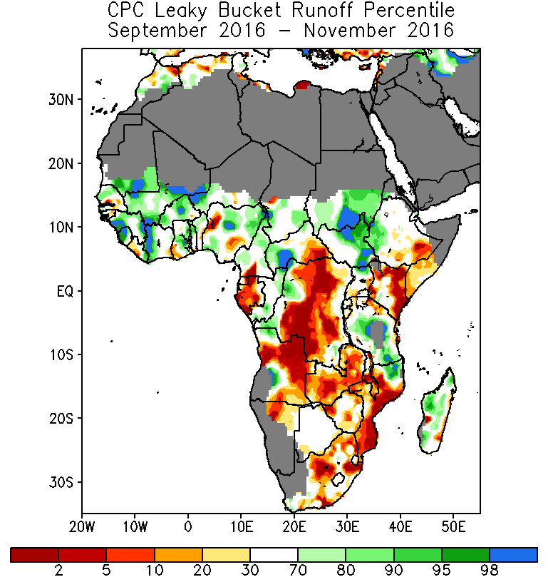
2016-2017 Southern Africa Season
From September-November 2016, runoff was lowest in record over parts of Angola, Zambia, Mozambique, Malawi, Zimbabwe, and South Africa

Slide 19
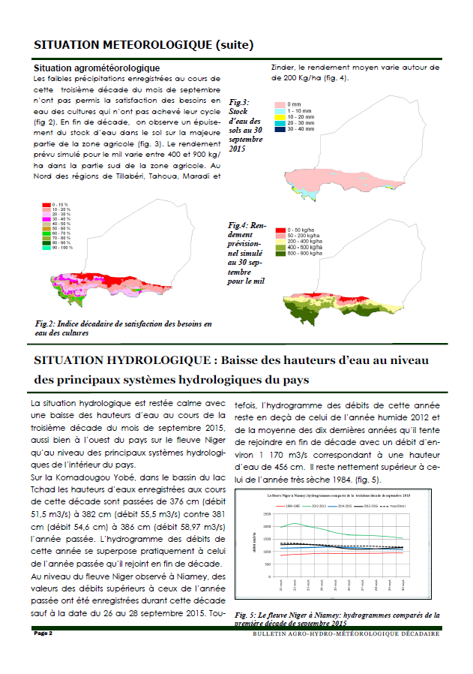
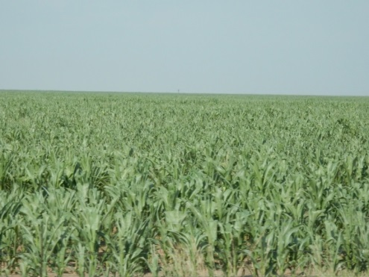
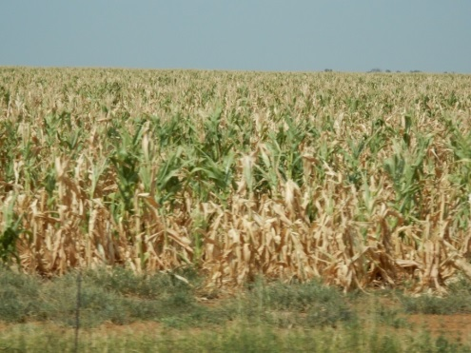
Ground information and feedbacks
Media reports, crop tours done by FEWS NET representatives, meteorological bulletins, and other information help calibrate the hazards outlook
Tamuka Magadzire, FEWS NET1

Slide 20
What about Drought Outlook?
Under development
Consider current drought conditions
Base outlook on model parameter guidance
Compute drought indices forecast

Slide 21
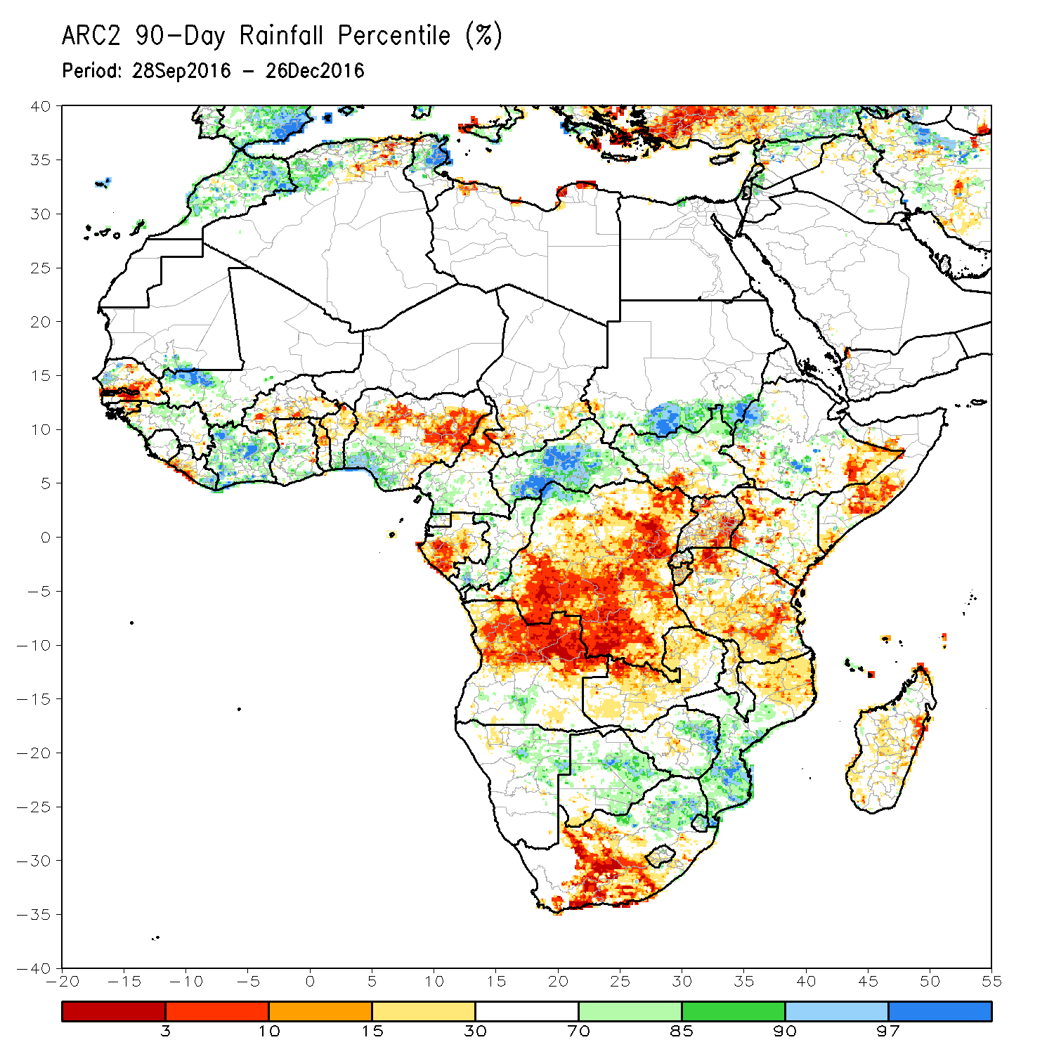
Current Drought Conditions
Abnormal dryness
Deficient rain but not much impact on crops
Abnormal dryness

Slide 22
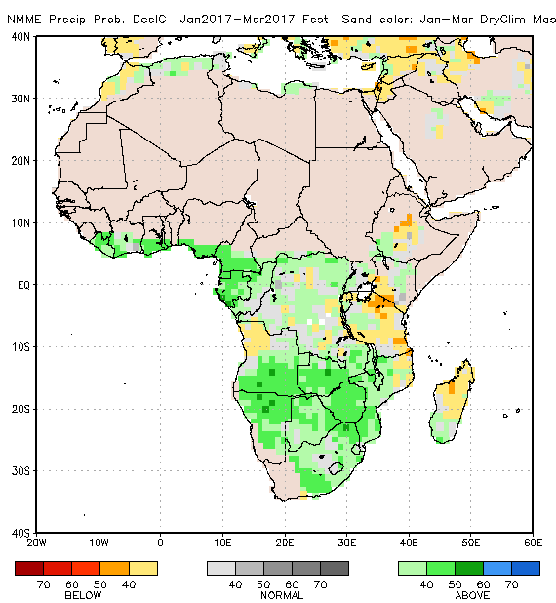
January-March 2017 Seasonal Outlook
Abnormal dryness/drought likely to remain
Abnormal dryness/drought likely to develop
Abnormal dryness/drought likely to improve/dissipate

Slide 23
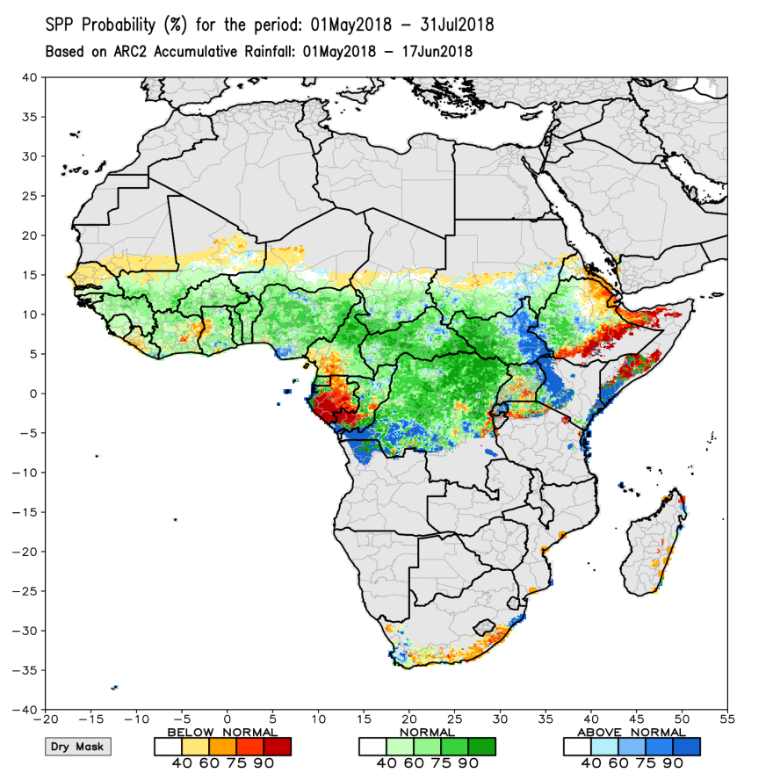
Seasonal Performance Probability (SPP)
Provides an empirical outlook for seasonal performance based on accumulated rainfall

Slide 24
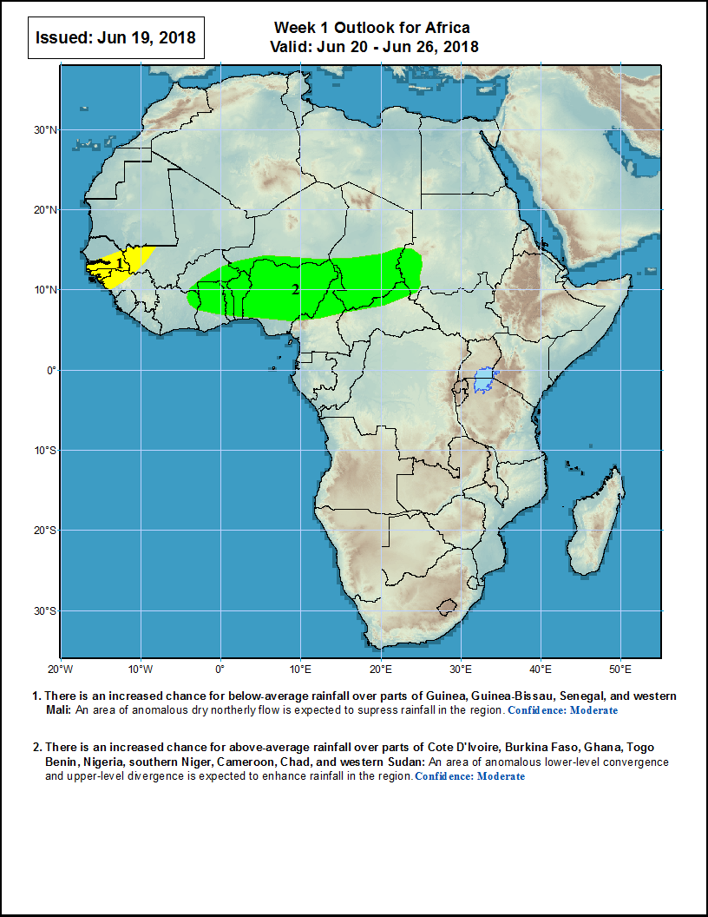
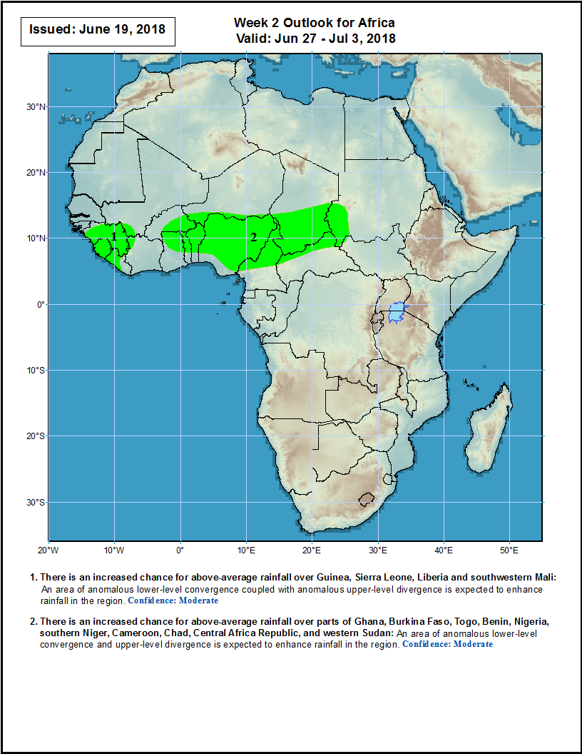
Short and medium-term forecasts
Africa rainfall outlooks in terms of increased chance for above (below)-average rainfall for week 1 & week 2

Slide 25
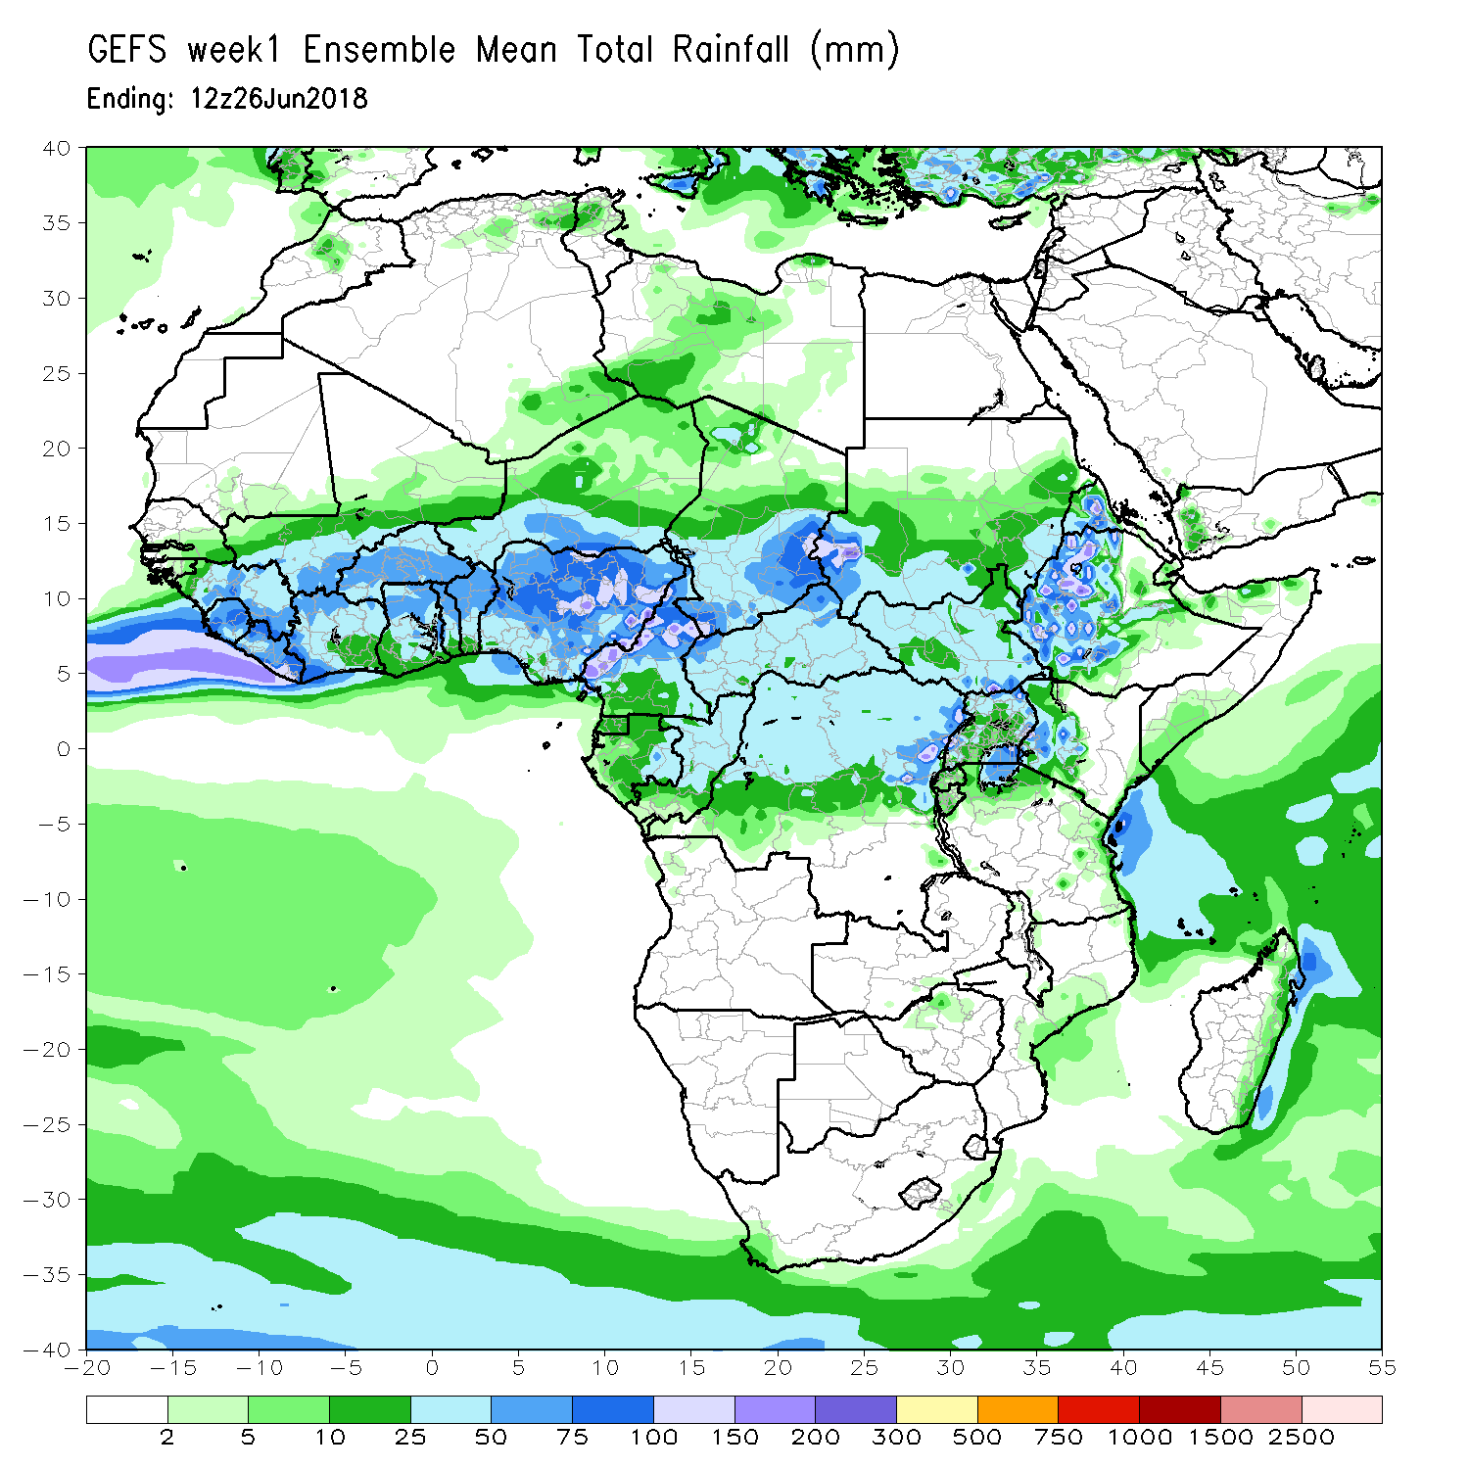
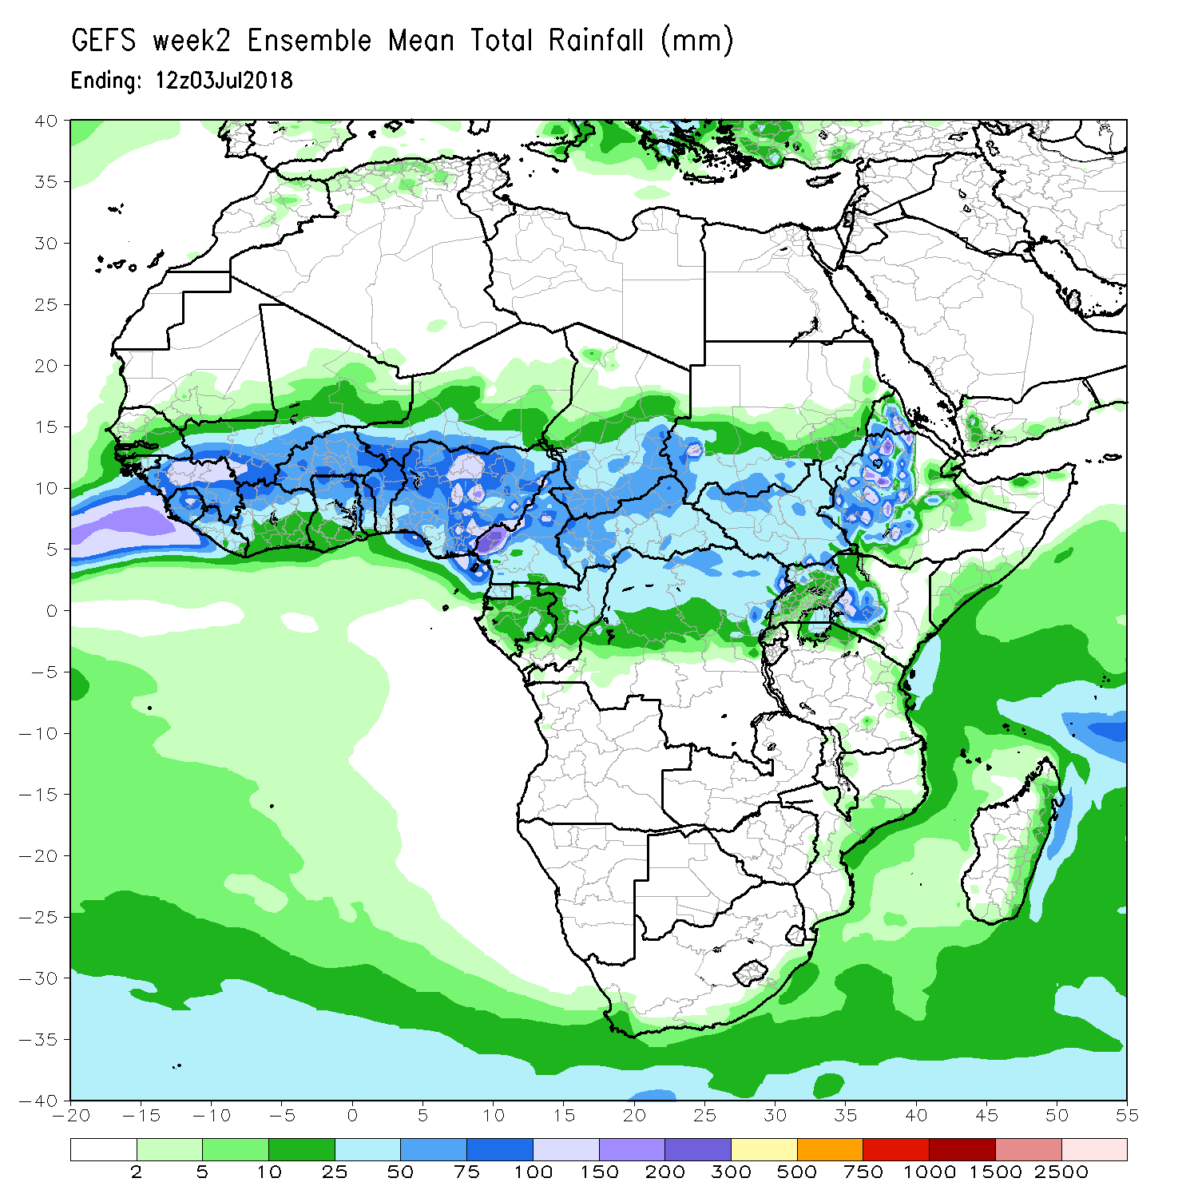
Short and medium-term quantitative precipitation forecast (QPF)
Continuation (disruption) of, heavy (suppressed) rainfall over different areas/regions

Slide 26
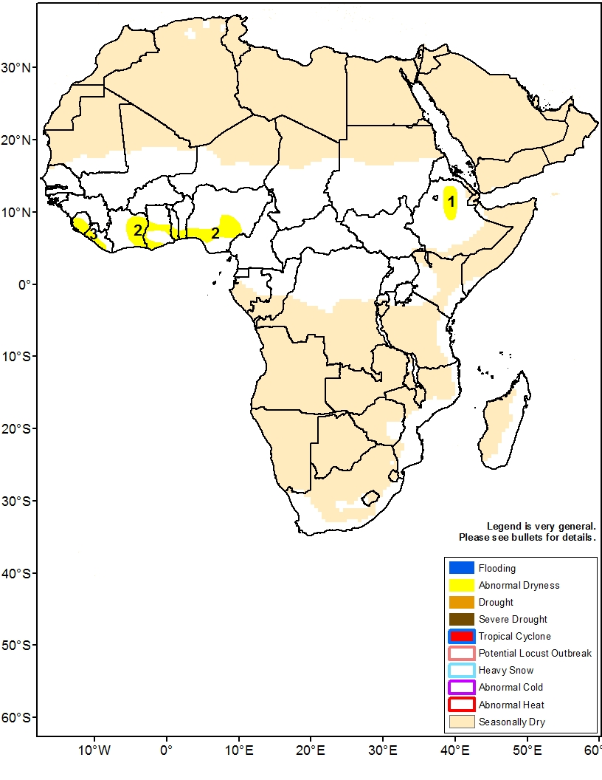
Hazards Outlook
June 21 - 27

Slide 27
Where to Access the Data?
Current monitoring data available at
ftp://ftp.cpc.ncep.noaa.gov/fews/DroughtMonitor/
Ancillary data: seasonal dry mask and land mask
Time scales: 1, 3, 6, 12, and 24 months
Data updated monthly

Slide 28
Summary
The regional hazards outlook process consists of an in depth analysis of climate, land surface information, precipitation forecast, in situ feedback, teleconference, draft, and final document.
A collaborative effort between the NOAA Climate Prediction Center and its partners.
Drought indices as SPI and soil moisture percentile help to detect the onset and development of drought.
http://www.cpc.ncep.noaa.gov/products/african_desk/cpc_intl/africa/africa.shtml
http://www.cpc.ncep.noaa.gov/products/african_desk/cpc_intl/camerica/camerica.shtml
http://www.cpc.ncep.noaa.gov/products/african_desk/cpc_intl/casia/casia.shtml

