Slide 1
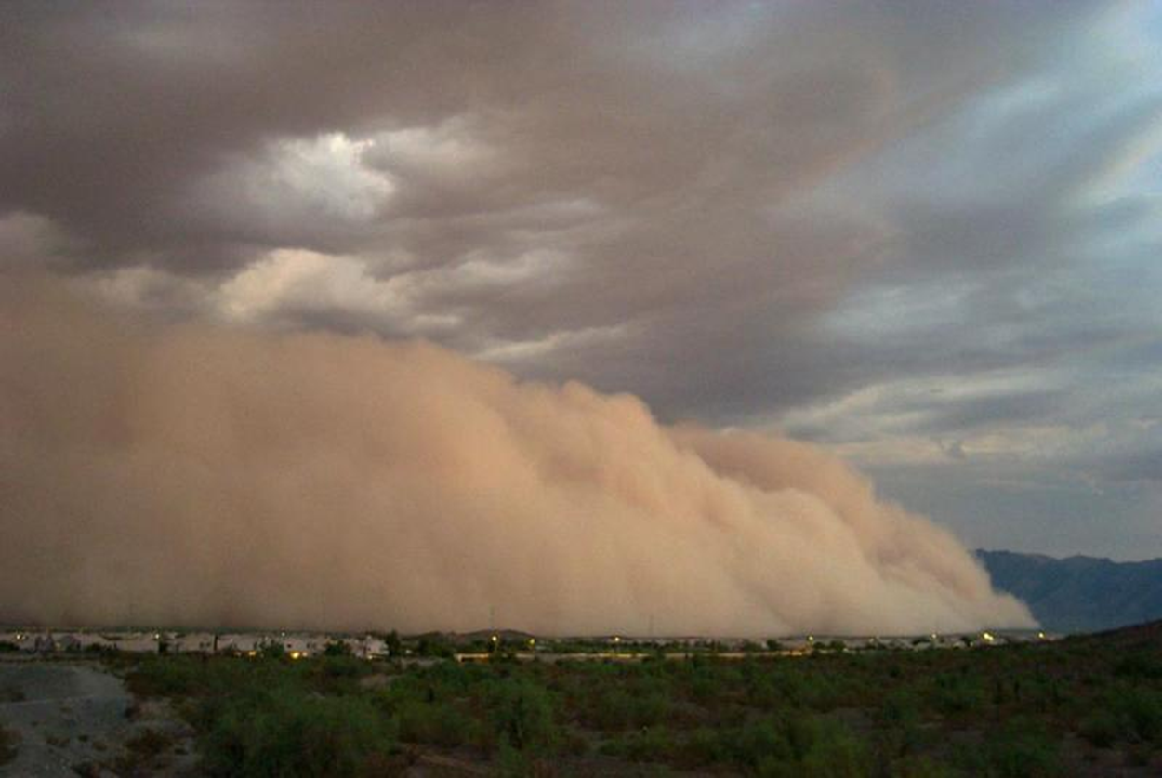
Can a regional model improve the ability to forecast the North American monsoon?
Christopher L. Castro
Department of Atmospheric Sciences
University of Arizona
Tucson, Arizona
NOAA Climate Test Bed Seminar
Camp Springs, Maryland
March 19, 2012

Slide 2
Presentation Overview
Motivation for improved seasonal forecasts of the North American Monsoon and fundamental processes that should be represented in a physical model
Methodology of dynamically downscaling a global reanalysis and a global seasonal forecast model.
Improved representation of monsoon climatology in RCM
Does the representation of interannual variability improve in the seasonal forecast with a RCM? How and why?
Concluding points
Acknowledgements: Jae Kyung-Schemm and Henry Juang (NOAA/NCEP); Ed Cook and Russ Vose (NOAA); Matt Switanek , Francina Dominguez , Hsin-I Chang, and Carlos Carrillo (UA) . Funding provided by National Science Foundation.

Slide 3
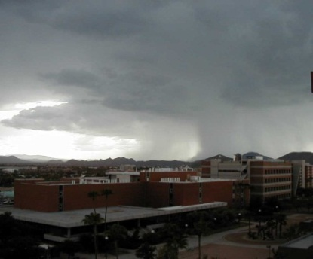
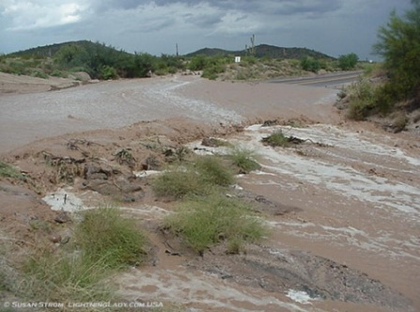
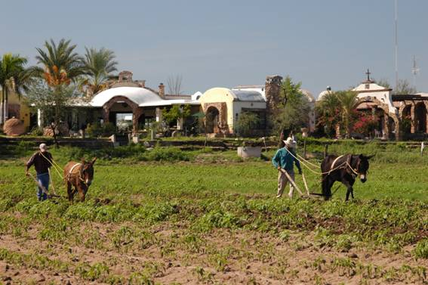
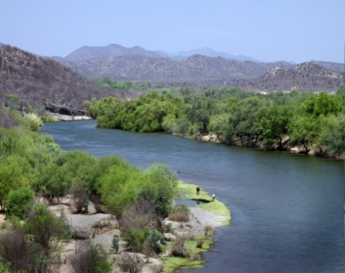
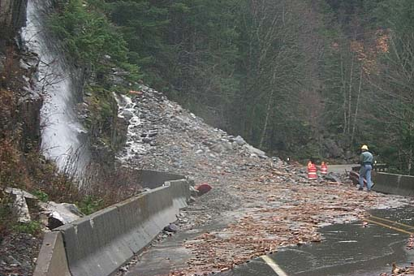
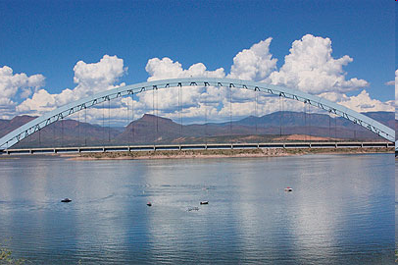
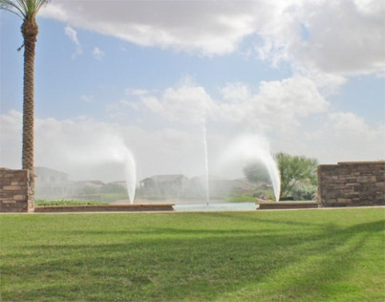
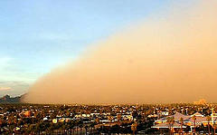
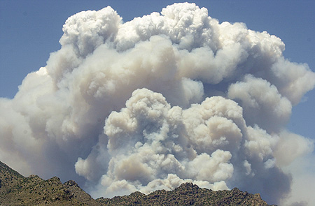
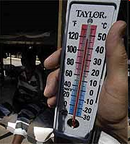
Motivation: Why is the monsoon important to seasonally forecast?
Severe Weather Hazards
Climate Impacts
Microburst
Flash flood
Agriculture
Ecosystems
Landslide
Lightning
Water supply
Water demand
Dust storm
Wildfire
Power use
Extreme Heat

Slide 4
What do we need to get “right” in simulating the warm season in North America, in particular the North American Monsoon? Short answer: Physical processes that encompass both “large” and “small” scales

Slide 5
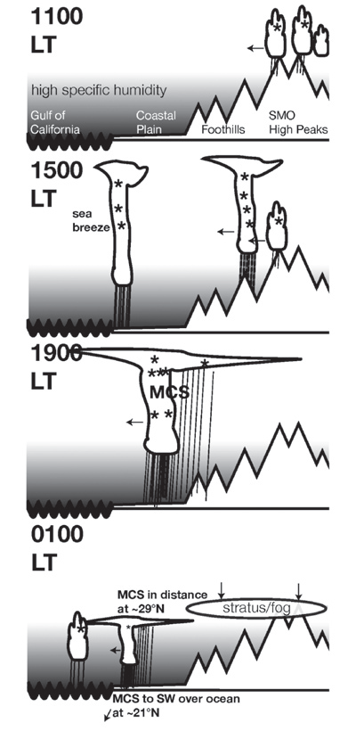
Diurnal Cycle of Convection Most important
Convective clouds form over the mountains in the morning.
By afternoon and everning storms propagate to the west towards the Gulf of California where they can organize into mesoscale convective systems if there is sufficient moisture and instability.
It’s likely that a resolution less than 5 km is necessary to represent this process correctly in regional models. Global models pretty much fail.
(Nesbitt et al. 2008)

Slide 6
Intraseasonal variability
Includes:
Easterly waves
Tropical cyclones
Low level moisture surges
Upper level disturbances
Madden Julian Oscillation
All these factors can help convection organize and intensify.
(Moloney et al. 2008)

Slide 7
Monsoon Interannual Variability
Idea: Atmospheric teleconnections that originate in the western Pacific (and maybe other places) affect the distribution and amount of rainfall, especially in the early part of the summer.
The dominant spatial pattern of precipitation anomalies (SPI) in early summer.
Its relationship to large-scale circulation (500-mb height anomalies).
Ciancarelli et al. (2009)

Slide 8
Climate Forecast System (CFS) model, Version 1 performance for warm season
T62 Resolution (~200 km)
15 ensemble members initialized late spring from NCEP Reanalysis II
Southwest U.S. is one of those regions where there is marginal performance
Therefore, CPC goes with an “equal chances” monsoon forecast most of the time
CFS JJA Precipitation Anomaly Correlation from twenty-year reforecast
From Saha et al. (2006)

Slide 9
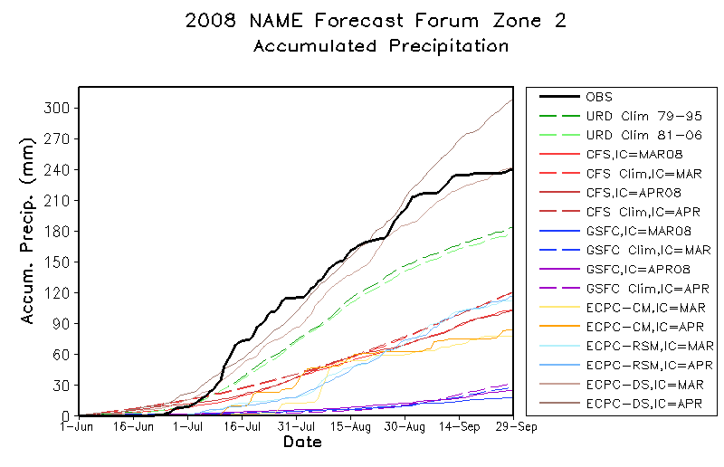
Global climate models cannot resolve the North American monsoon well
Southern Arizona and northern Sonora

Slide 10
Dynamical Downscaling Types from Castro et al. (2005)
Examples
Numerical weather prediction
TYPE 1: remembers real-world conditions through the initial and lateral boundary conditions
TYPE 2: initial conditions in the interior of the model are “forgotten” but the lateral boundary conditions feed real-world data into the regional model
Retrospective sensitivity or process studies using global reanalyses
TYPE 3: global model prediction is used to create lateral boundary conditions. The global model prediction includes real-world surface data
Seasonal climate forecasting
TYPE 4: Global model run with no prescribed internal forcings. Couplings among the ocean-land-continental ice-atmosphere are all predicted
Climate change projection

Slide 11
WRF Downscaling of CFS Reforecasts (1982-2000)
Convection
Kain-Fritsch
Microphysics
Single
moment
3-class
Land surface
NOAH
Radiation
Goddard SW
RRTM LW
Dynamic core
Conservation
Equations and
diffusion
Boundary
layer
MJY Scheme
WRF configuration for UA operational forecasting at 32 km grid spacing over the contiguous U.S. and Mexico
9 CFS ensemble members per season
Boundary Forcing
Lateral boundary and spectral nudging
Coarse resolution driving data
NCEP-NCAR Reanalysis
CFS Warm Season Reforecasts
(April through June initializations)

Slide 12
Spectral nudging in brief We apply at scales greater than 4Δx of driving global model
Form of nudging coefficients for a given model variable in spectral domain:
Fourier expansion coefficients of variable in driving larger-scale model (a)
Fourier expansion coefficients of variable in the regional model (m)
Nudging coefficient. Larger with increasing height.

Slide 13
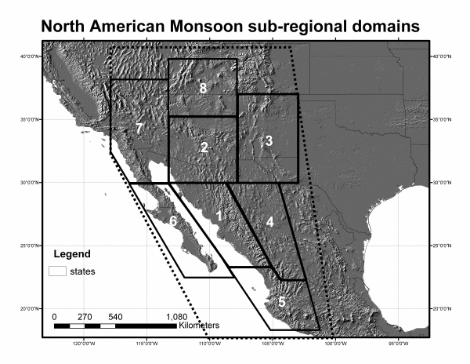
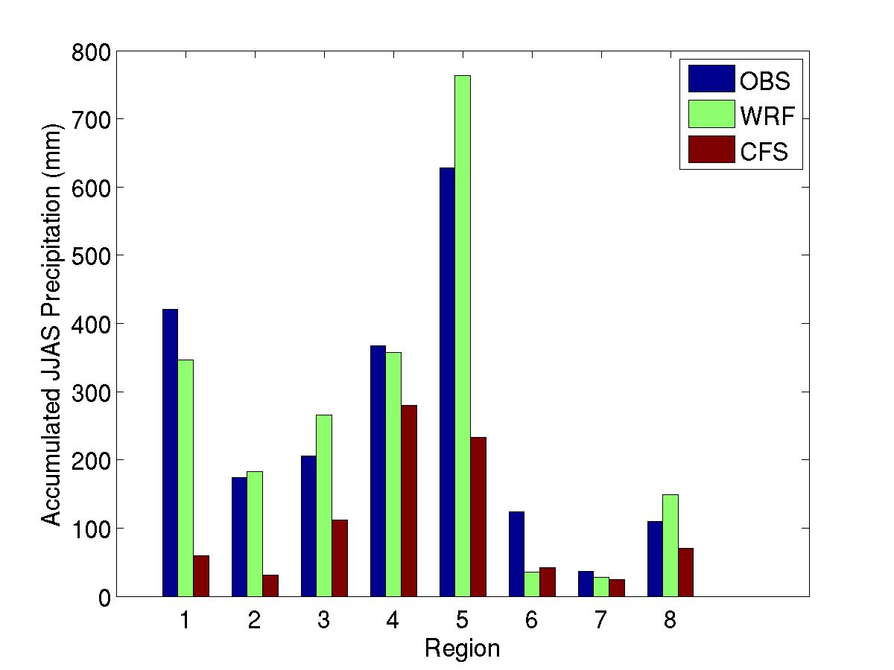
Seasonally-averaged precipitation climatology (JJAS) for NAME precipitation zones
Core Monsoon
Region
Dramatic improvement in the climatology of monsoon precipitation accounted for by a better representation of the diurnal cycle of convection. Downscaling also improves on the monthly evolution of precipitation (not shown).

Slide 14
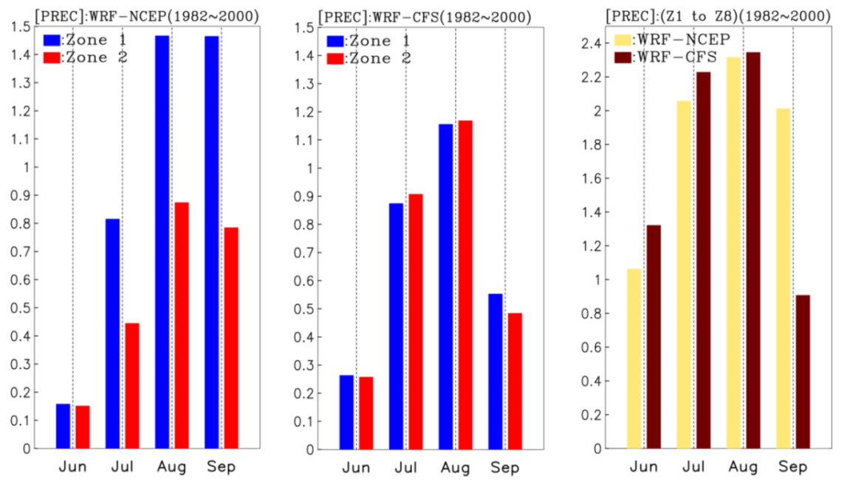
Evolution of monthly precipitation in NAME zones 1 and 2
WRF Downscaling of the atmospheric reanalysis and CFS model show a rapid transition in early summer associated with monsoon onset.
Precipitation in mm/day

Slide 15
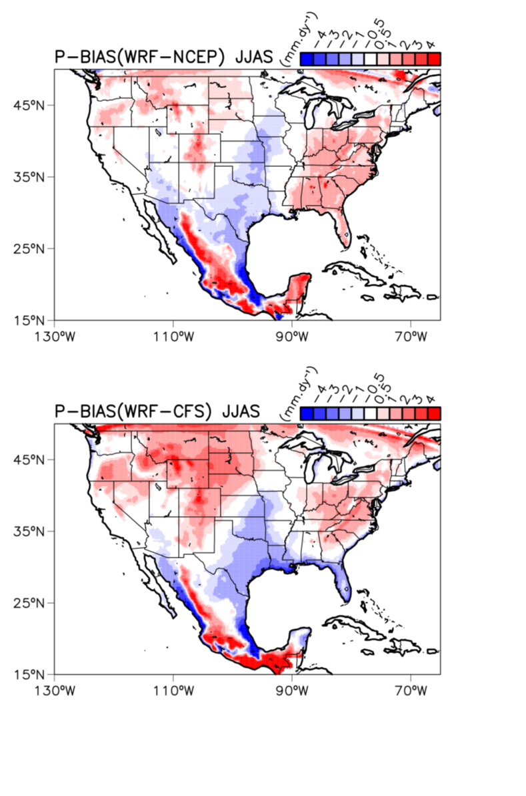
Model precipitation biases compared to observations (new US-Mexico NOAA product)
Systematic problems in the climatological representation of rainfall that are clearly terrain-dependent. Similar problems in other RCMs.
Reflects the fact that the RCM is challenged to represent organized, propagating convection, irrespective of the driving GCM.
This type of convection varies on an intraseasonal timescale and accounts for more precipitation away from the mountains.

Slide 16
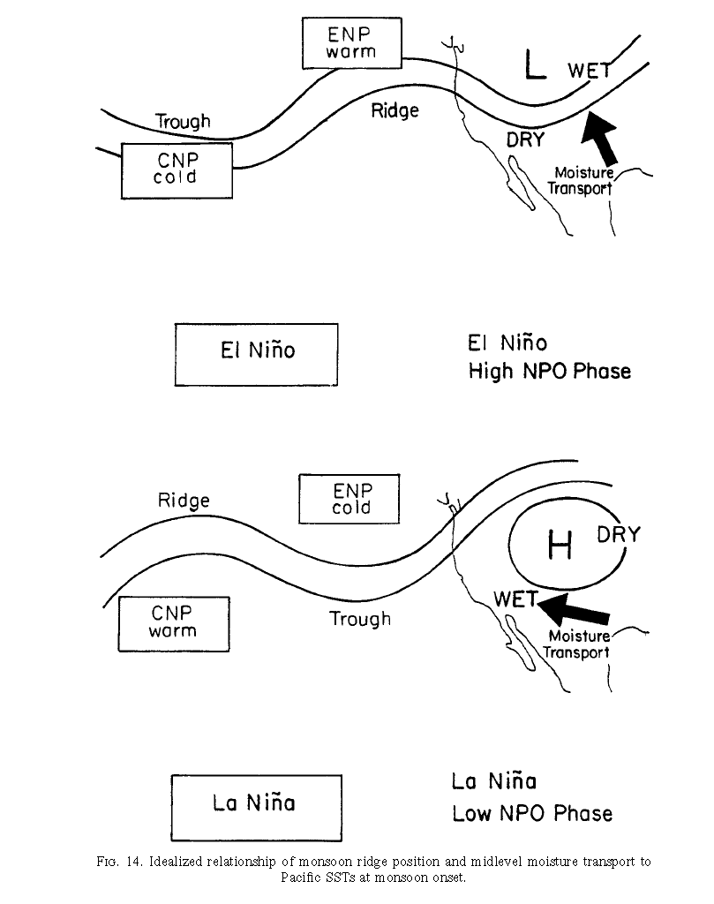
Dominant mode of precipitation variability in early summer and relationship to Pacific SST
Climatology delayed
Climatology accelerated

Slide 17
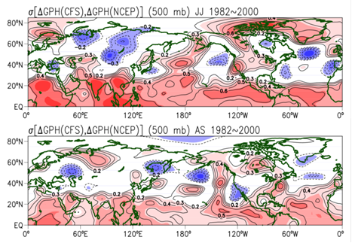
Early vs. late summer 500-mb height anomaly correlation: CFS and NCEP reanalysis
Marked decrease in the ability of CFS to represent the large-scale circulation anomalies over North America from early to late summer.
Reflects the ability of CFS to capture large-scale circulation anomalies associated with ENSO during the early warm season.

Slide 18
Early summer (JJ) Temperature Anomaly Correlation
NCEP Reanalysis
CFS model
WRF Downscaled
NCEP Reanalysis
WRF Downscaled
CFS model

Slide 19
Early summer (JJ) vs. Late summer (AS)
Temperature Anomaly Correlation for CFS and CFS-WRF
CFS model: Early summer
CFS model: Late summer
WRF Downscaled
CFS Model: Early summer
WRF Downscaled
CFS Model: Late summer

Slide 20
Early summer (JJ) vs. Late summer (AS)
Precipitation Anomaly Correlation for CFS and CFS-WRF
CFS model: Early summer
CFS model: Late summer
WRF Downscaled
CFS Model: Early summer
WRF Downscaled
CFS Model: Late summer

Slide 21
Early summer (JJ) precipitation anomaly correlation for NAME Tier 2 Region

Slide 22
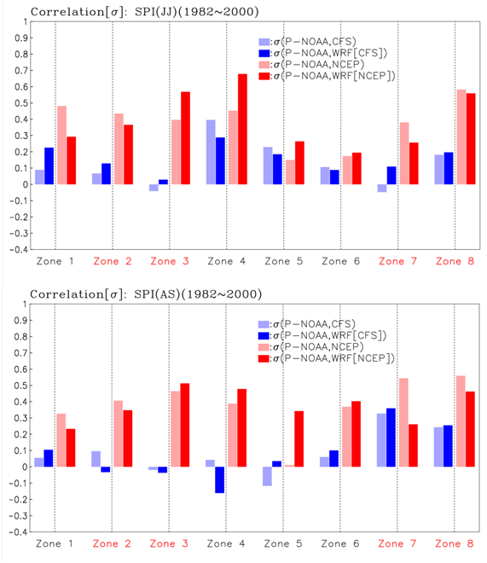
Early vs. late summer precipitation anomaly correlation: NAME precipitation zones
Early summer: WRF-CFS shows modest increase in anomaly correlation in core monsoon region (Zones 1 and 2) above CFS model.
Late summer: Marked decrease in anomaly correlation throughout most NAME zones for both CFS and WRF-CFS.

Slide 23
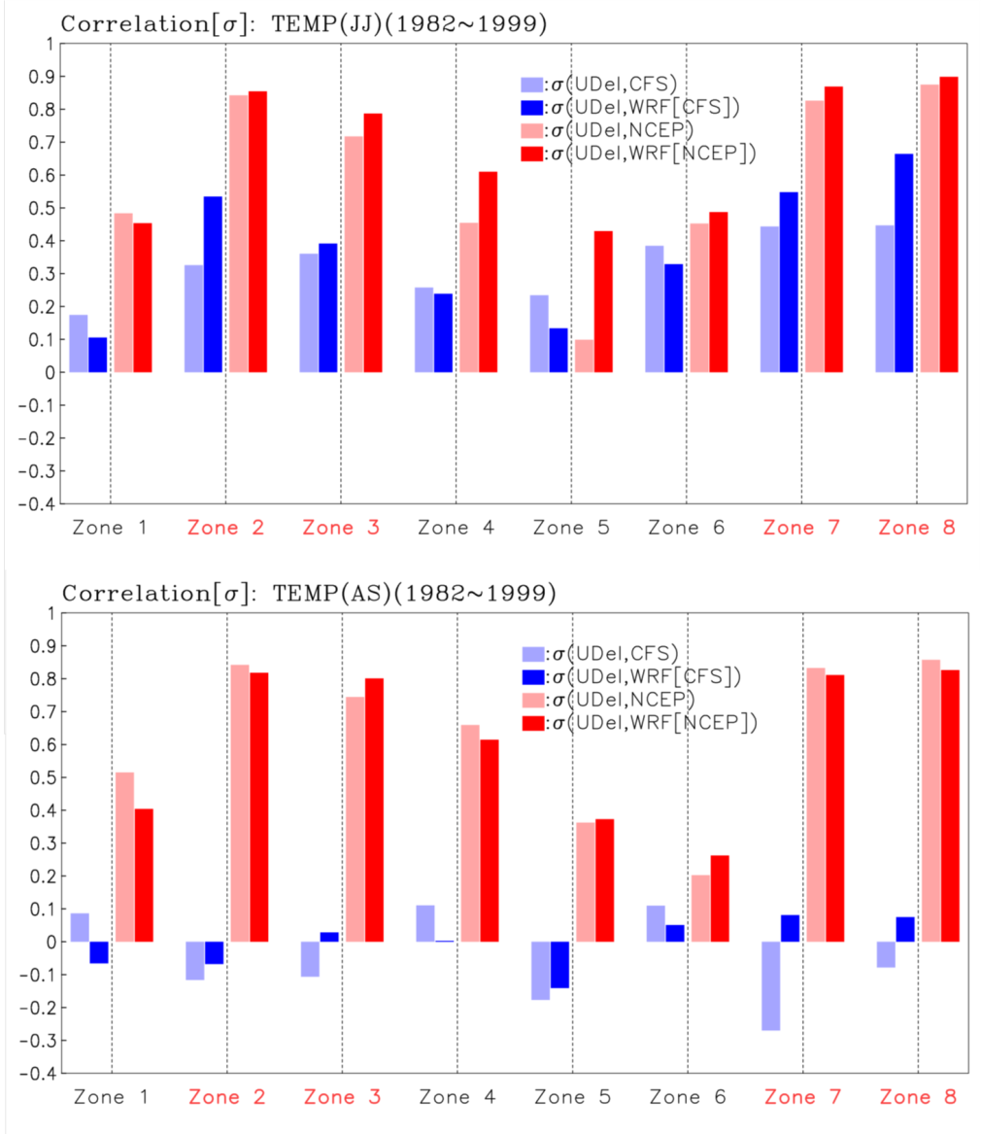
Early vs. late summer temperature anomaly correlation: NAME precipitation zones
Early summer: WRF-CFS shows increase in anomaly correlation in regions where already substantially high in CFS model.
Late summer: Marked decrease in anomaly correlation throughout most NAME zones for both CFS and WRF-CFS.

Slide 24
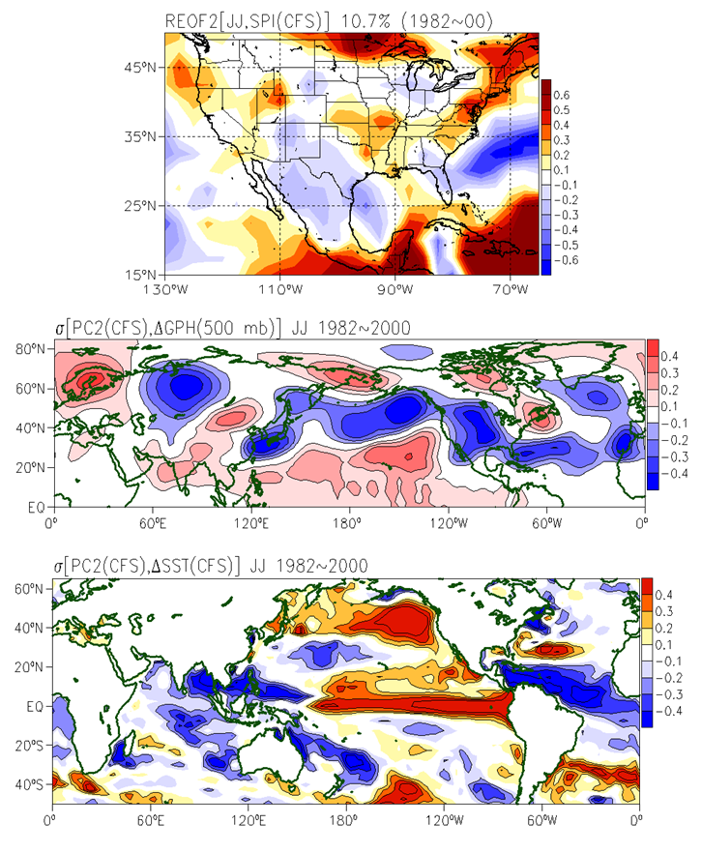
Mode of early warm season precipitation in CFS most highly correlated to observations and relationship to large-scale forcing
Dominant mode of early warm season precipitation in CFS associated with ENSO variability
Relationship to CFS atmospheric circulation anomalies
Relationship to CFS sea surface temperature anomalies

Slide 25
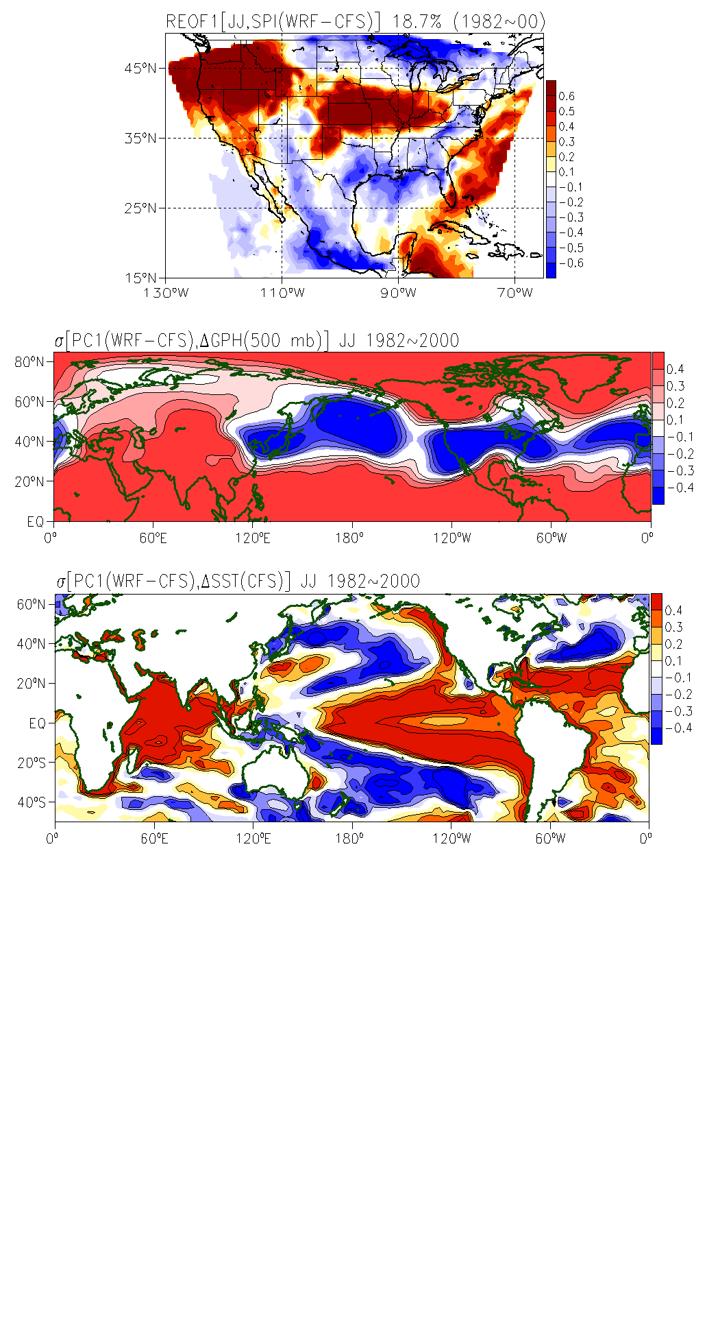
Mode of early warm season precipitation in WRF-CFS most highly correlated to observations and relationship to large-scale forcing
Dominant mode of early warm season precipitation in WRF-CFS associated with ENSO variability
Relationship to CFS atmospheric circulation anomalies
Relationship to CFS sea surface temperature anomalies

Slide 26
Time series of observed and modeled JJ SPI: NAME precipitation zone 1

Slide 27
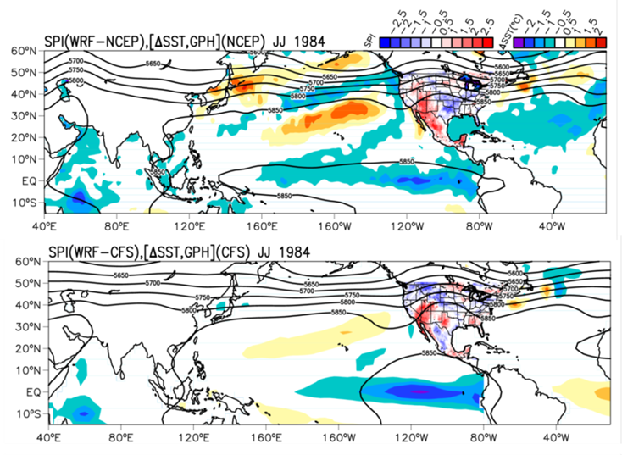
Large-scale circulation, sea surface temperature anomalies from global models and regional model simulated precipitation anomalies
1984: Wet and early monsoon
1993: Dry and delayed monsoon
Early and wet monsoon well forecast
Similar results from WRF-NCEP, WRF CFS
Monsoon ridge dependence on ENSO forcing
Late monsoon, Midwest flooding not forecast
WRF-NCEP, WRF CFS results differ
SST forcing signal not captured by CFS.

Slide 28
Concluding points
Dynamical downscaling improves North American Monsoon climatology, due to the improved representation of the diurnal cycle of convection. Organized convection is a problem, though.
In general, WRF tends to increase the temperature and precipitation anomaly correlation in regions where it is already positive in CFS.
WRF slightly improves the ability to forecast the monsoon in the early part of the warm season, considering Arizona and Sonora, because that is the part of the summer when precipitation depends more on ENSO-PDV forcing.
The ability of a regional climate model to improve seasonal forecasts depends on getting the large-scale circulation anomalies correct in the driving global model. CFS performance inconsistent in this regard.
Acknowledgements: Jae Kyung-Schemm and Henry Juang (NOAA/NCEP); Ed Cook and Russ Vose (NOAA); Matt Switanek (UA) Francina. Funding provided by National Science Foundation.

