Slide 1
Asymmetric Global Warming: Day vs. Night
Liming Zhou
Georgia Institute of Technology
(National Science Foundation)
CTB Seminar Series at NASA
May 25, 2011
/47

Slide 2
Background
/47

Slide 3
Diurnal Cycle of Surface Air Temperature
  Maximum/minimum temperature (T_{max}/T_{min}), diurnal temperature range (DTR), and mean temperature (T_{mean})
T_{max}
DTR=T_{max}-T_{min}
T_{mean}=(T_{max}+T_{min})/2
DTR
Temperature
T_{min}
0 Local Time 24
/47

Slide 4
One Extreme Case: DTR = 0
  DTR represents the day-night temperature difference
  A decrease in DTR means hotter nights, i.e., the day-night temperature difference is becoming smaller
  DTR=0: the day and nigh temperatures are the same
T_{max}
DTR
DTR = 0°C
DTR = 15°C
Temperature
DTR
DTR = 20°C
T_{min}
0 Local Time 24
/47

Slide 5
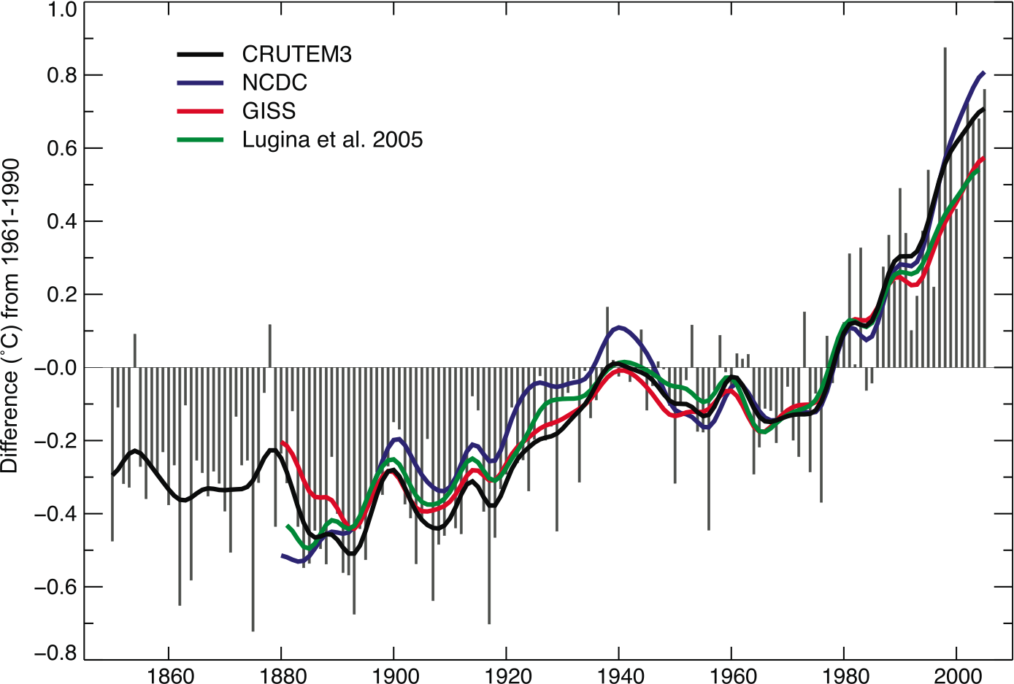
Global Warming
  Global mean surface temperature has risen by about 0.74°C from 1906 to 2005, with the largest increase over land in the last 50 years
DTR=T_{max}-T_{min}
T_{mean}=(T_{max}+T_{min})/2
Annual anomalies of global mean land-surface air temperature (°C), 1850 to 2005 (IPCC, 2007)
/47

Slide 6
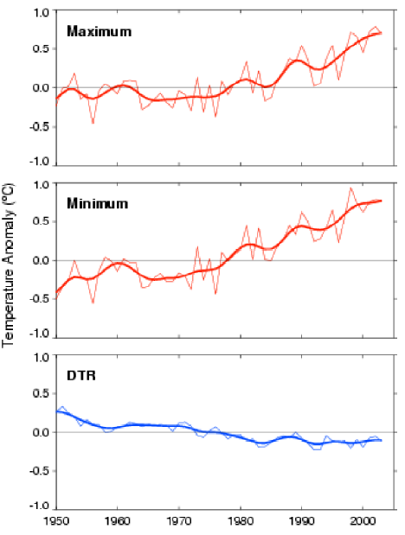
Global Warming vs. DTR Decrease
  T_{min} warmed much faster than T_{max} T_{mean} and DTR
  DTR trends are a signal connected to global warming
DTR=T_{max}-T_{min}
T_{mean}=(T_{max}+T_{min})/2
Trend and time series of annual T_{max},T_{min}, and DTR for 1950-2004
(Vose et al., 2005)
/47

Slide 7
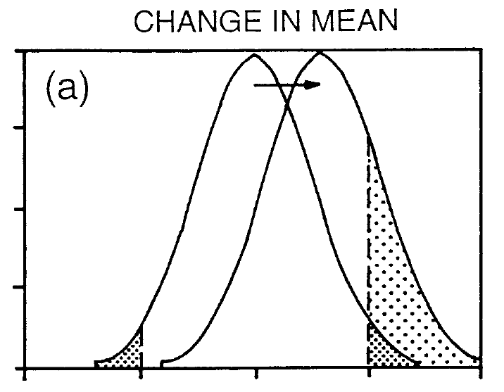
Why Study DTR
  A small change in the mean can result in a large change in the frequency of extremes (Means et al., 1984)
  A change in the variance of a distribution will have a larger effect on the frequency of extremes than a change in the mean (Katz and Brown 1992)
  As an extreme T indicator, DTR can be a critical and effective variable to detect and attribute surface warming
(Meehl et al., BAMS, 2000)
/47

Slide 8

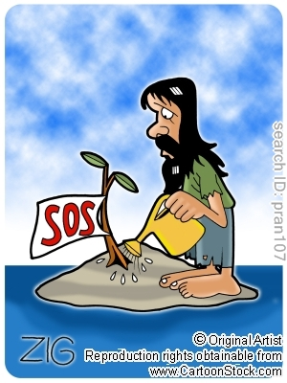

Decreasing DTR has Significant Ecological, Societal and Economic Consequences
  on public health, e.g., increasing mortality, hospitalization, emergency room visits and respiratory symptoms
  on ecosystem health, e.g., reducing plant productivity (net photosynthesis occurs best at a large DTR)
  on economy, e.g., losses in agriculture, disasters, insurance & recreations, and rising energy demand
human health
plant health
rising energy demand

Slide 9
What Caused the DTR Decrease?
(Current View)
  Increased cloud cover has been used to primarily explain the worldwide reduction of DTR while precipitation and soil moisture play a secondary role
clouds/soil moisture/precipitation DTR
clouds/soil moisture/precipitation DTR
  Other factors (e.g., greenhouse gases, aerosols and changes in land surface) are thought to have a small effect.
/47

Slide 10
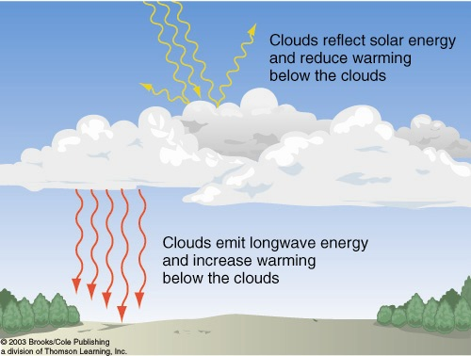
Cloud Cover DTR
(primary)
  Clouds, especially thick low clouds, greatly reduce T_{max} and thus DTR by reflecting sunlight and increasing downward longwave radiation
( Karl et al. 1993; Dai et al. 1997, 1999)
/47

Slide 11
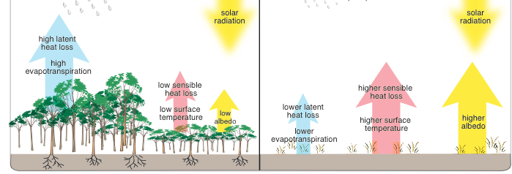
Soil Moisture/Precipitation DTR (secondary)
  Soil moisture reduces T_{max} and thus DTR by enhancing evaporative cooling through evapotranspiration
  Precipitation influences DTR mainly through its association with clouds and soil moisture
( Karl et al. 1993; Dai et al. 1997, 1999)
/47

Slide 12
Statistical Relationship: Simple Negative Linear Correlation
linear regression | correlated? | R² | observed?
DTR = β₀+β₁ CC + ε | yes, β₁ negative | dominant | yes
DTR = β₀+β₁ P + ε | yes, β₁ negative | secondary | yes
DTR = β₀+β₁ SM + ε | yes, β₁ negative | secondary | yes
Note: CC – cloud cover; P – precipitation; SM – soil moisture
/47

Slide 13
We Expect to See
linear regression | correlated? | R² | observed?
DTR = β₀+β₁ CC + ε | yes, β₁ negative | dominant | yes
DTR = β₀+β₁ P + ε | yes, β₁ negative | secondary | yes
DTR = β₀+β₁ SM + ε | yes, β₁ negative | secondary | yes
CC/P/SM
opposite long-term trends
between DTR vs. CC/P/SM
Trend
DTR
year (decadal)
/47

Slide 14
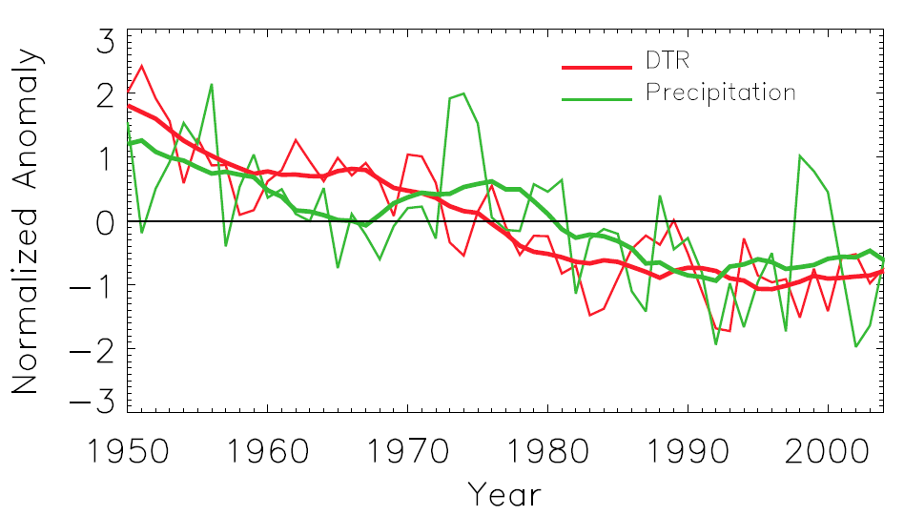
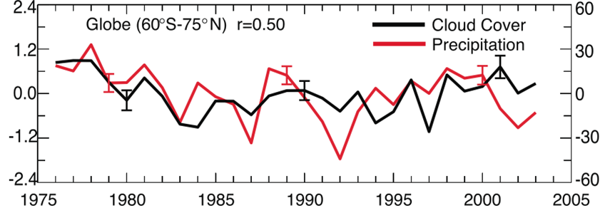
But at the Global Scale We See Concurrent Trends in DTR and Precipitation/Clouds
  DTR-CC/P relationship shows inconsistency between high- and low-frequency signals
total cloud cover over land
(Norris, 2007)
(Dai et al. 2006)
/47

Slide 15
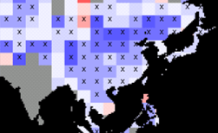
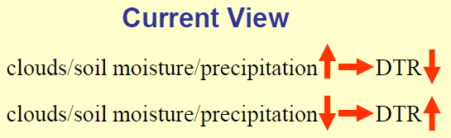
But at Regional Scales We also See Concurrent Decreasing Trends in DTR and Clouds
  Significant decreasing trends in both DTR and cloud cover have been observed in China since 1950
Reduced clouds in China (Kaiser, GRL, 1998 )
Reduced DTR in China (Zhou et al., CD, 2009)
/47

Slide 16
So the Question Is
  Current mechanisms (e.g., cloud cover/precipitation/soil moisture) can explain the observed short-term (high-frequency) DTR variability but not the observed long-term (low-frequency) DTR variability over some regions.
  What is responsible for the observed long-term DTR trends?
    natural forcing (e.g., decadal internal variability)?
    anthropogenic forcing (e.g., increased greenhouse gases and aerosols)?
    land cover/use changes (e.g., land surface properties)?
/47

Slide 17
Outline
  Spatial patterns of observed long-term DTR trends
  IPCC AR4 simulated DTR trends: anthropogenic vs. natural forcing
  Impacts of changing land surface on DTR
  Future work
/47

Slide 18
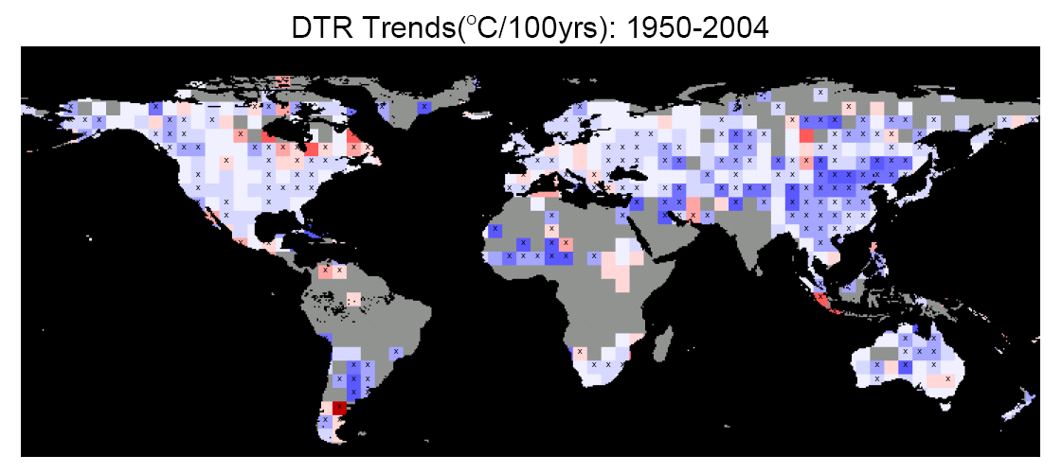
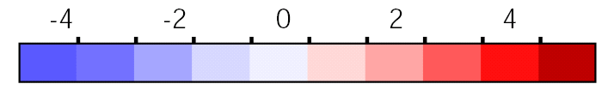
Topic I: Spatial Patterns of Observed Long-term DTR Trends
Larger DTR reduction over drier regions
(Zhou et al., PNAS, 2007; Zhou et al., CD, 2009)
/47

Slide 19
Observed DTR Time Series: Global Mean
  T_{min} (+0.22/10yrs) warmed much faster than T_{max} (+0.14/10yrs) and thus DTR decreased (-0.07/10yrs)
/47

Slide 20
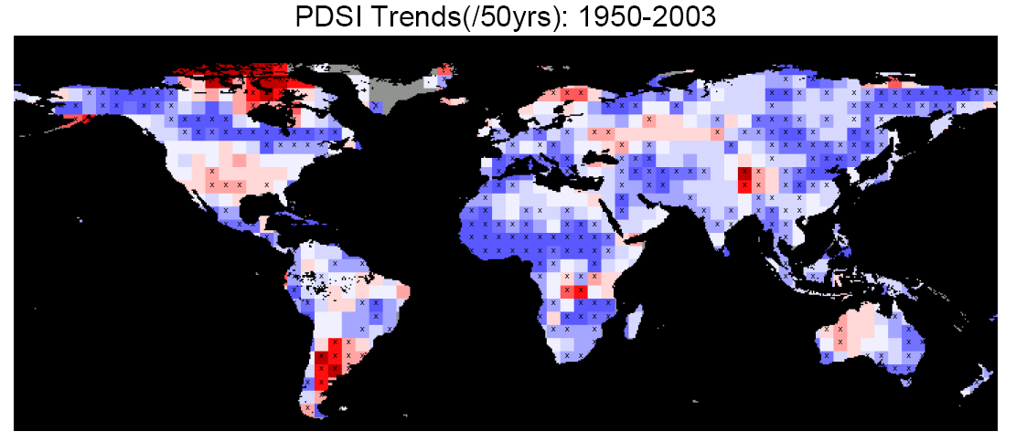
Observed DTR Trends: Spatial Pattern
  DTR decreased most over semi-arid regions such as Sahel and North China where pronounced drought has occurred.
40 largest DTR trends
504 grid boxes at 5 ° lat x 5 ° lon
/47

Slide 21
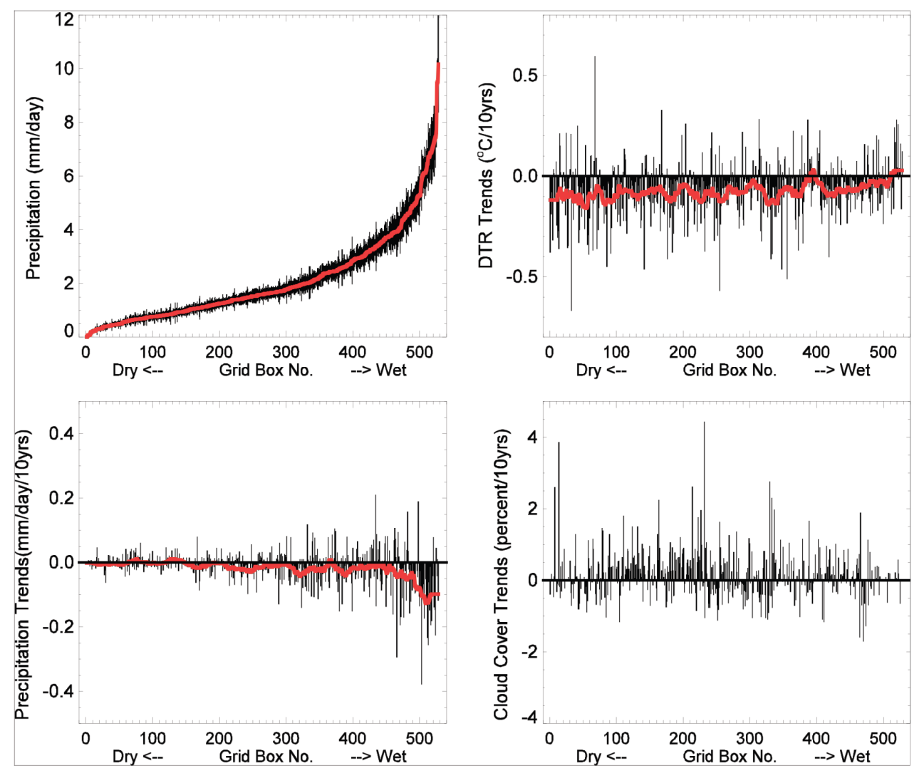
Observed Trends of DTR, Cloud, & Precipitation Spatial Decoupling (Grid by Grid)
  DTR decreased most over driest regions
  Spatial decoupling for the trends between DTR vs. cloud cover/precipitation over many grid boxes
precipitation
DTR trend
ranked each of the 504 grid boxes from dry to wet based on its climatological precipitation
precipitation trend
cloud cover trend
/47

Slide 22
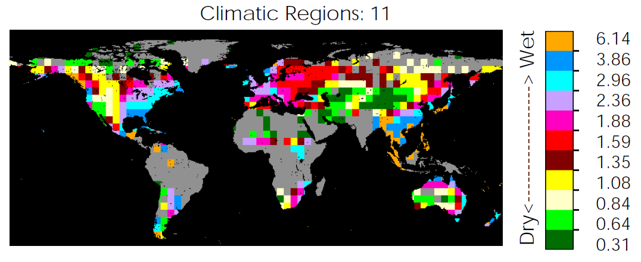
Averaging Data by Large-scale Climate Region
  To reduce the data noise at grid scales, the data were averaged by large-scale climate region (from 3 to 23 regions) based on climatological precipitation amount.
regional average precipitation
/47

Slide 23
Spatial Dependence of DTR Trends on Precipitation: Large-scale Average
  Linear relationship: DTR/T_{min} trend-precipitation the drier the climate, the stronger the warming trend in T_{min} and the larger the decreasing trend in DTR
wet
dry
/47

Slide 24
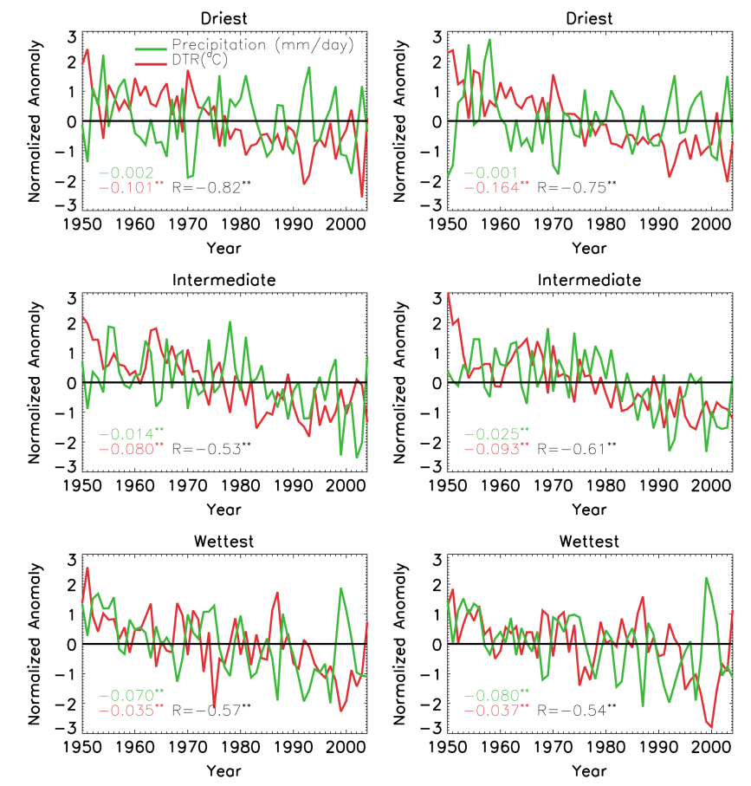
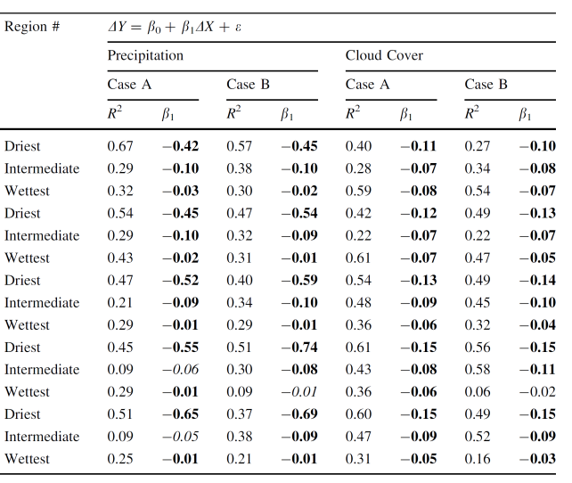
DTR-CC/P Correlation:
Low- vs. High-Frequency Inconsistency
  After detrending the original time series (e.g., removing the low-frequency signal), the negative DTR-CC/P relationship is robust at both global and regional scales, while this relationship does not hold for low-frequency signals.
/47

Slide 25
Topic I: Conclusions
  The negative DTR-cloud/precipitation correlation is observed in the high- frequency signals at both global and regional scales, but not in the low-frequency signals, suggesting that changes in cloud/precipitation cannot explain the observed long-term DTR trends.
  There is a strong spatial dependence of long-term T_{min} and DTR trends on climatological precipitation, indicating stronger T_{min} warming trends and larger DTR decreasing trends over drier regions.
  Such spatial dependence possibly reflects large-scale effects of increased greenhouse gases and aerosols on low-frequency DTR changes.
  (Zhou et al., PNAS, 2007; Zhou et al., CD, 2009)
/47

Slide 26
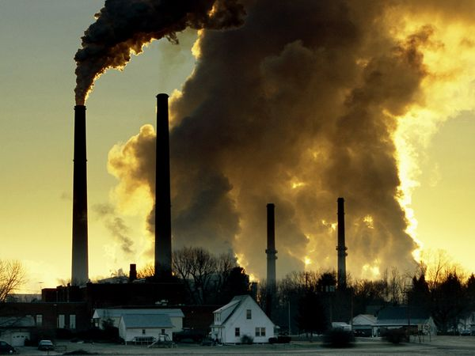
Topic II: IPCC AR4 Simulated DTR Trends: Anthropogenic vs. Natural Forcing
Impacts of increased greenhouse gases and
aerosols on long-term DTR trends
(Zhou et al., CD, 2010; Zhou et al., GRL, 2009)
/47

Slide 27
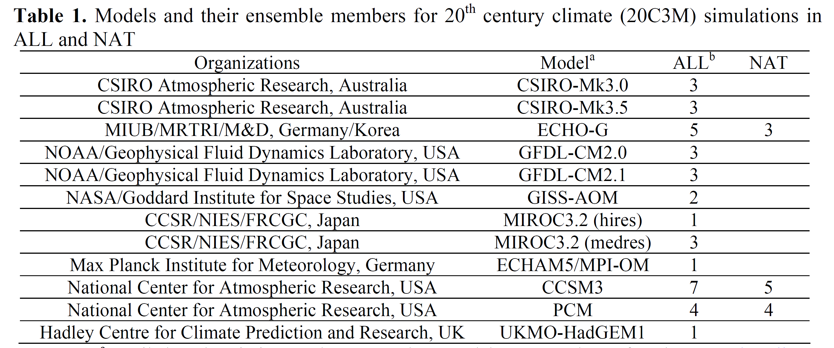
Data: Observed and Multi-model Simulated
  Simulated T_{max}, T_{min} and DTR and other related variables from 48 AOGCMs in the 20th century:
    ALL: anthropogenic + natural forcing (36 simulations)
    NAT: natural forcing only (12 simulations)
  Observed T_{max}, T_{min}, DTR, cloud cover and precipitation from 1950-1999
/47

Slide 28
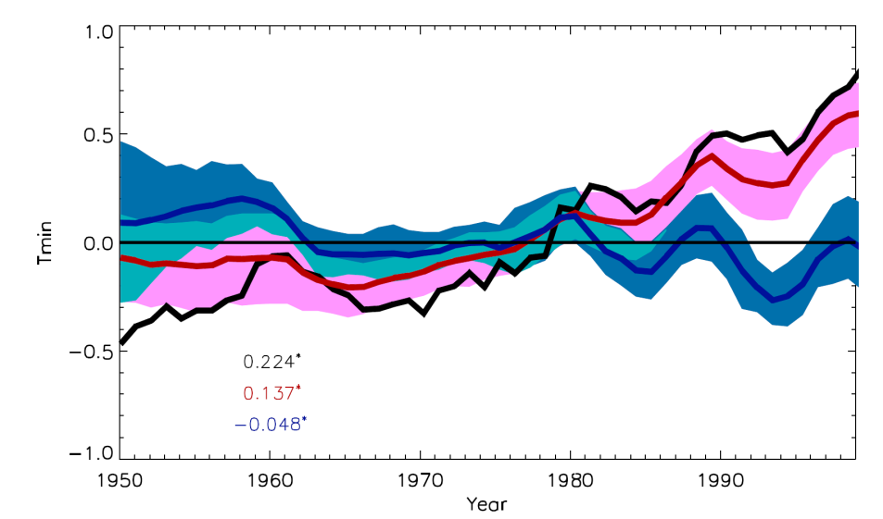
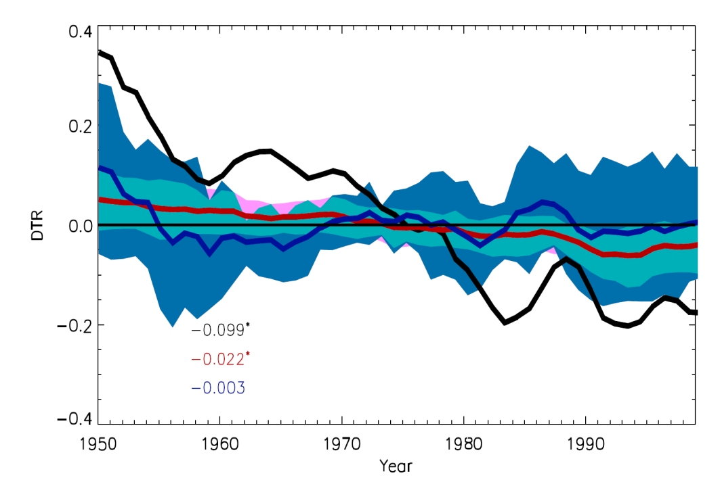
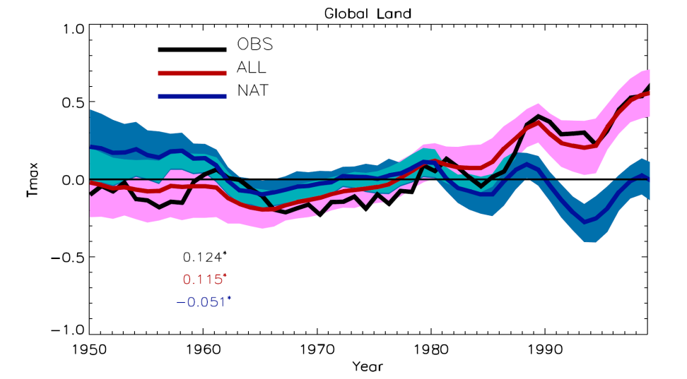
Simulated vs. Observed: Global Mean
ALL captures major features of the observed temperature changes while NAT differs distinctly from the observations
DTR trend in ALL is much smaller than that observed
Tmin
DTR
Tmax
/47

Slide 29
Simulated ALL vs. Observed Trends: Spatial Pattern
Largest DTR decreases are simulated in high latitudes and arid/semi-arid regions
Tmax
Tmin
DTR
Observed
Simulated in ALL
/47

Slide 30
Simulated NAT vs. Observed Trends: Spatial Pattern
Unlike observations, simulated T_{max} & T_{min} show cooling trends
Tmax
Tmin
DTR
Observed
Simulated in NAT
/47

Slide 31
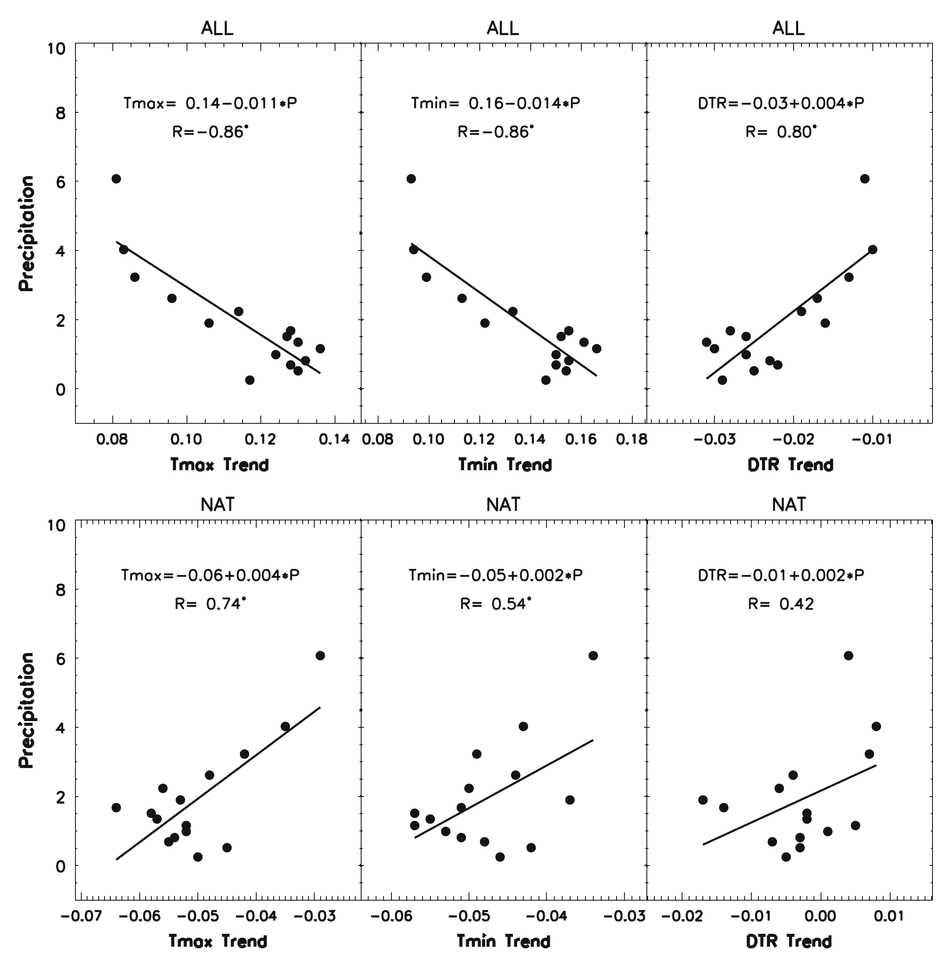
Simulated vs. Observed Trends: Spatial Dependence of DTR Trend on Precipitation
ALL reproduced major observed features while NAT shows the opposite.
Tmax
Tmin
DTR
ALL
OBS
Tmax
Tmin
DTR
NAT
opposite slopes
/47

Slide 32
DTR-CC/P Correlation:
Low- vs. High-Frequency Inconsistency
Both the observed and simulated show a negative DTR-CC/P correlation in high-frequency components, but not in low-frequency components.
/47

Slide 33
Surface Radiative Forcing Decreased the DTR
Clouds decrease slightly while changes in surface radiative forcing are evident: enhanced downward longwave radiation (DLW) and decreased downward solar radiation (DSW)
20th century 21st century
20th century 21st century
attribution
time series analysis
geospatial analysis
(clear-sky vs. all-sky)
(ALL vs. NAT)
(high- vs. low- frequency)
(global vs. regional)
Tmax
Tmin
DTR
cloud
DSW
DLW
DSW & DLW DTR
/47
Simulated in ALL

Slide 34
Topic II: Conclusions
  When both anthropogenic and natural forcings are included, the models generally reproduce observed major features of T_{max}, T_{min}, and DTR, while none of the observed trends are simulated when only natural forcings are used.
  Greenhouse effects (especially water vapor) and decreased downward solar radiation (due to increasing aerosols and water vapor) contribute primarily to the model simulated DTR decreases.
  (Zhou et al., CD, 2010; Zhou et al., GRL, 2009)
/47

Slide 35

Topic III: Impacts of Changing Land Surface on DTR
A hypothesis for impacts of drought and vegetation
removal on DTR over the Sahel
(Zhou et al., PNAS, 2007; Zhou et al., JGR, 2008)
/47

Slide 36
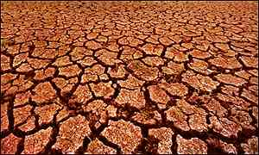
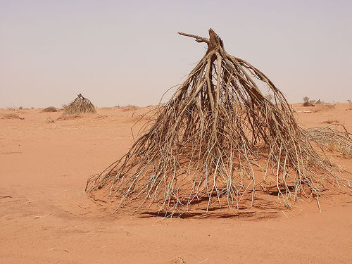

Why Sahel?
  Sahel has experienced unprecedented drought from late 1950s to early 1990s
/47

Slide 37
Observed DTR Trends in the Sahel
  T_{min} has a strong/significant warming trend while T_{max} shows a small/insignificant trend, and thus the DTR declines
  Concurrent long-term decreasing trends in both rainfall and DTR
/47

Slide 38
Clouds/Soil Moisture/Rainfall Cannot Explain the Sahelian DTR Decrease
drought
clouds/soil moisture/precipitation
DTR
Observed: DTR
  factors other than clouds, rainfall and soil moisture are mainly responsible for the observed decreasing DTR trend in the Sahel.
/47

Slide 39
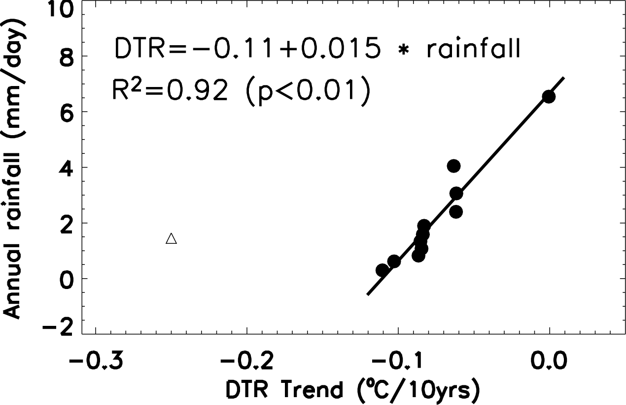
Anthropogenic Forcings Cannot Explain Most of the Sahelian DTR Trend Either
  Sahelian DTR trend is much larger than expected by the DTR trend - precipitation linear relationship
Sahel
DTR trend vs. precipitation by large-scale
climate region for 1950-2004
/47

Slide 40
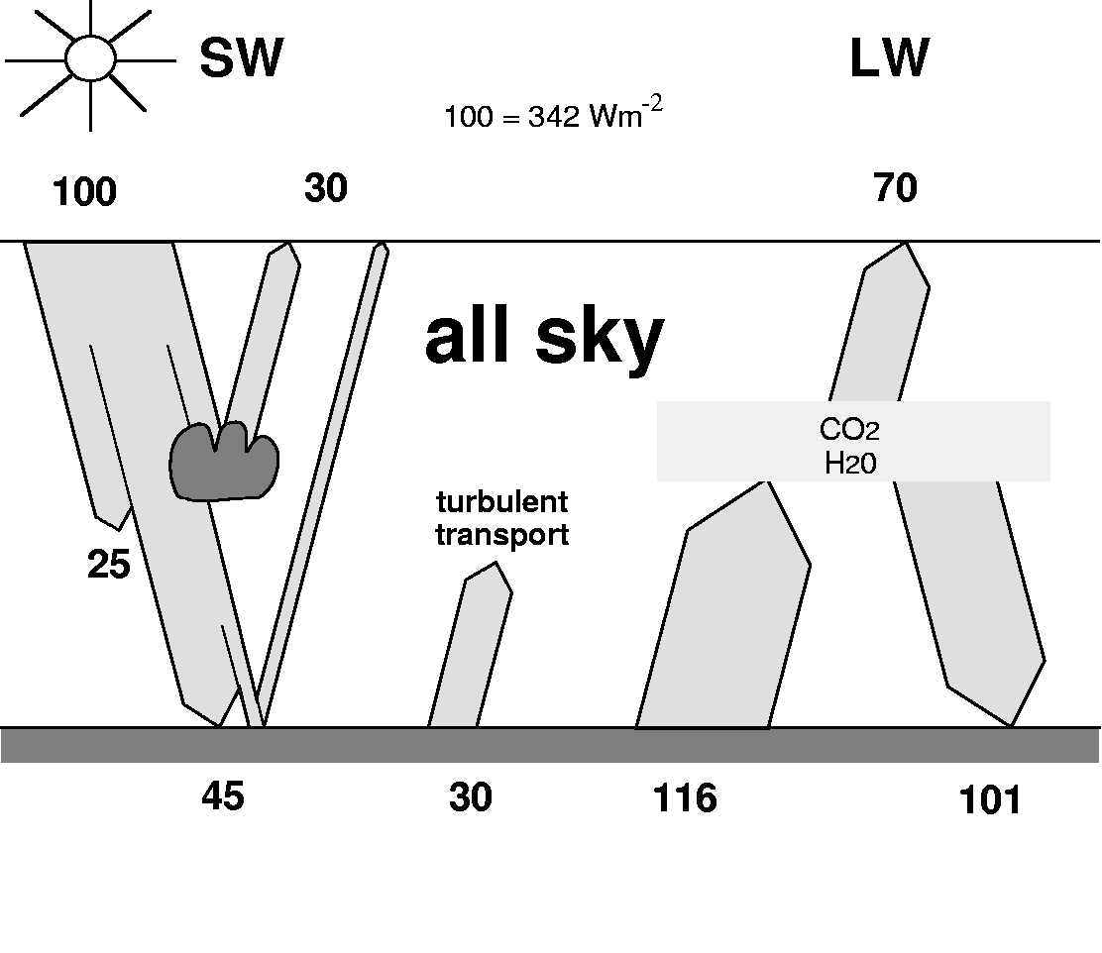
One Possibility – Albedo and Emissivity
    Soil aridification and vegetation reduction due to drought and land use change (e.g., deforestation, overgrazing, overfarming) increase albedo and decrease emissivity.
    Higher albedo reduces the absorption of solar radiation but such effect is compensated by more incoming radiation due to less cloud cover.
α
/47

Slide 41

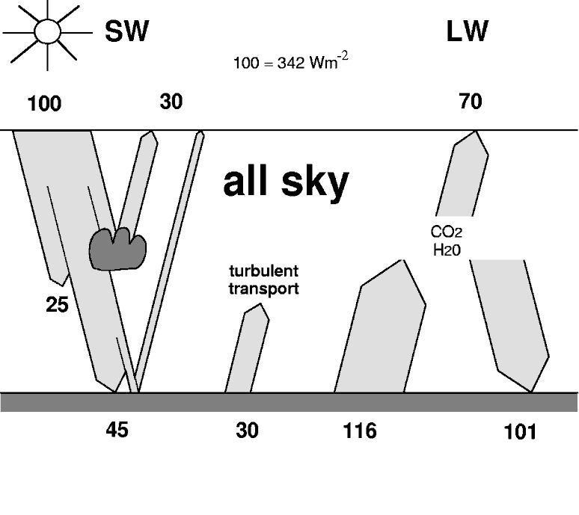

New Hypothesis for Reducing the DTR
  Drought and human -induced reduction in
  vegetation cover and soil emissivity
    Lower emissivity reduces thermal emission and less vegetation increases soil heat storage, both warming the surface during nighttime.
G
ε
G
ε
/47

Slide 42
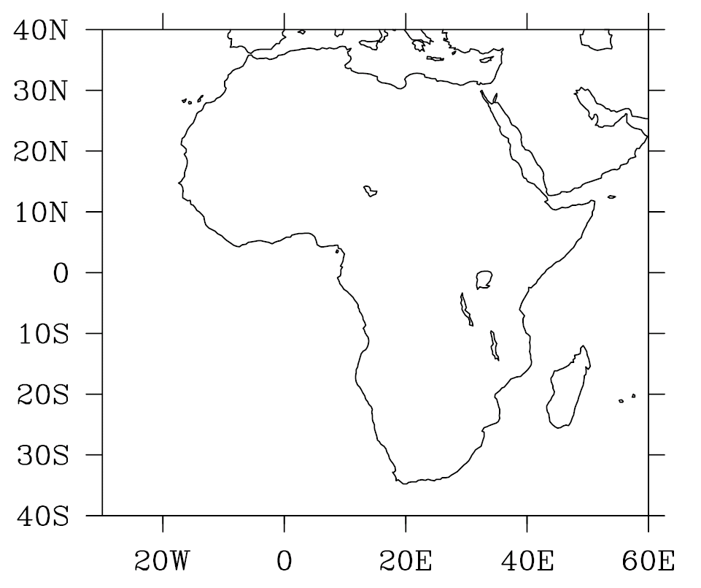
Climate Model Sensitivity Tests
  Three 20yrs simulations using NCAR CAM3/CLM3:
    Control run (CTL): no changes in vegetation and ε_{g} =0.96
    Exp A: remove all vegetation and ε_{g} =0.89
    Exp B: remove all vegetation and ε_{g} =0.96
Test region: Sahel
A-CTL: effects of vegetation + emissivity B-CTL: effects of vegetation only
Typical soil emissivity: ε_{g} = 0.96
Desert soil emissivity: ε_{g} =0.89
/47

Slide 43
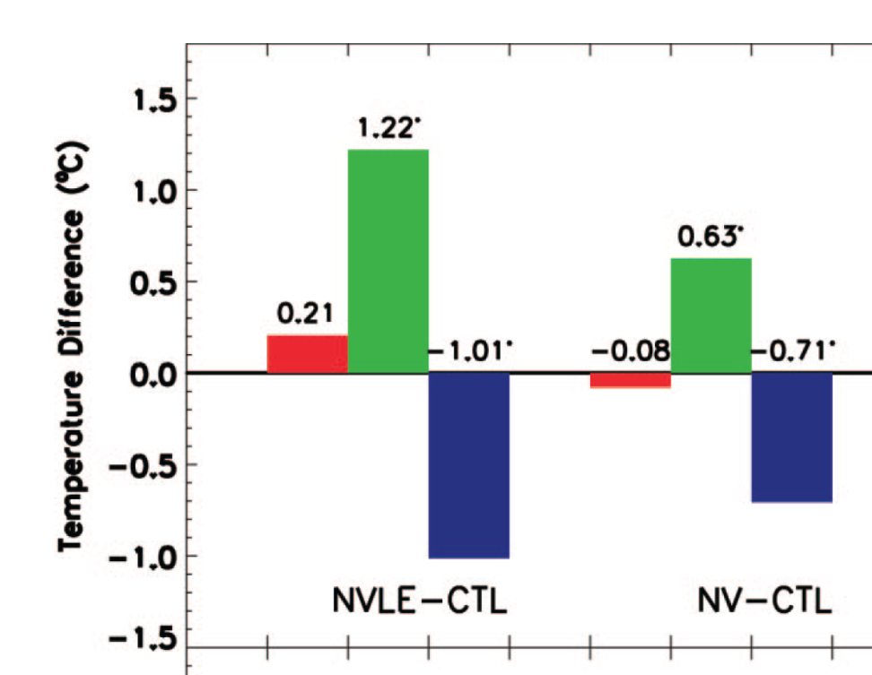
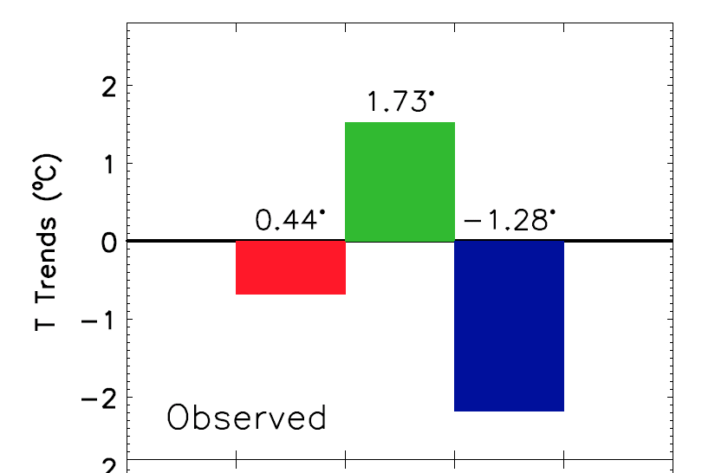
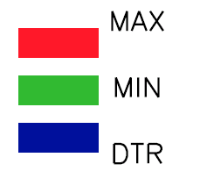
Observed vs Simulated Temperatures
  Reduced soil emissivity and vegetation both decrease DTR
vegetation + emissivity
Observed
A - CTL
B - CTL
vegetation only
Observed and simulated changes in annual T_{max},T_{min}, and DTR
/47

Slide 44
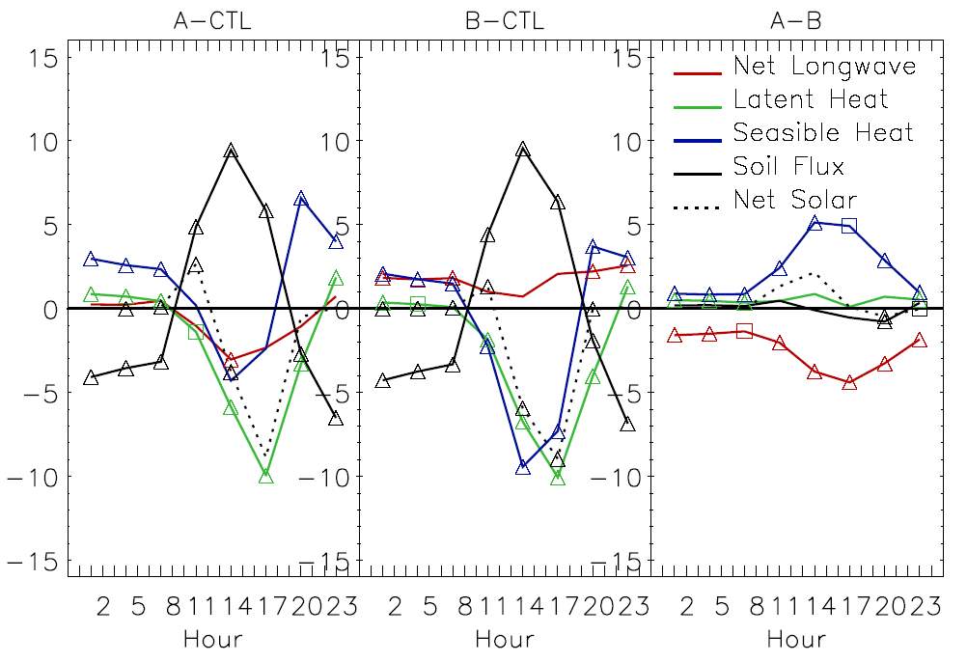
Explanations: Radiation and Energy Budget
  emissivity thermal emission
  vegetation soil heat storage
  T_{min}
Difference
Differences in the diurnal cycle of radiation and energy budget
/47

Slide 45
Consistent with Observations
  The observed long-term decreasing DTR trend reversed after rainfall and vegetation recovered.
  Satellites observed a greening trend in NDVI over the Sahel
  Observed T_{min} is correlated negatively with NDVI significantly
Time series of annual DTR, cloud cover,
rainfall, and NDVI for 1976-2004
NDVI – satellite measured vegetation index
/47

Slide 46
Topic III: Conclusions
  Climate model simulations show that the reduction in vegetation and soil emissivity warms T_{min} much faster than T_{max} and thus decreases the DTR.
  These simulations suggest that vegetation removal and soil aridification due to drought and human activities may have increased T_{min} and thus decreased DTR over semiarid regions.
  This new hypothesis is consistent with observations over the Sahel.
  (Zhou et al., PNAS, 2007; Zhou et al., JGR, 2008)
/47

Slide 47
Future Work
  Observational: detect and attribute the observed DTR changes to variables related to surface radiation and land surface properties over regions with adequate data.
    impacts of clouds and aerosols on diurnal cycles of energy balance (e.g., downward solar and thermal radiation)
    comprehensive statistical analyses between DTR and related contributors using surface and atmospheric observations, reanalysis data, and remote sensed products
    impacts of natural modes of variability (e.g., ENSO, AMO)
  Modeling: better simulate the diurnal cycle of temperature and related processes (e.g., DTR magnitude and trend) by improving treatments and representation of:
    aerosols and clouds
    land surface boundary layer processes
/47

