Slide 1

Prospects for Ultra-High Resolution Global Climate Prediction
Jim Kinter
Center for Ocean-Land-Atmosphere Studies
Climate Test Bed Seminar Series
29 September 2010

Slide 2
Origins
  The World Modeling Summit (WMS) in May 2008 called for a revolution in climate modeling to more rapidly advance improvements in accuracy and reliability
  The WMS recommended petascale supercomputers dedicated to climate modeling based in at least 3 international facilities
    Dedicated petascale machines are needed to provide enough computational capability and a controlled environment to support long runs and the management, analysis and stewardship of very large (petabyte) data sets
  The U.S. National Science Foundation, recognizing the importance of the problem, realized that a resource (Athena) was available to meet the challenge of the World Modeling Summit and offered to dedicate the Athena supercomputer over a six-month period in 2009-2010
  An international collaboration was formed among groups in the U.S., Japan and the U.K. to use Athena to take up the challenge

Slide 3
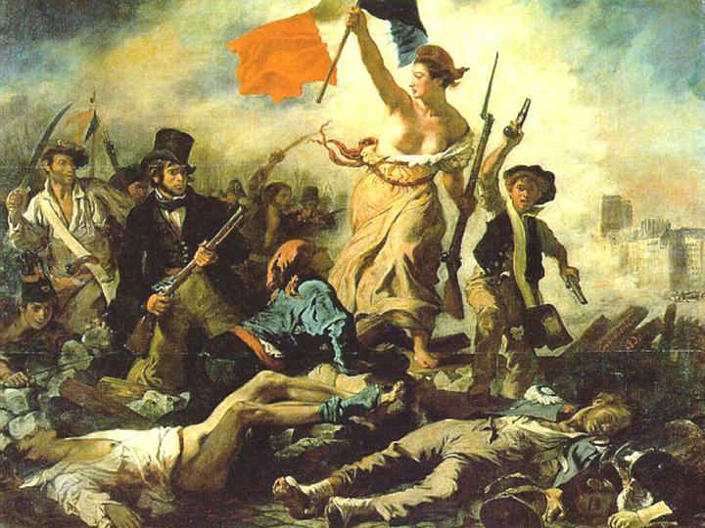
Revolutionizing Climate Modeling
May 2008 World Modeling Summit
Requirements for Climate Change Modeling:
Dedicated High-End Computing
International Collaboration
Apologies to Eugene Delacroix

Slide 4
Origins
  The World Modeling Summit (WMS) in May 2008 called for a revolution in climate modeling to more rapidly advance improvements in accuracy and reliability
  The WMS recommended petascale supercomputers dedicated to climate modeling based in at least 3 international facilities
    Dedicated petascale machines are needed to provide enough computational capability and a controlled environment to support long runs and the management, analysis and stewardship of very large (petabyte) data sets
  The U.S. National Science Foundation, recognizing the importance of the problem, realized that a resource (Athena) was available to meet the challenge of the World Modeling Summit and offered to dedicate the Athena supercomputer for 6 months in 2009-2010
  An international collaboration was formed among groups in the U.S., Japan and the U.K. to use Athena to take up the challenge

Slide 5
Project Athena:
Science Goals
Hypothesis: Increasing climate model resolution to accurately resolve mesoscale phenomena in the atmosphere (and ocean and land surface) can dramatically improve the fidelity of the models in simulating climate – mean, variances, covariances, and extreme events.
Hypothesis: Simulating the effect of increasing greenhouse gases on regional aspects of climate, especially extremes, may, for some regions, depend critically on the spatial resolution of the climate model.
Hypothesis: Explicitly resolving important processes, such as clouds in the atmosphere (and eddies in the ocean and landscape features on the continental surface), without parameterization, can improve the fidelity of the models, especially in describing the regional structure of weather and climate.

Slide 6
Project Athena: Collaborating Groups
COLA - Center for Ocean-Land-Atmosphere Studies, USA (NSF-funded)
ECMWF - European Center for Medium-range Weather Forecasts, UK
JAMSTEC - Japan Agency for Marine-Earth Science and Technology, Research Institute for Global Change, Japan
University of Tokyo, Japan
NICS - National Institute for Computational Sciences, USA (NSF-funded)
Cray Inc.
Codes
NICAM: Nonhydrostatic Icosahedral Atmospheric Model
IFS: ECMWF Integrated Forecast System
Supercomputers
Athena: Cray XT4 - 4512 quad-core Opteron nodes (18048)
  #30 on Top500 list (November 2009) – dedicated Oct’09 – Mar’10
Kraken: Cray XT5 - 8256 dual hex-core Opteron nodes (99072)
  #3 on Top500 list (November 2009) replaced Athena – allocation of 5M SUs

Slide 7
Many Thanks To …
ECMWF
  Mats Hamrud
  Thomas Jung
  Martin Miller
  Tim Palmer (co-PI)
  Peter Towers
  Nils Wedi
NICS
  Phil Andrews (co-PI)
  Troy Baer
  Matt Ezell
  Christian Halloy
  Dwayne John
  Bruce Loftis
  Kwai Wong
Cray
  Pete Johnsen
  Per Nyberg
JAMSTEC/U. Tokyo
  Chihiro Kodama
  Masaki Satoh (co-PI, U. Tokyo)
  Hirofumi Tomita (co-PI, JAMSTEC)
  Yohei Yamada
NSF
  AGS: Jay Fein
  OCI: Steve Meacham, Rob Pennington
COLA
  Deepthi Achutavarier
  Jennifer Adams
  Eric Altshuler
  Ben Cash
  Paul Dirmeyer
  Bohua Huang
  Emilia Jin
  Jim Kinter (PI)
  Larry Marx
  Julia Manganello
  Cristiana Stan
  Tom Wakefield

Slide 8
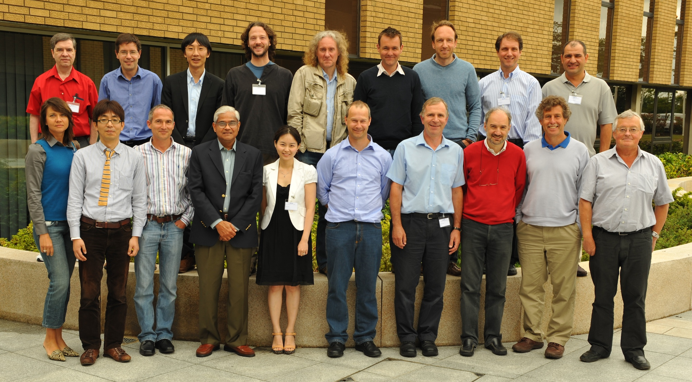
Athena Workshop
  ECMWF, reading, UK
  7-8 June 2010
  Marx Forbes Kodama Cash Hodges Shaffrey Jung Kinter Fuentes
  Manganello Tomita Bechtold Shukla Jin Wedi Towers Molteni Palmer Miller

Slide 9


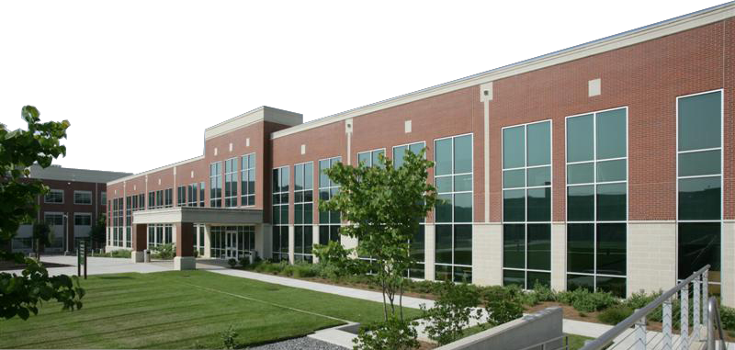



National Institute for
Computational Sciences
University of Tennessee and ORNL partnership
NICS is funded by the National Science Foundation, is located at Oak Ridge National Lab, and is managed by the University of Tennessee
NICS operates the first academic petascale supercomputer in the world
Leverages the capabilities of the ORNL
computing complex
Managed by UT-Battelle for the Department of Energy

Slide 10
NICS and Athena
NICS provides and supports computational resources for academic researchers: Cray XT5 and XT4, SGI UltraViolet for visualization and data analysis, CPU-GPU cluster, scratch and archival storage, …
The Cray XT4 – Athena – the first NICS machine in 2008
  4512 nodes @ AMD 2.3 GHz quad-core processor + 4 GB RAM
  18,048 cores + 17.6 TB aggregate memory
  165 TFLOPS peak performance
  Other resources: 85 TB Lustre file system, 258 TB auxilliary file system (called Nakji) and a 5-node, 16-core 128-GB system (called Verne) to help with data analysis and management
  Replaced by Cray XT5 – Kraken – in March 2009

Slide 11
NICS Support for COLA Team
The Athena project received an extraordinarily high level of direct support.
  Contract with Cray provided h/w support during business hours.
  NICS systems staff (Matt and Rick) and computational science staff (Kwai, Christian, Dwayne) attentive seemingly 24/7.
  NICS management and staff were committed to making this project a success.
  COLA viewed as a partner not a customer.
Direct support was very smooth because NICS and COLA teams were able to rise to the challenges.

Slide 12
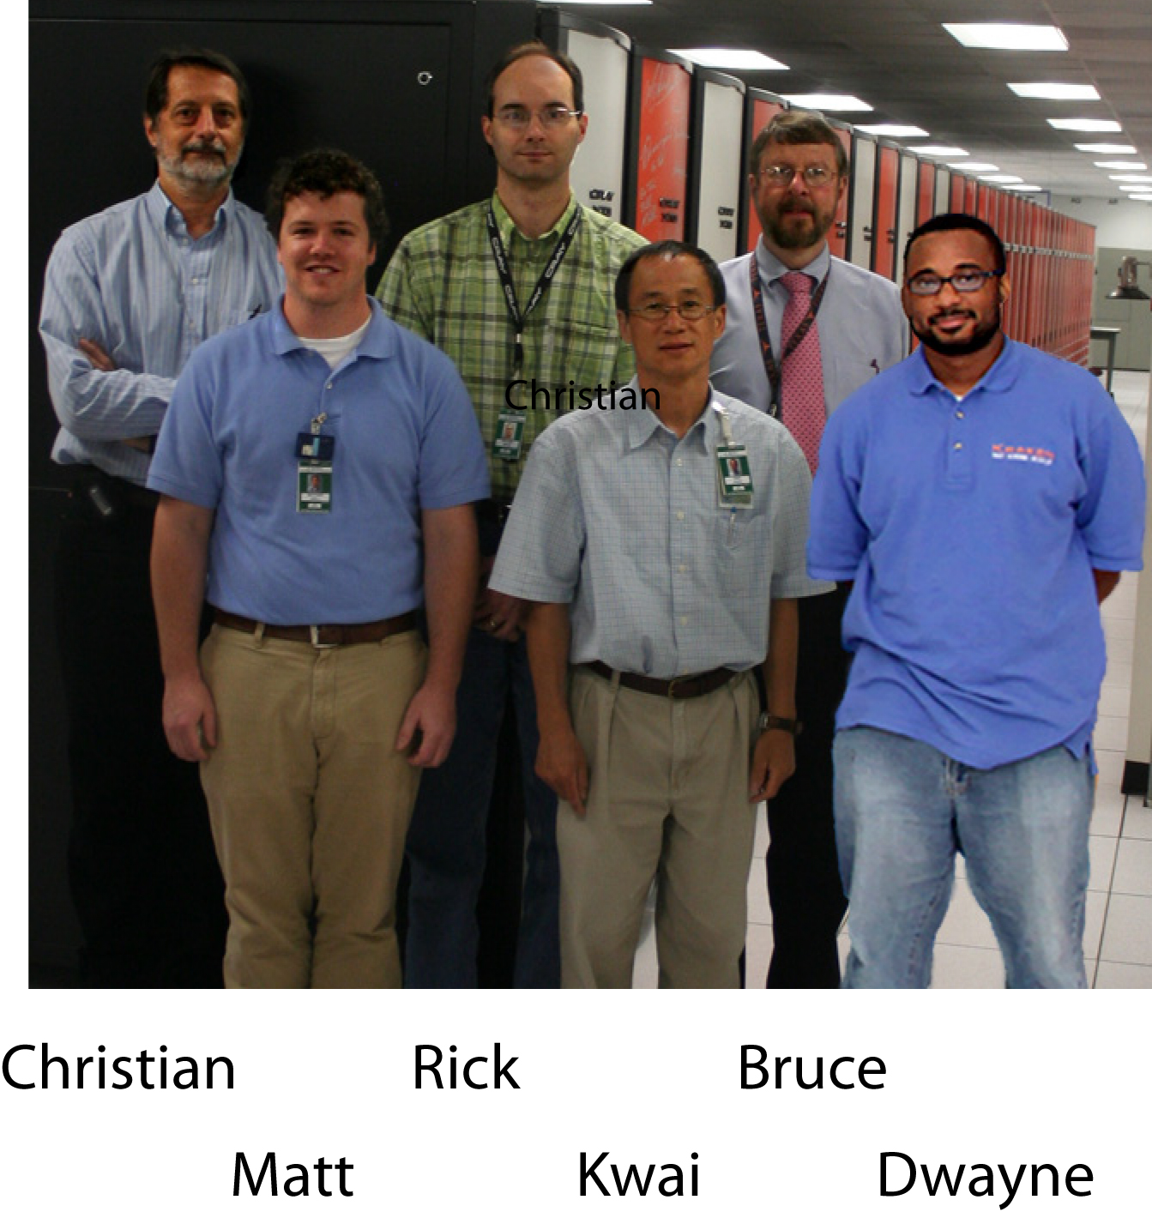
NICS Athena
Support Team

Slide 13
Production Computing
Supporting a single project on Athena provided some flexibility not otherwise available. NICS could change priorities and queuing parameters to be more effective.
Supercomputer Tetris Problem: keeping the scheduler busy running 2 codes and using extra nodes for post-processing.
COLA and ECMWF staff over 70M hours over 6 months on
Athena – out of a potential ~79M hours.
Athena has been
very reliable.

Slide 14
NICS Lessons Learned
Dedicated usage of a relatively big supercomputer greatly enhances productivity
Dealing with only a few users and their requirements allows for more efficient utilization
Challenge: Dedicated simulation projects like Project Athena can generate enormous amounts of data to be archived, analyzed and managed. NICS (and TeraGrid) do not currently have enough storage capacity. Data management is a big challenge.
Preparation time: 2 to 3 weeks at least were needed before the beginning of dedicated runs to test and optimize the codes and to plan strategies for optimal use of the system. Communication throughout the project was essential: (weekly telecons, email lists, personal calls, …)
Project Athena was a valuable experience for NICS, demonstrating the value of developing good teamwork practices through real partnership between science groups and computational support group.

Slide 15
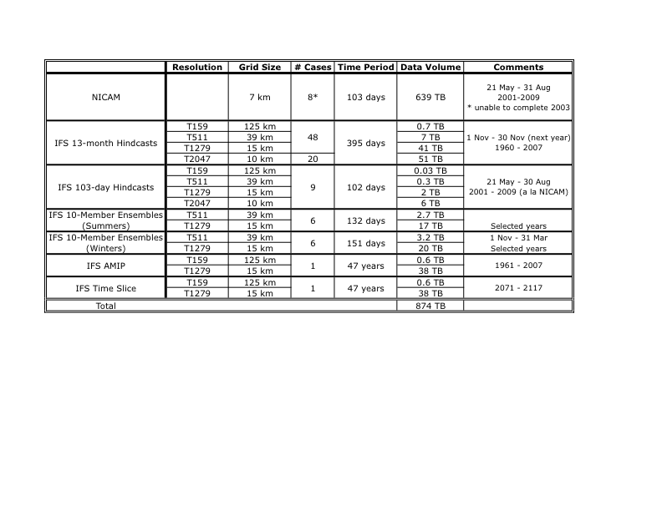
Athena Experiments
http://wxmaps.org/athena/home/

Slide 16
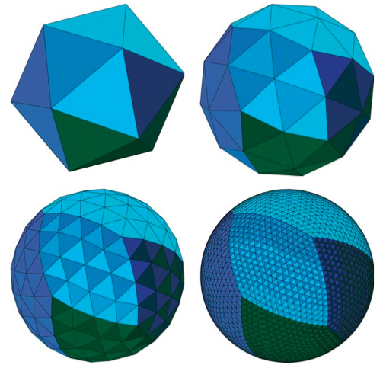
NICAM Domain Decomposition
We ran 7-km grid on 640 nodes (2560 cores), because the computation was constrained by memory per core on Athena … more grid bisections means more “ghost rows” means more memory demand

Slide 17
Web Page http://wxmaps.org/Athena/home

Slide 18
Sample Results
Basics of model climate
Resolution dependence of snow
Diurnal cycle of precipitation
Projection of climate change
Tropical cyclones

Slide 19
Sample Results
Basics of model climate
Resolution dependence of snow
Diurnal cycle of precipitation
Projection of climate change
Tropical cyclones

Slide 20
Total Column Liquid Water (DJF 1989-2007)
T159-SSM/I
T511-T159
T1279-T511
T2047-T1279
Notes:
Summer changes more confined to the tropics.

Slide 21
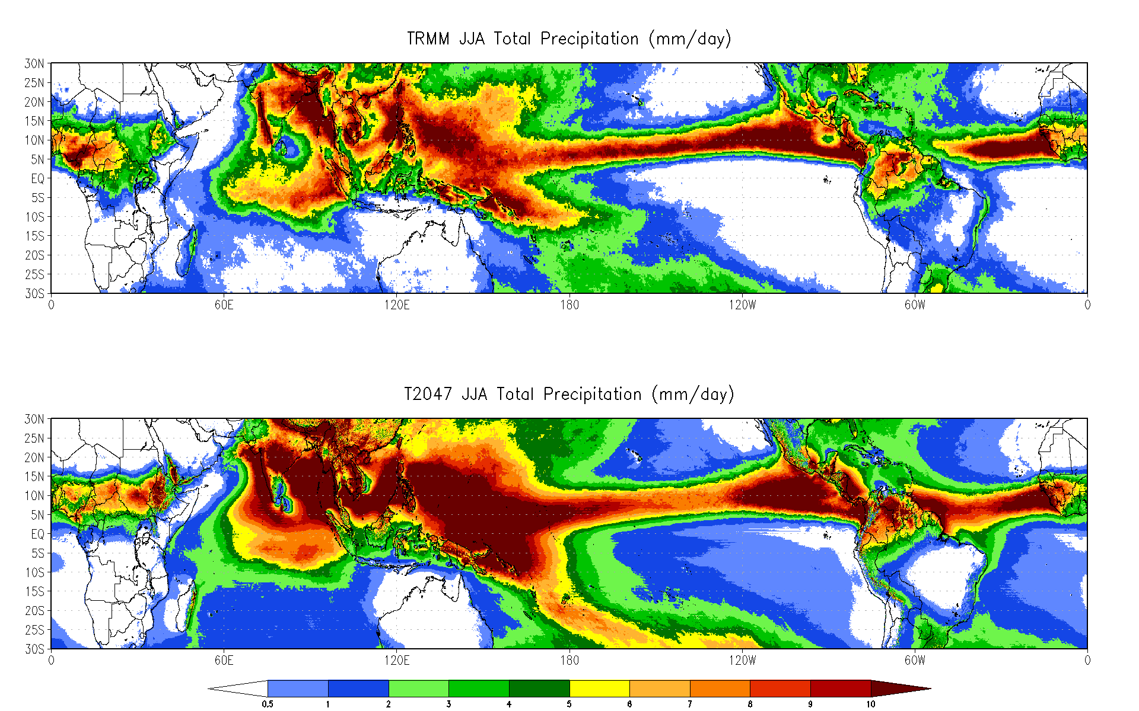
Total JJA Precipitation (2000-2008)
Notes:
Summer changes more confined to the tropics.

Slide 22
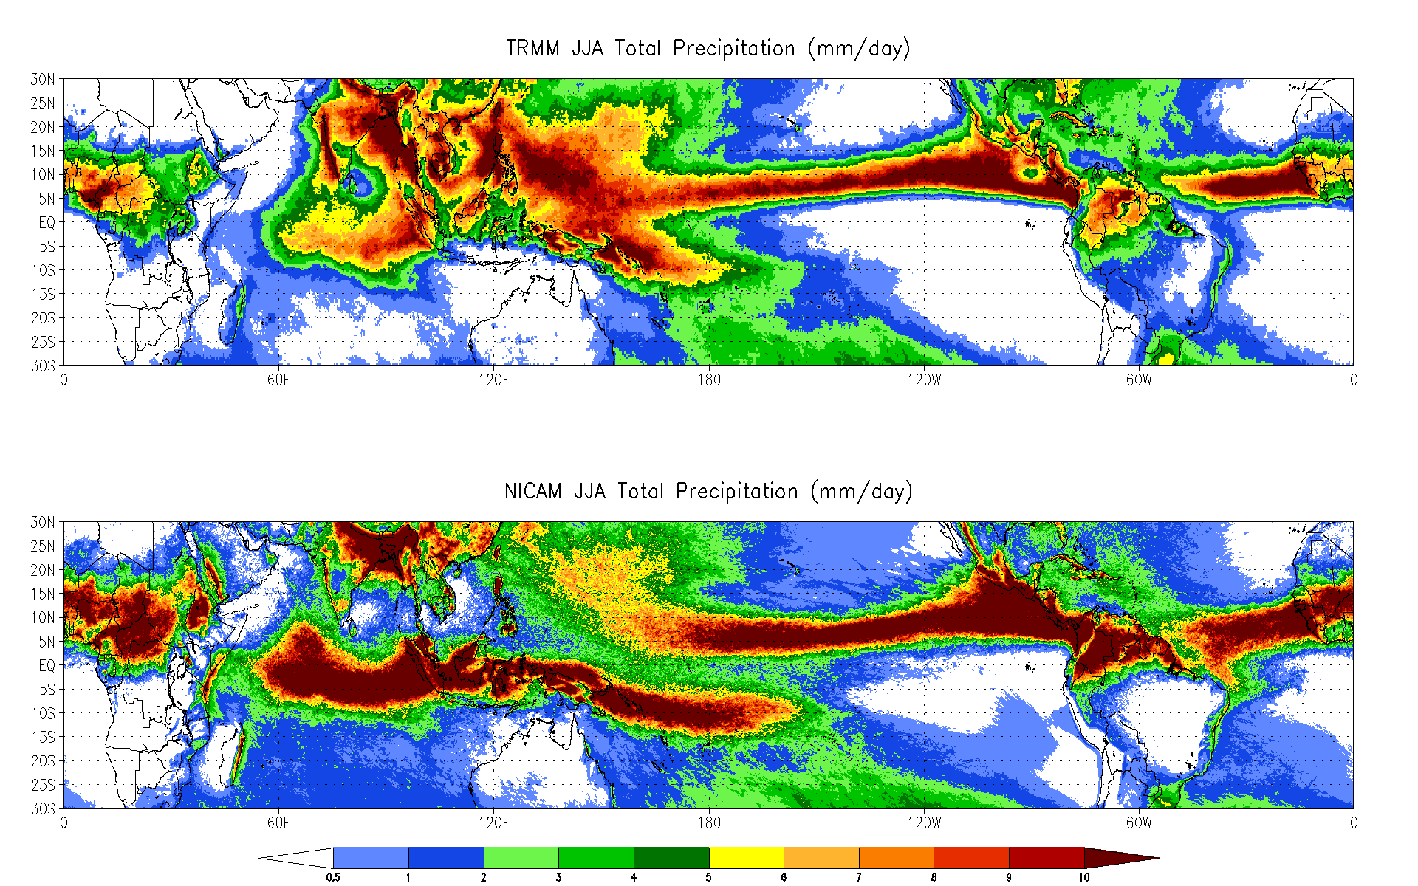
Total JJA Precipitation (2000-2008)
LARGE BIASES REMAIN
Notes:
Summer changes more confined to the tropics.

Slide 23
Blocking Frequencies: DJFM 1960-2007
Tibaldi-Molteni Index

Slide 24
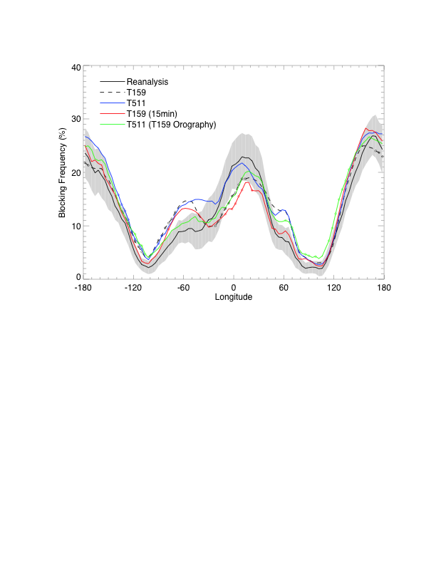
Blocking Frequencies: DJFM 1989-2007
Tibaldi-Molteni Index

Slide 25
Sample Results
Basics of model climate
Resolution dependence of snow
Diurnal cycle of precipitation
Projection of climate change
Tropical cyclones

Slide 26
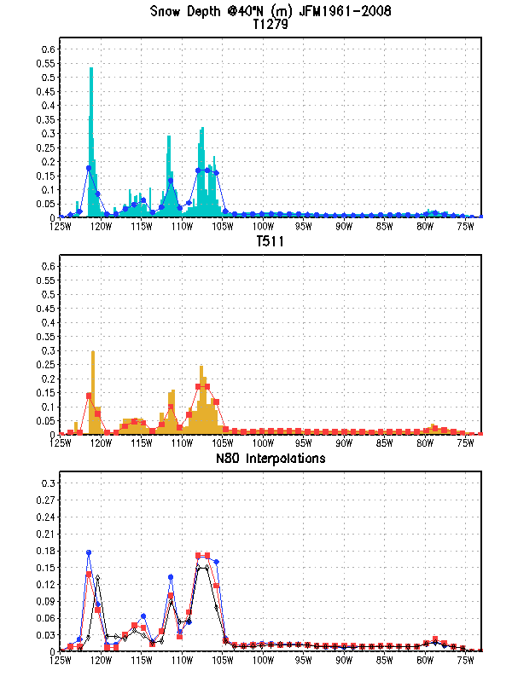
IFS JFM Mean Snow Depth
CONUS Transect at 40 N
15-km grid
Interpolated 15-km and 39-km grid data ~agree with native 125-km grid values
Orographic features are not properly represented at low resolution
39-km grid
125-km grids
Notes:
Moving on to a different aspect of precipitation… snowfall in transect across CONUS shows clear signature of orography. Reduced versions of high res models are similar to T159 version, although shifted westward

Slide 27
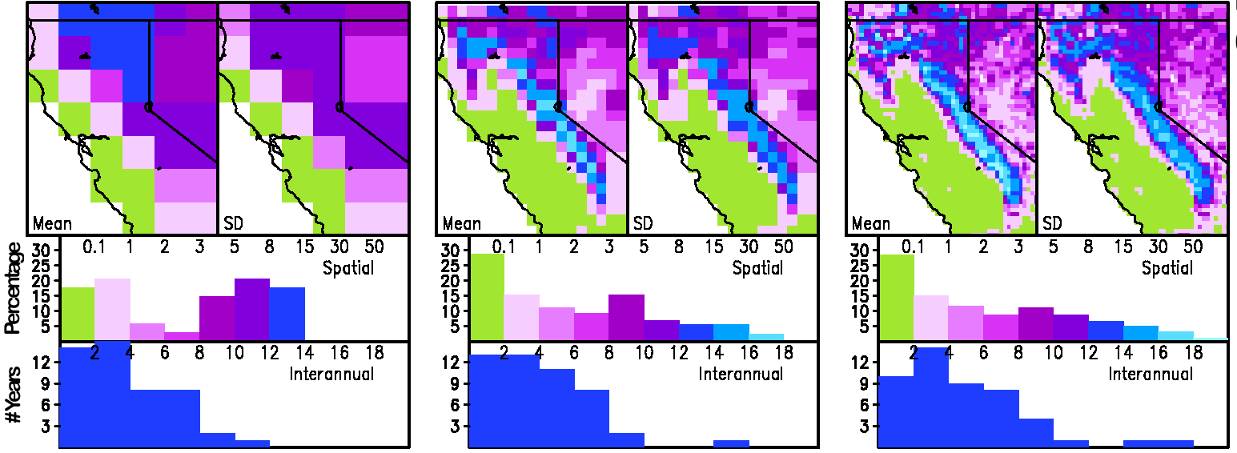
Snow Depth (mm) in Western N. America
T159 (125 km)
T511 (39 km)
T1279 (16 km)
Decreasing Resolution Biases Distribution
Notes:
Busy slide but worth going into. Top row is reduced resolution, ie everything at T159. Panels are mean and SD. Histograms show percentage of pixels in each range

Slide 28
Sample Results
Basics of model climate
Resolution dependence of snow
Diurnal cycle of precipitation
Projection of climate change
Tropical cyclones

Slide 29
Resolution Dependence of Diurnal Cycle of Precipitation
amplitude
phase
NICAM
NICAM

Slide 30
Resolution Dependence of Diurnal Cycle of Precipitation
amplitude
phase

Slide 31
Sample Results
Basics of model climate
Resolution dependence of snow
Diurnal cycle of precipitation
Projection of climate change
Tropical cyclones

Slide 32
Athena Experiments

Slide 33
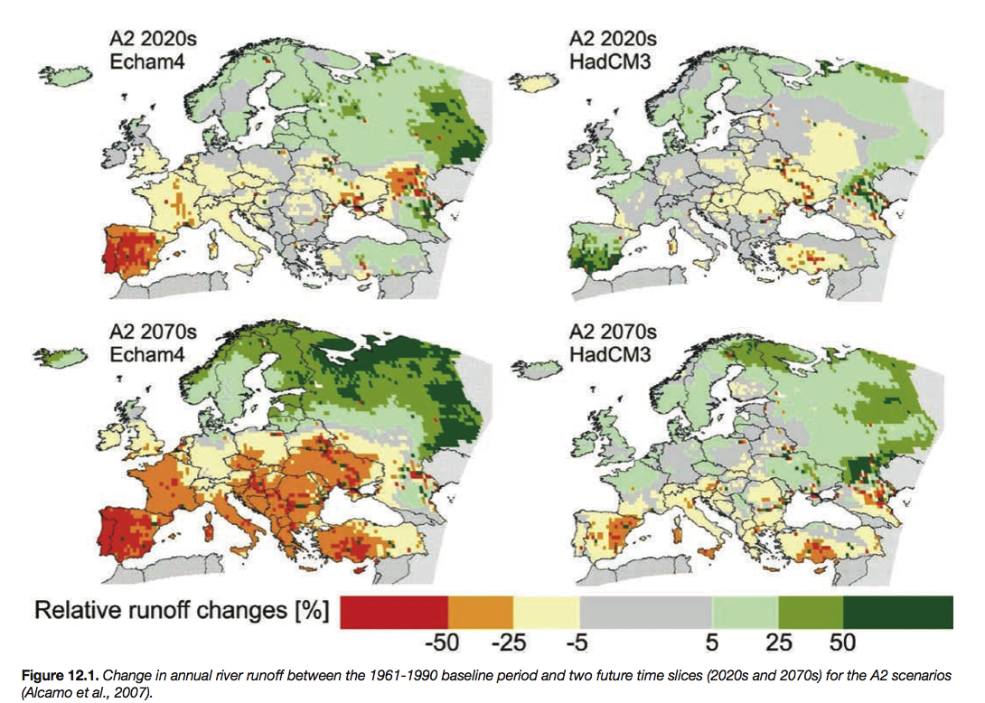
Regional Climate Change – Beyond Today’s Models’ Ability?

Slide 34
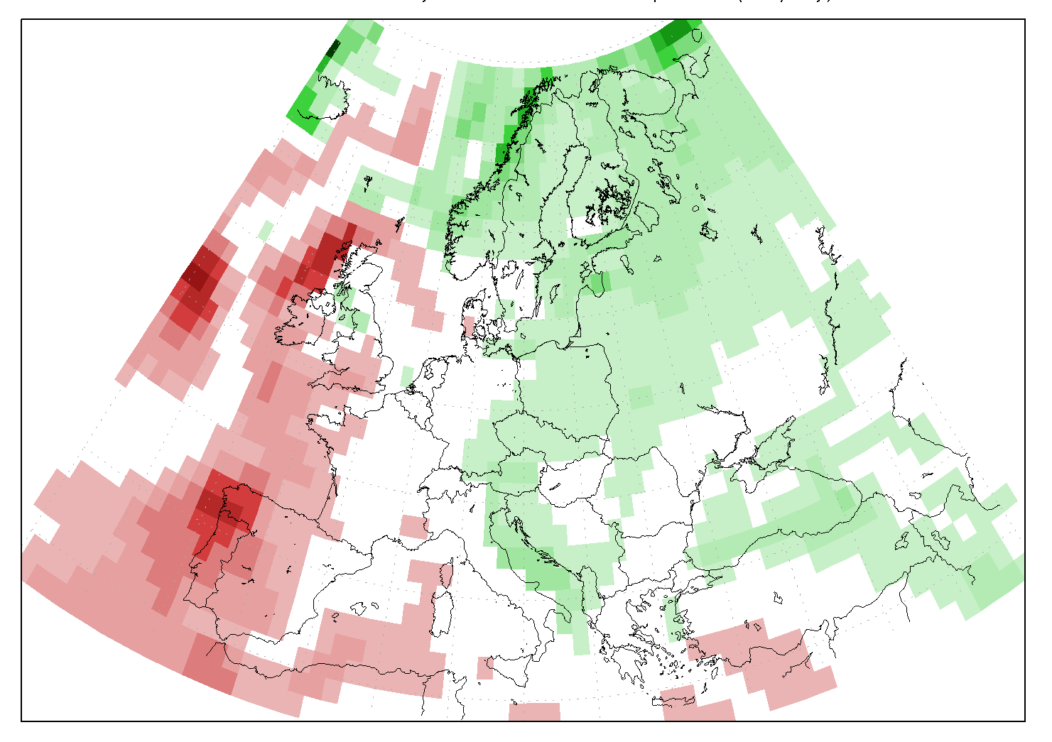
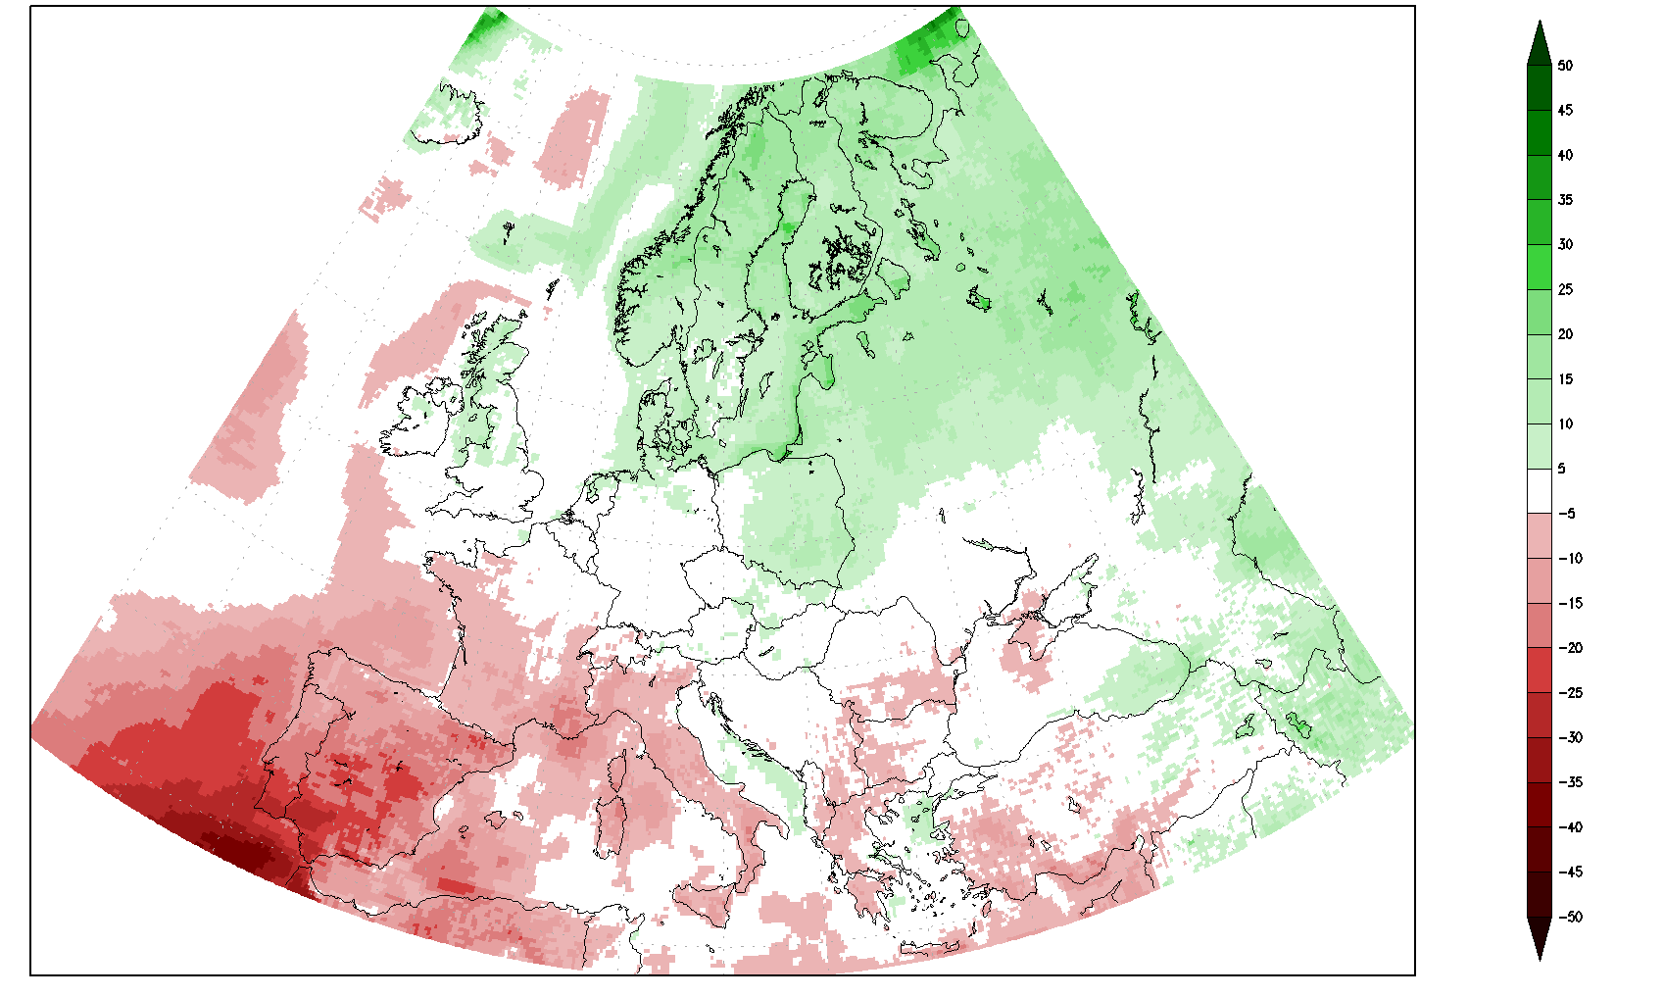
Annual Mean Precipitation Change
Europe: 21st C minus 20th C
T159 (125-km)
T1279 (16-km)
“Time-slice” runs of the ECMWF IFS global atmospheric model with observed SST for the 20th century and CMIP3 projections of SST for the 21st century at two different model resolutions
The continental-scale pattern of precipitation change associated with global warming is the same, but the regional details are quite different, particularly in southern Europe.

Slide 35
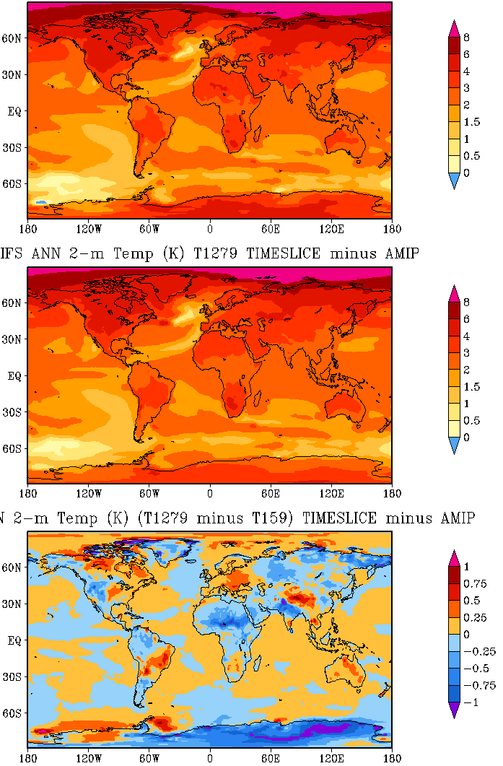
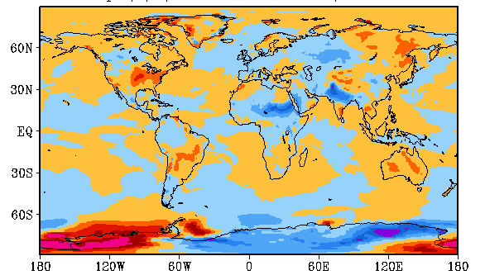
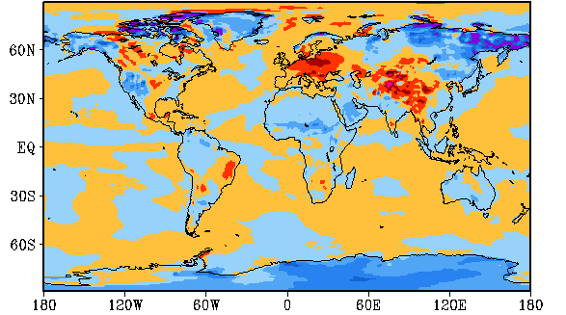
Temperature Change (21st C – 20th C)
Annual
JJA
128-km
diff
16-km
DJF
diff
diff

Slide 36
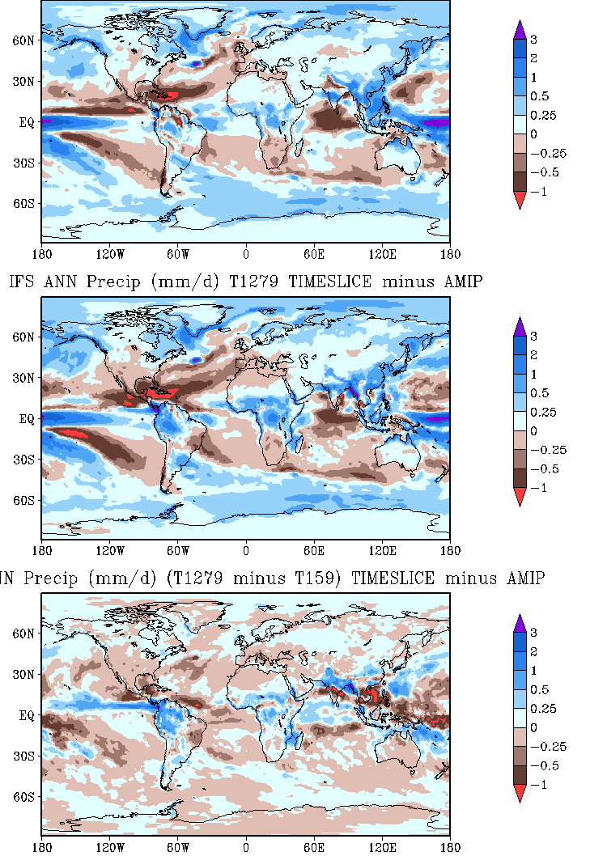
Precipitation Change (21st C – 20th C)
Annual
128-km
Wetter Sahel & Amazon
in 21st C
16-km
Drier overall
in 16-km run
diff

Slide 37
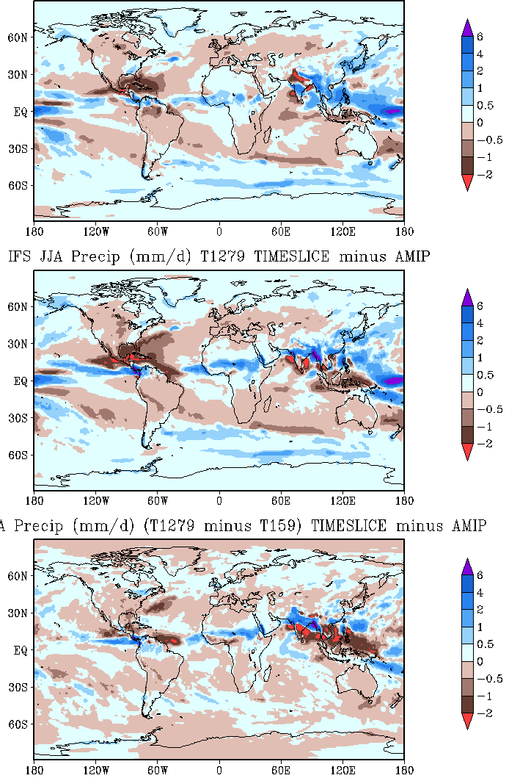
Precipitation Change (21st C – 20th C)
JJA
Less rainfall in tropical cyclone regions of Atlantic and eastern Pacific
in 21st C
128-km
16-km
Monsoon changes
make northern region of
south Asia wetter
diff

Slide 38
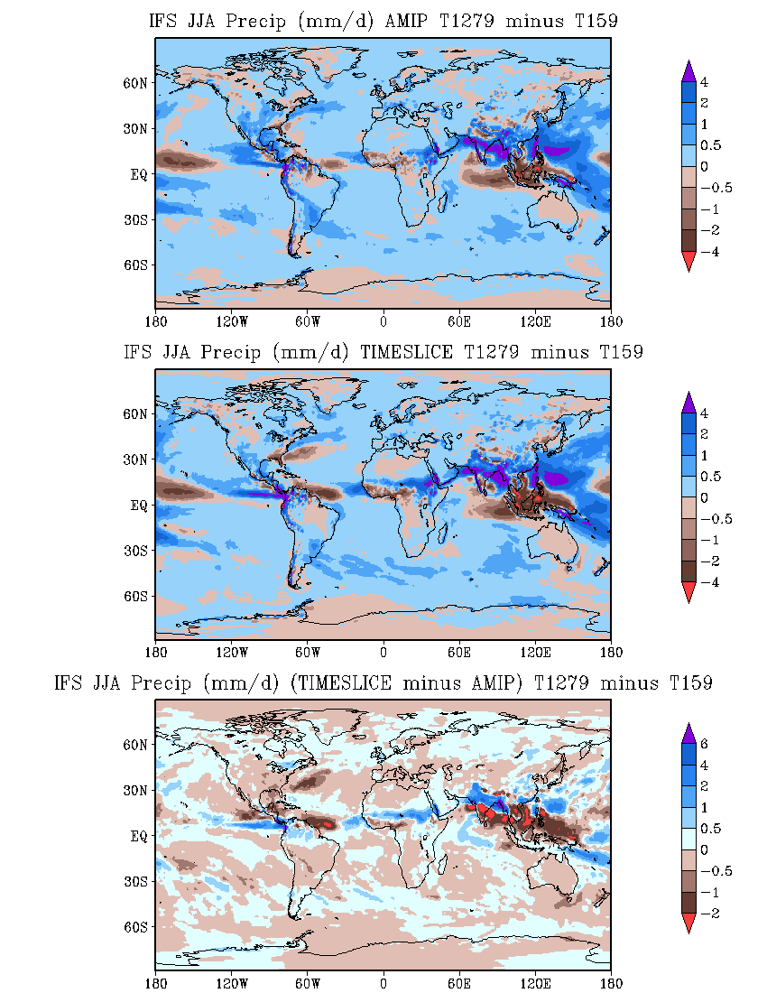
Precipitation Change (21st C – 20th C)
JJA
AMIP
HOWEVER, note that T1279:
Is wetter almost everywhere
produces a northward shift of the monsoon belt, relative to T159, in both the AMIP and Time_Slice runs
Time
Slice
diff

Slide 39
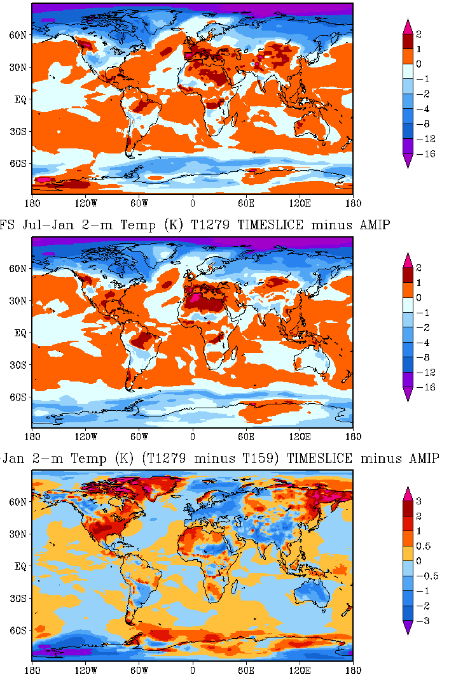
Annual T Range Change (21st C – 20th C)
July minus January
128-km
July warms up more
than January between 50S and 50N (opposite poleward of 50°)
except over US in low-res run
16-km
Largest difference due to resolution occurs in North America, eastern Siberia
diff

Slide 40
Sample Results
Basics of model climate
Resolution dependence of snow
Diurnal cycle of precipitation
Projection of climate change
Tropical cyclones

Slide 41
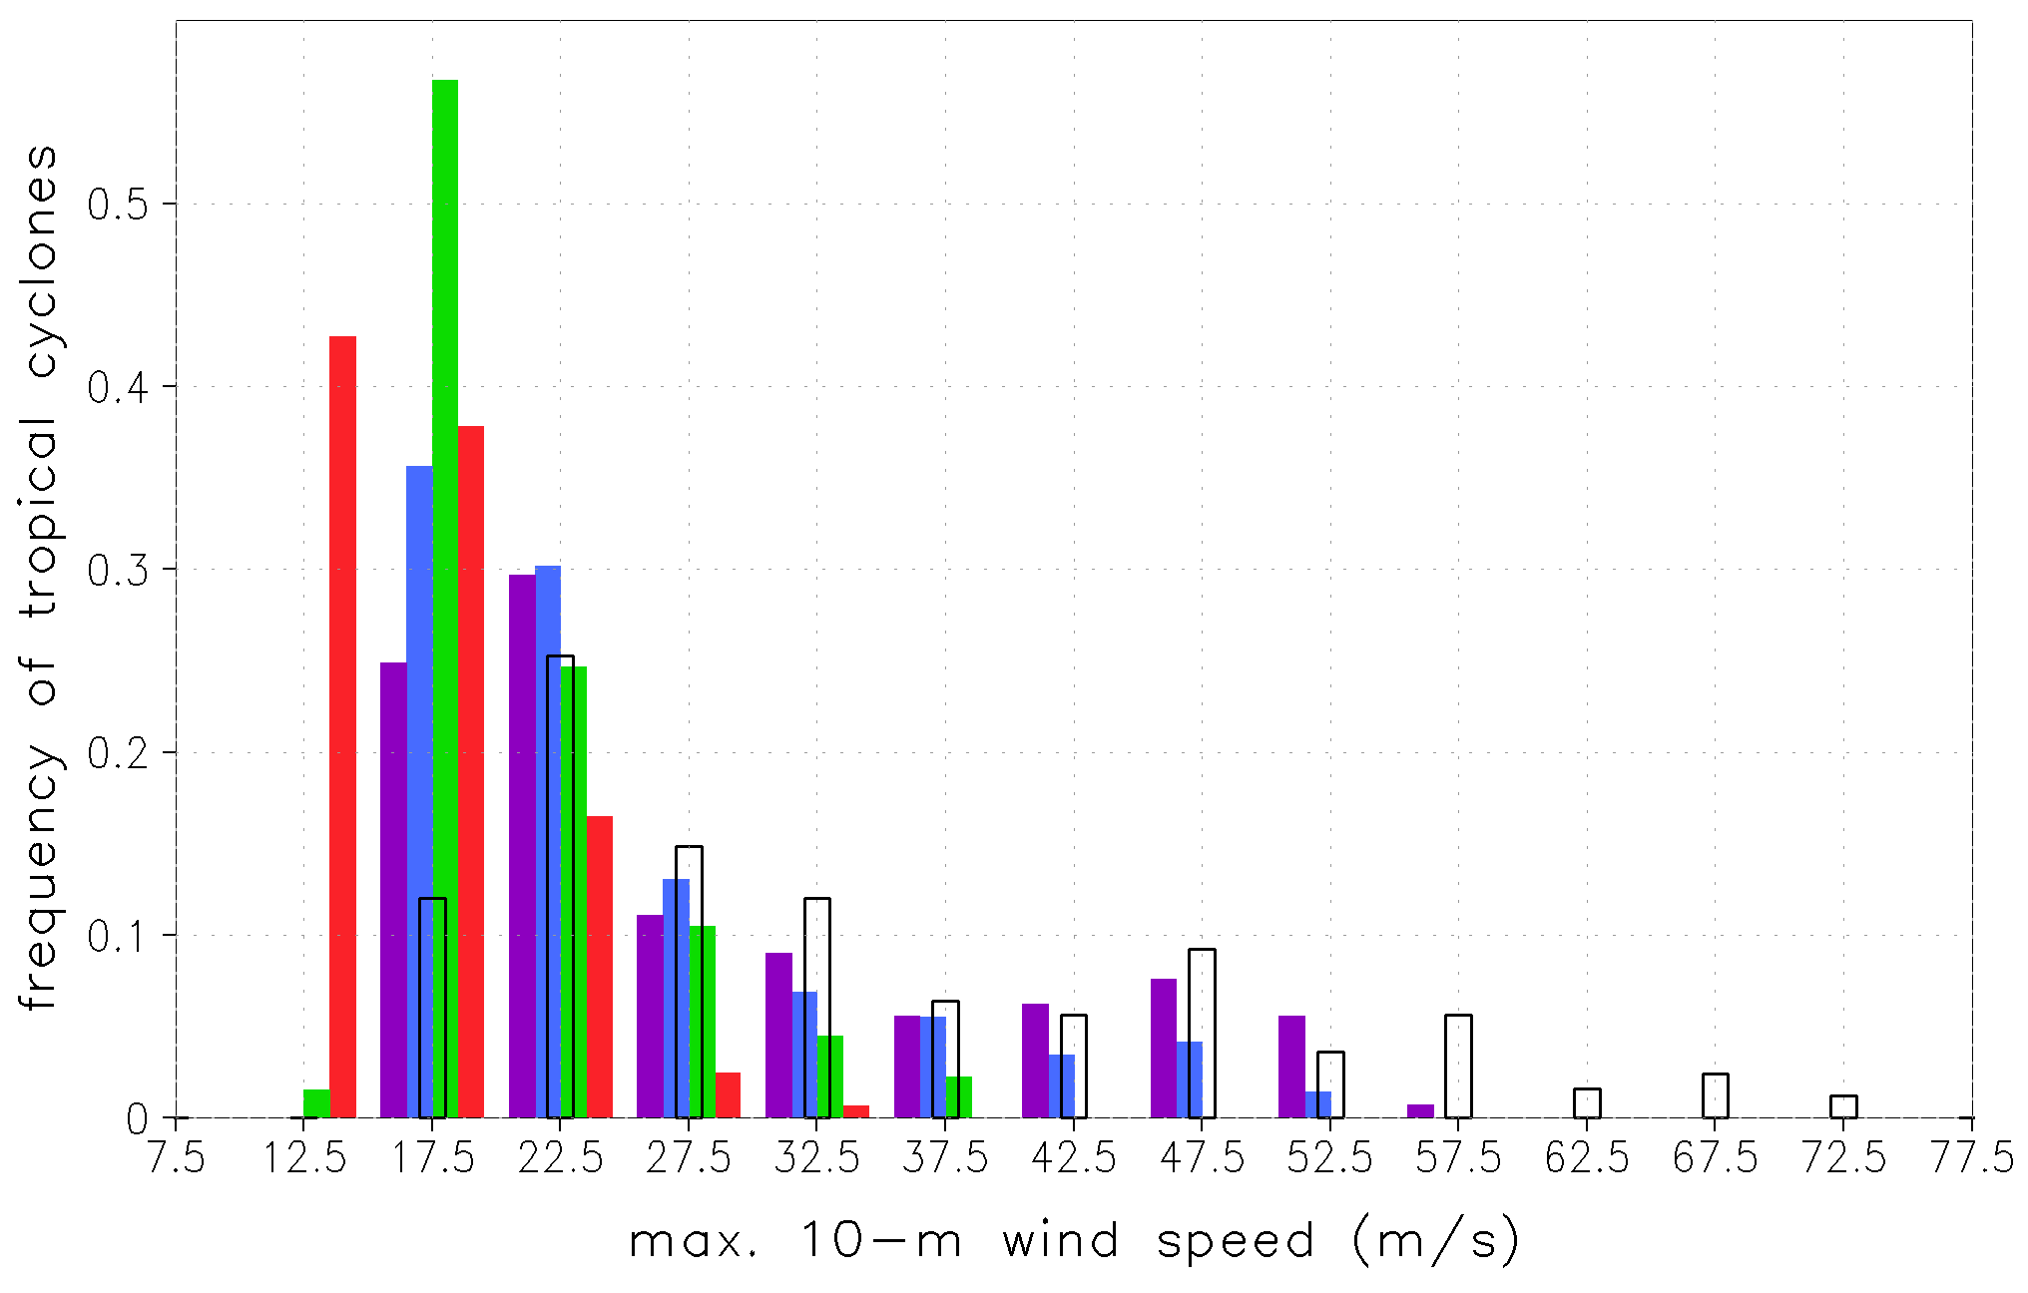
North Atlantic Tropical Cyclones Intensity Distribution
IFS, March-November, 1990-2008
TS
CAT1
CAT2
CAT3
CAT4
CAT5
OBS
T2047
T1279
T511
T159

Slide 42
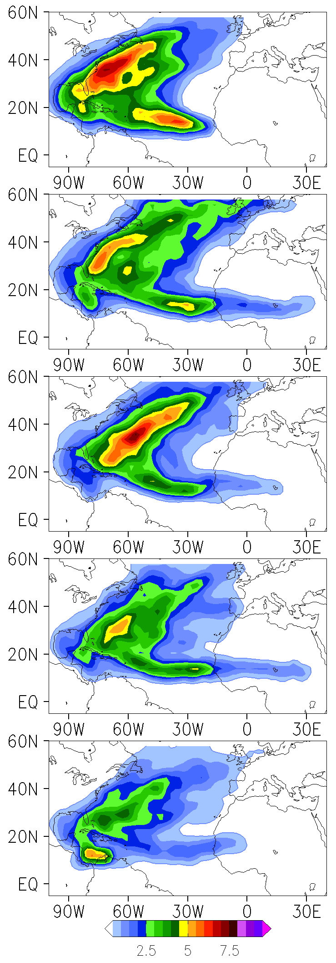
North Atlantic Tropical Cyclones Track Density
IFS, March-November, 1990-2008
OBS
T2047
T511
T1279
T159

Slide 43
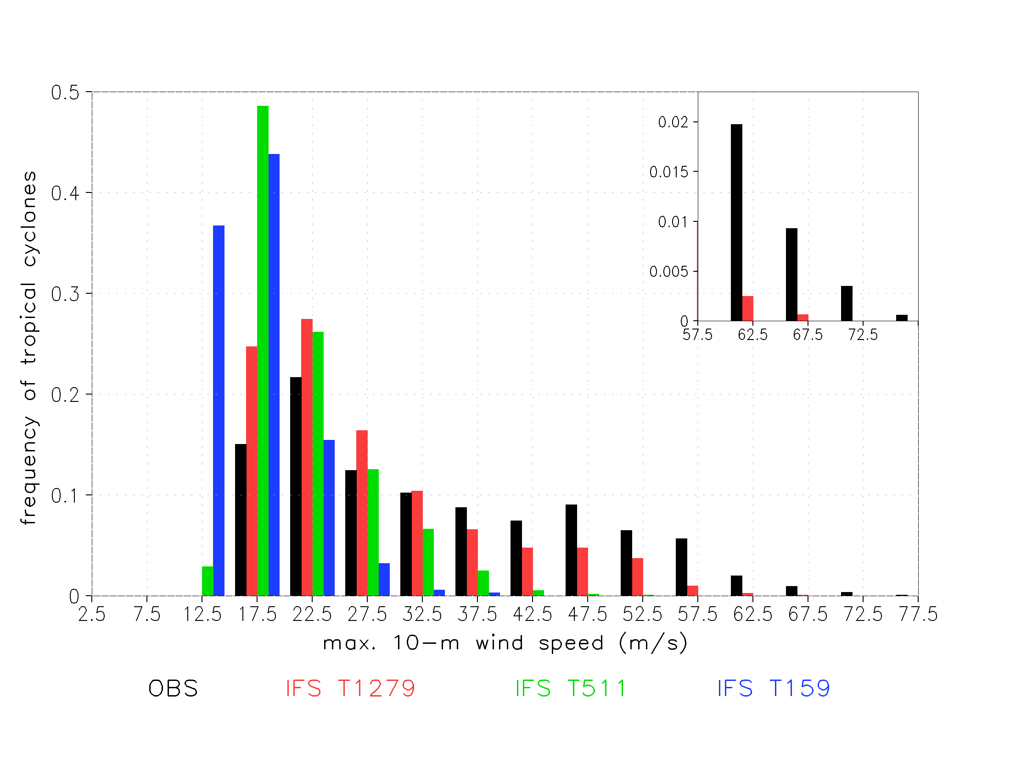
Resolution Dependence of Tropical Cyclones in Global Simulations

Slide 44
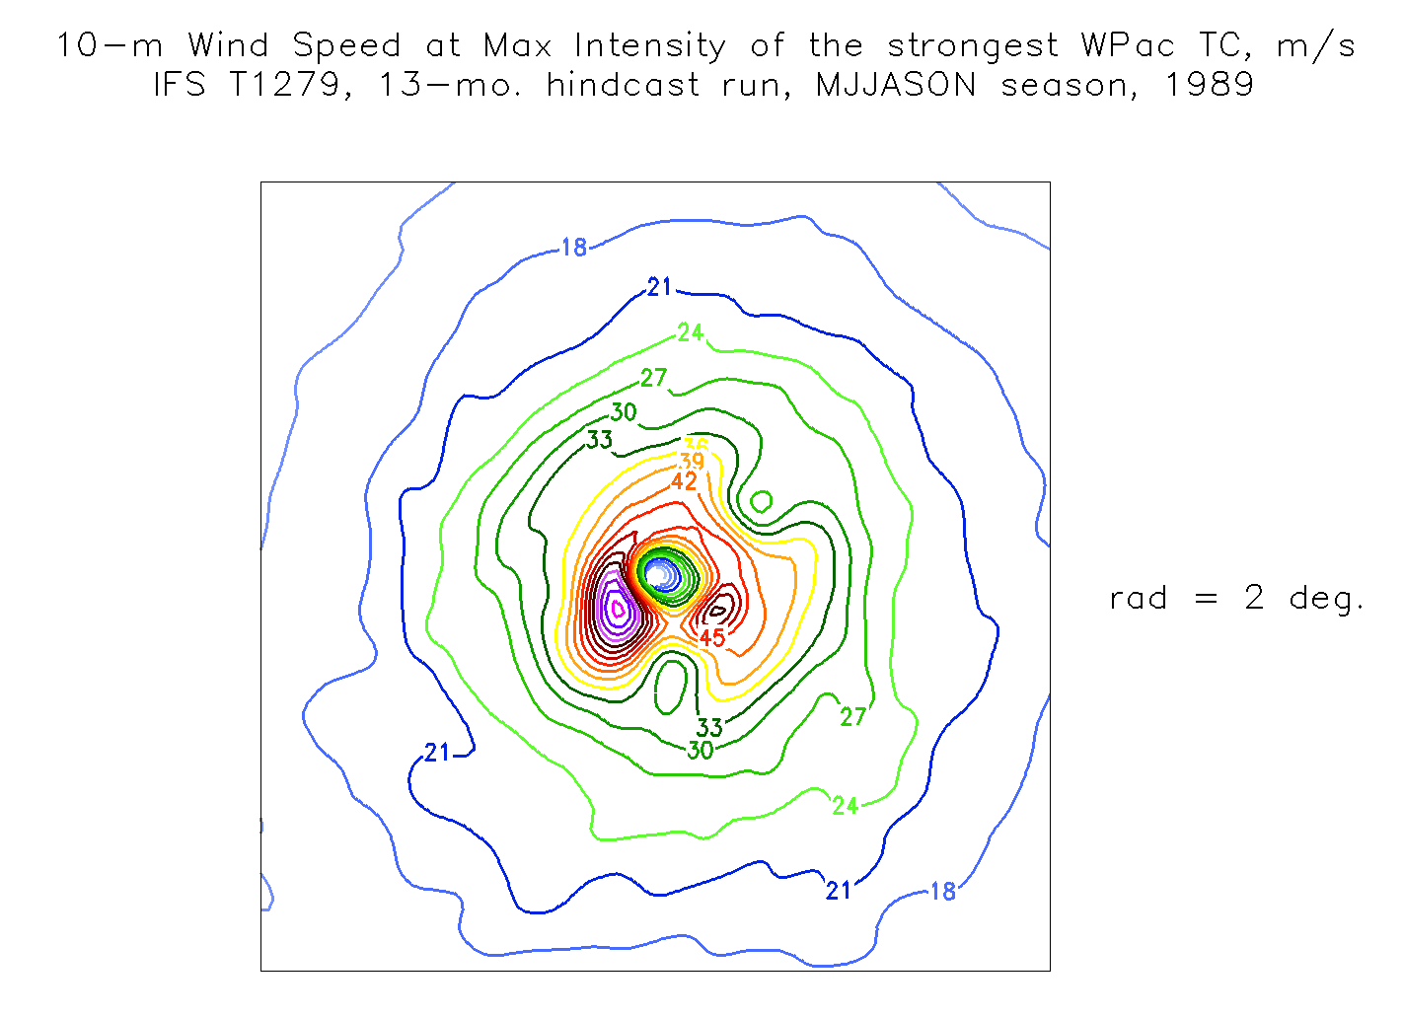

Slide 45
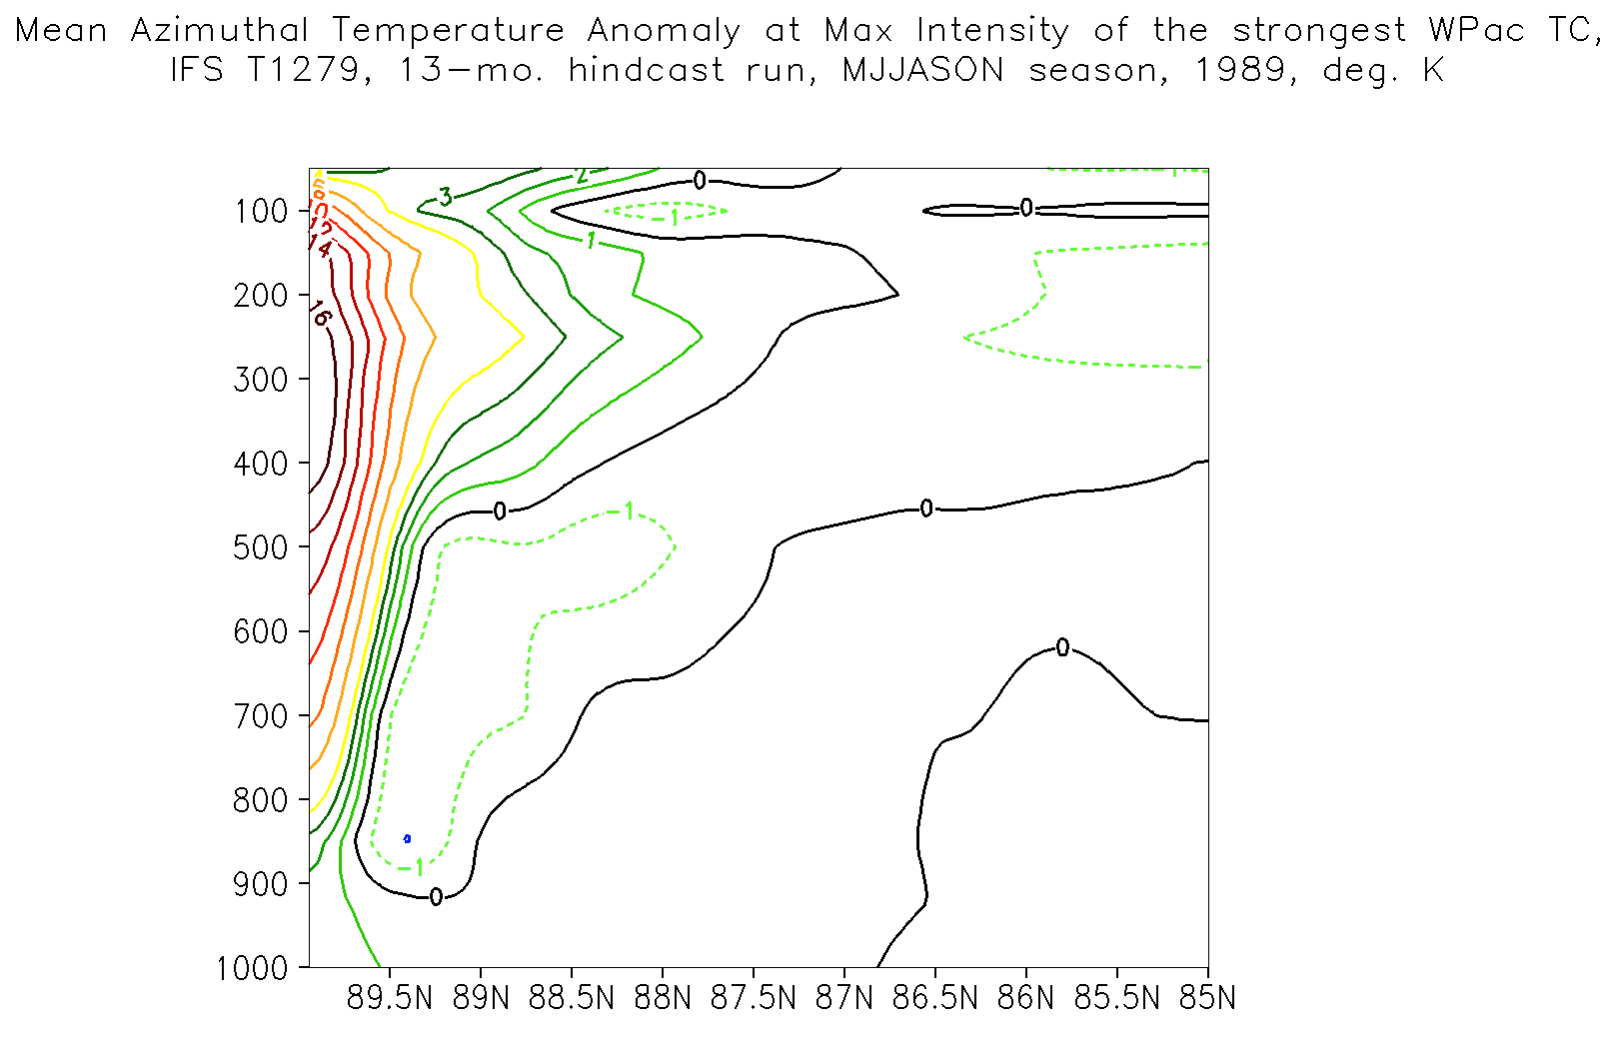

Slide 46
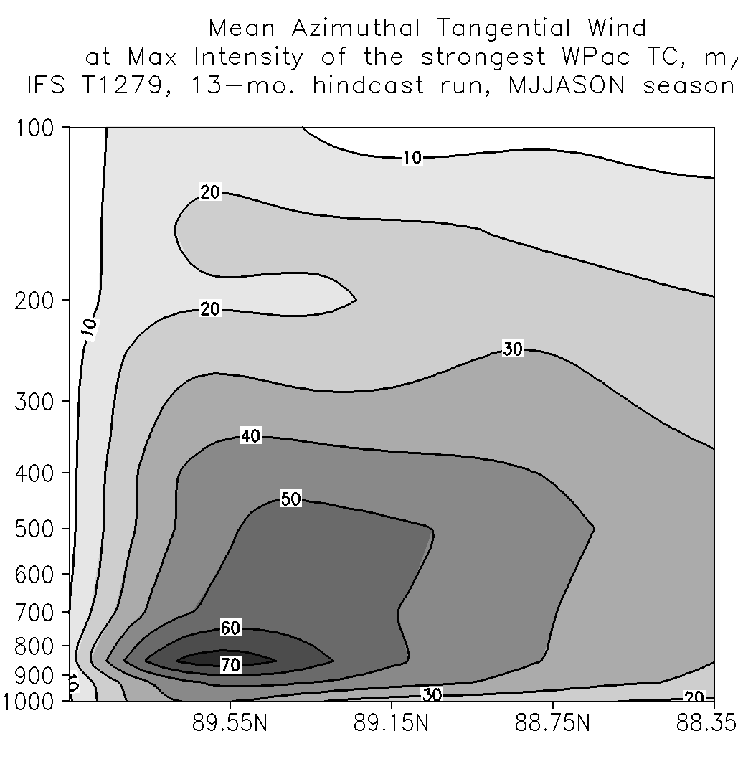
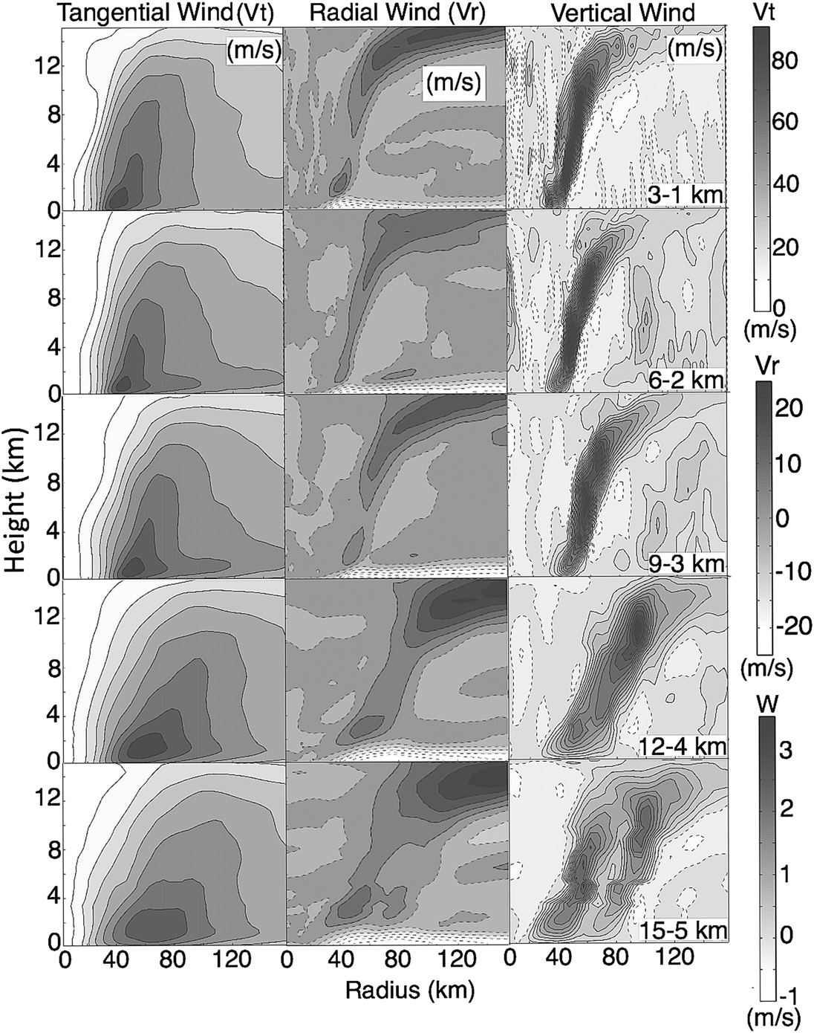
Mean Azimuthal Tangential Wind
Fiero et al. (2009)
Athena
height (km)
0
40
80
120
12
WRF-ARW
(15 km / 5 km)
radius (km)
ECMWF IFS
(16 km)

Slide 47
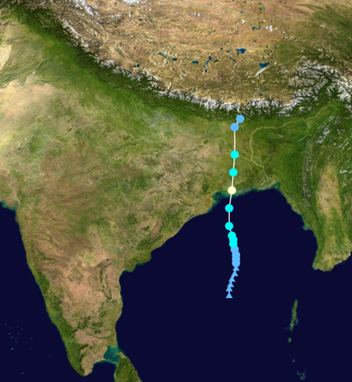
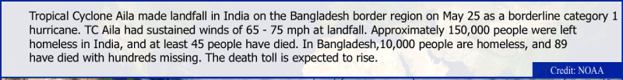
May 2009 - Tropical Cyclone Aila
Single case example:
NICAM simulation accurately predicted development, evolution and track of TC Aila over 5-day period
25May09
23May09
21May09

Slide 48

NICAM Animation
21 May – 31 August 2009

Slide 49
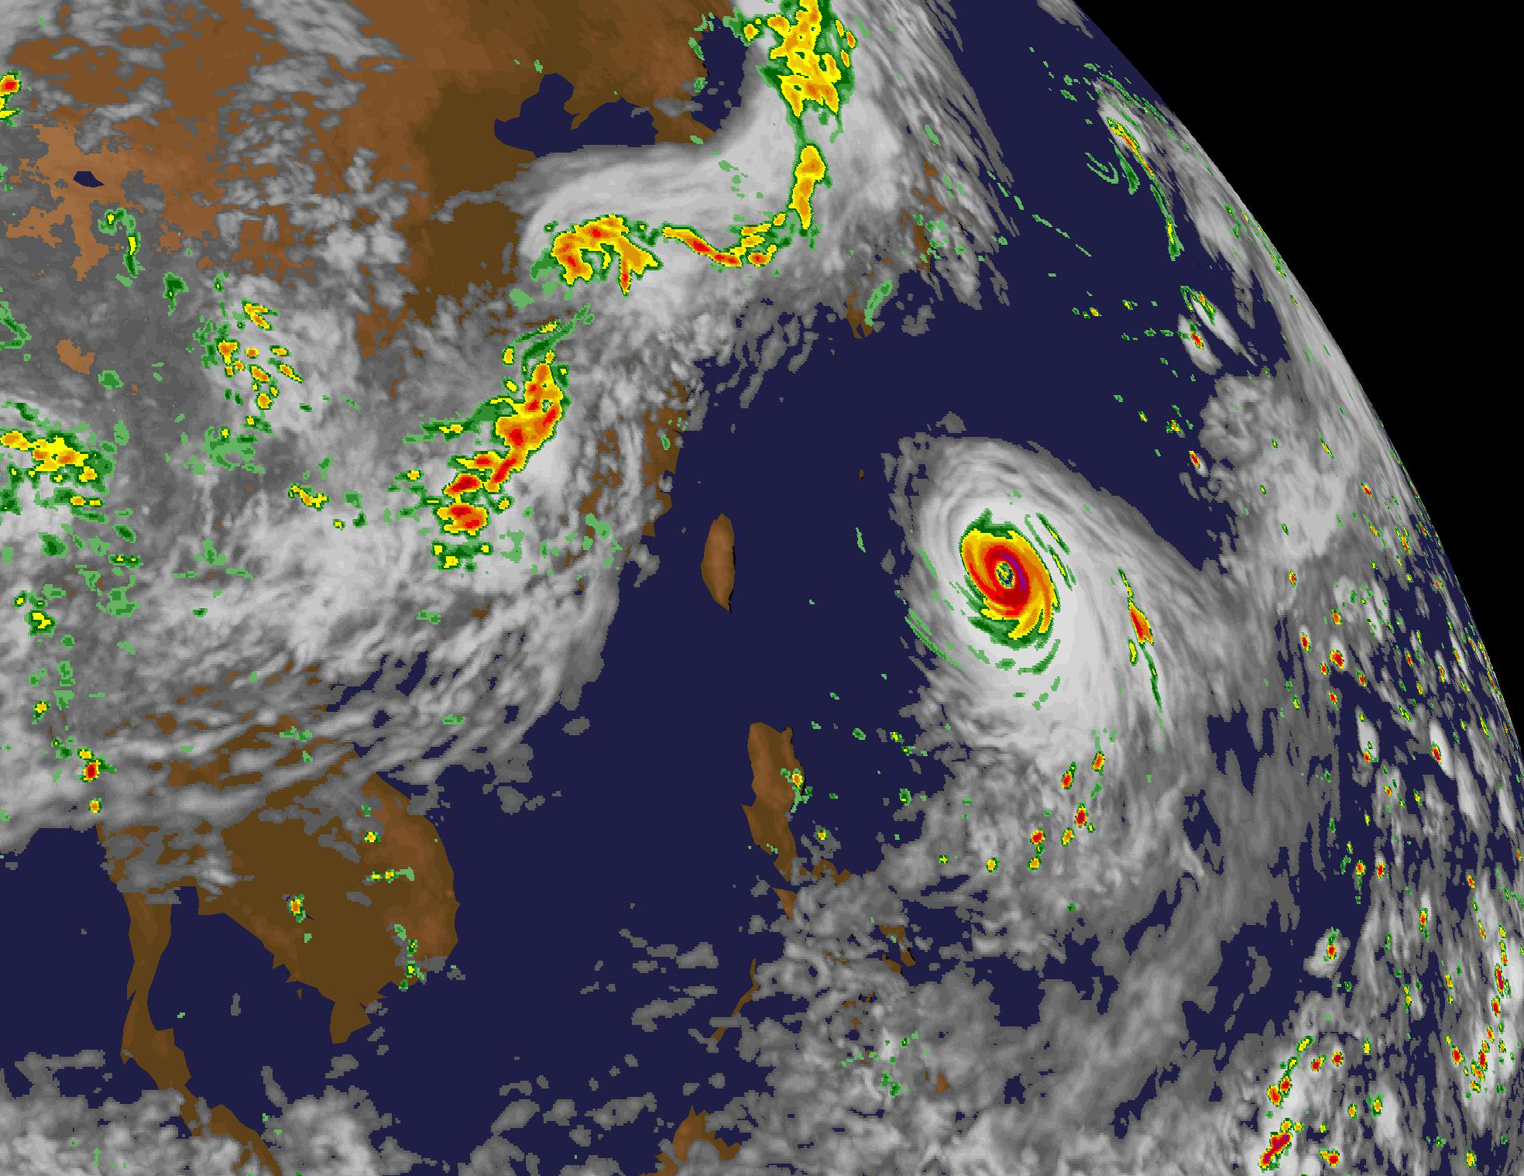

Slide 50
Project Athena: Summary
  Good news: Extreme spatial resolution (highest possible with hydrostatic dynamics and parameterized clouds) does not change qualitative features of climate simulation → our large-scale intuition still works for the most part
  As expected: High spatial resolution provides higher fidelity representation of features sensitive to orography
  Unexpected: Nonlinear dynamical effects can alter simulation changes due to spatial resolution improvements much more and possibly in different ways than we might have expected
  Bad news (expected?): There really is a “no-man’s land” between resolutions for which parameterized clouds are appropriate (> 15 km grid) and for which resolved clouds are appropriate (<< 7 km grid)

Slide 51
Project Athena: Summary
  NSF impetus: Act on results of 2008 World Modeling Summit
  Hypothesis: High spatial resolution and process-resolving models can dramatically improve simulation of climate
  COLA role: formed and led an international collaboration involving over 30 people in 6 groups on 3 continents
  Two state-of-the-art global AGCMs at the highest possible spatial resolution
  Dedicated supercomputer at NICS for Oct’09 – Mar’10
    Data ~900 TB total
    Overall results look very promising
    Long term - model output data will be invaluable for large community of climate scientists (unprecedented resolution and simulation duration) and computational scientists (lessons learned from running dedicated production at nearly petascale)

