Slide 1
Independent Tests of OCNs and Other Alternative Normals on Different Surface Temperature Data Sets: Results and Implications for CPC Operations
Bob Livezey
Climate Prediction Center Seminar
February 20, 2013

Slide 2
Outline
Introduction and motivation
Climates are dominantly warming so official normals are dominantly cold biased
Two challenges:
Estimating normals as “expected values” rather than as retrospective references
Tracking the normal history; signal separation/detrending
For tracking, how important is data homogenization?
Methods and their expected merits
Moving averages/running means
Simple prescribed models assuming linear change
A note about other smoothers
Independent tests
Impact of data sets
Validation of hinge choices
Relative performance on homogenized station records
Conclusions and Recommendations

Slide 3
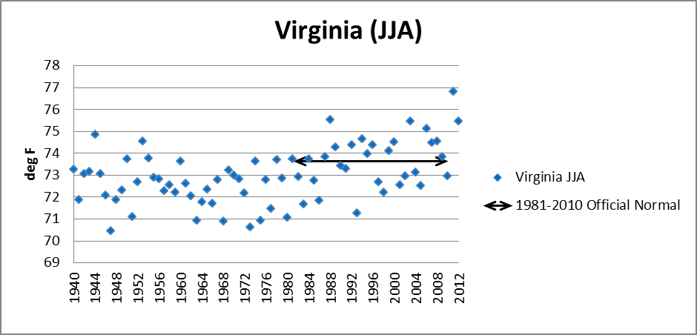
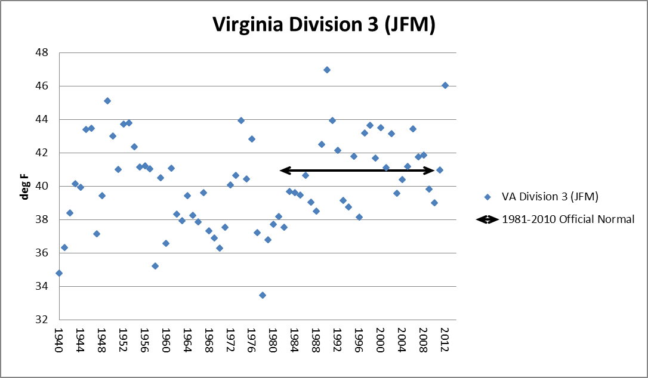
Introduction and Motivation
The climate is warming in most locations in every season, so official normals are cold biased

Slide 4
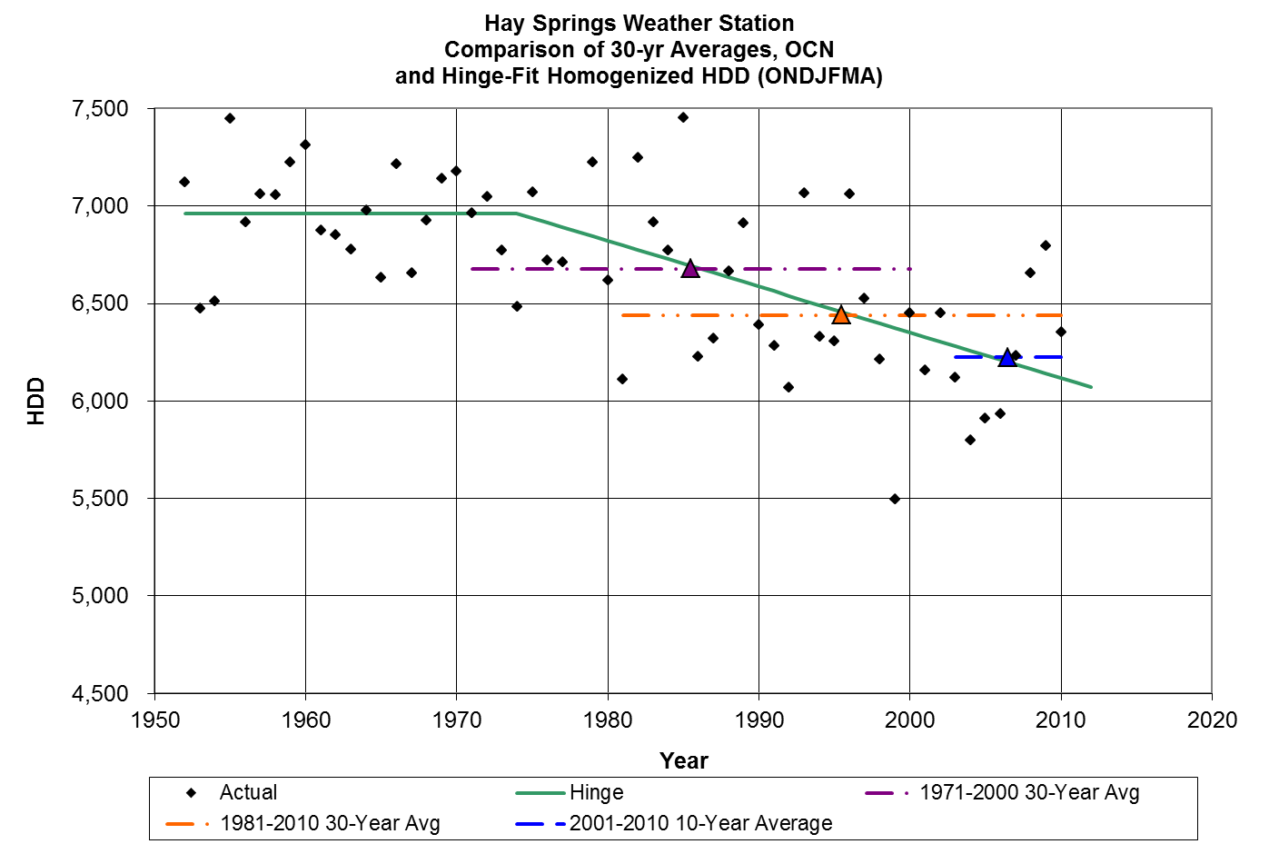
Introduction and Motivation
OK, so what?
If a normal is only used as a reference, the cold bias doesn’t matter and the consistency of official normals might be preferred
If the normal is used as the “expected value,” it does matter!
Every deg F difference in normals represents a difference of over 200 expected heating degree days per unit

Slide 5
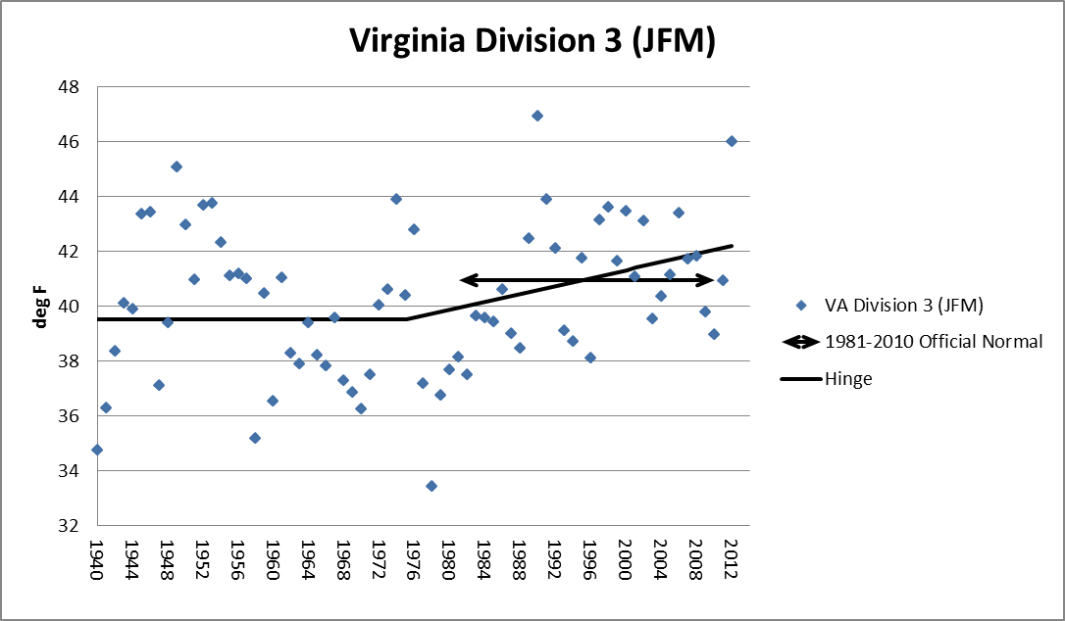
Introduction and Motivation
Aside from possible usefulness in estimating current normals, why would we want to track the climate (i.e. detrend/separate climate change signal from climate noise)?
To get the best, most relevant estimates of:
Rates of warming
Variability
Current probabilities and conditional probabilities
Assume that at least to 1st order, so far climate noise (variability) is independent of climate change:
Track the normal smoothly and simply
Recenter residuals to the current climate

Slide 6
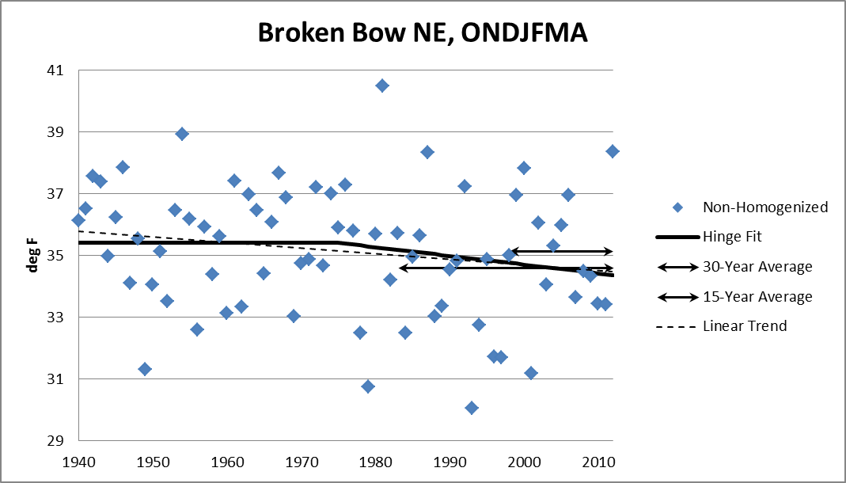
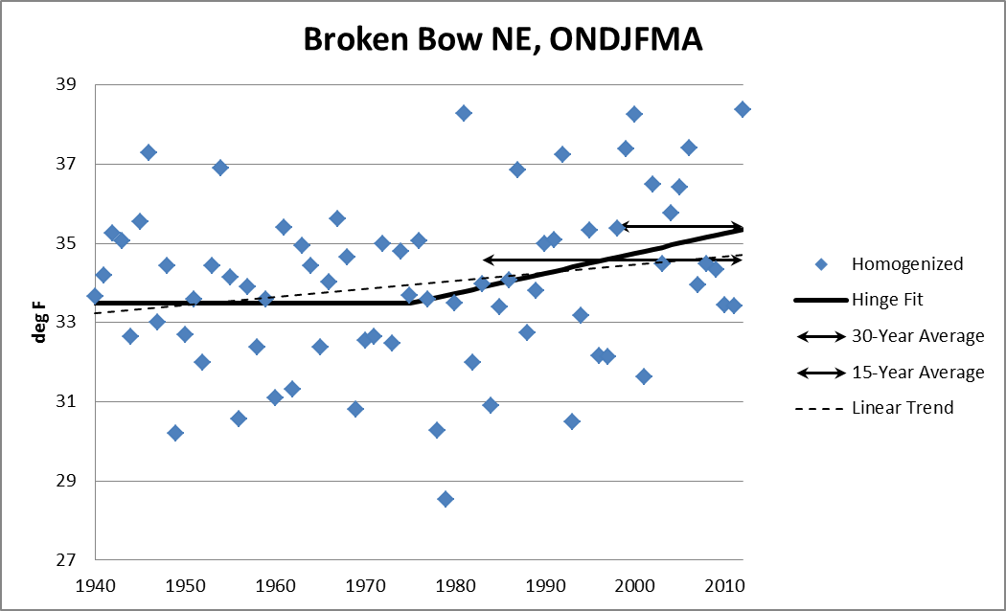
Is use of homogenized data necessary and important?
Emphatically yes if your goals are best estimates of current climate, warming trends, probabilities and conditional probabilities!

Slide 7
Is use of homogenized data necessary and important?
NCDC provides easy public access to homogenized station records for the 1218 UCHCN along with corresponding raw and time-of-obs (TOB) corrected series.
NWS (CSD)/NCDC provides field office access to homogenized records at least at 4000 additional stations.
NCDC is addressing requirements for homogenized records for both monthly mean divisional data and daily station data.
Are CPC in-house records as free of inhomogeneities?
In this context CPC and NCDC goals are compatible, so shouldn’t leveraged data sets be consistent?

Slide 8
Methods and their expected merits (demerits)
Time averages:
30-years
Less than 30-years
Optimum Climate Normals (OCN) minimize sum of bias error (increases with averaging period) and sampling error (decreases with averaging period)
Fixed 10- or 15 years (CPC₁₀ & CPC₁₅)
Tailored to case (location/season):
Best performer over dependent period (OCN)
Optimize based on trend estimates (OCN_{1P} & OCN_{2P})
Intercept of weighted regression fit to series of estimates on more and more recent training periods (OCN_{M})

Slide 9
Methods and their expected merits (demerits)

Slide 10
Methods and their expected merits (demerits)
Trend-based methods
Full-period trend
Post-1975 trend
1975 hinge (Livezey et al., 2007; L7)
Estimated change-point and 2-phase hinges (3 variants)
Fit change point case by case (C Est)
Fit 1940-1975 slope case by case (Two-Phase C=1975)
Fit both of the above (Two-Phase C Est)
Various time series smoothers (autoregressive or spline methods)

Slide 11
Methods and their expected merits (demerits)

Slide 12
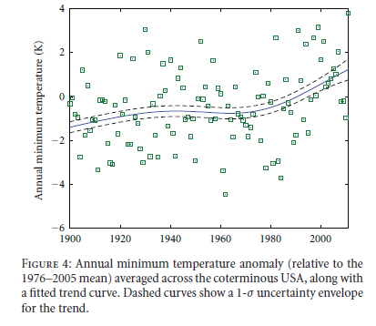
Methods and their expected merits (demerits)
Desirable attributes of methods:
Small squared error in estimating next year
Small bias error in estimating next year
Current normal stable when updated each year
Can be used to track the climate smoothly and realistically through the entire record
Krakuaer (Advances in Meteorology, 2012)
OCNs are the least stable and can’t be used to track the full record smoothly and without compromises, but are expected to have small bias and squared errors when warming is moderate
Post-1975 trend still unstable, but less so, with similar errors, but cannot track the full record
Full-period trend is very stable and can track the full record smoothly but not realistically, and has larger biases and squared errors
1975 hinges (1- and 2-phase) have all desirable attributes; parsimonious, well-supported model of climate change
Time series smoothers are the most arbitrary and require more compromises; generally just produce smoothed out hinges

Slide 13
Independent Tests of OCNs, Full-Period Trend and Hinges
Wilks’ (W13; JCAM, 2013) tested CPC’s OCNs and L7 and other hinges on periods (1994-2011 and 2006-2011 respectively) after the methods were proposed; the tests were on CPC mega-divisional data
W13 found for 1-year in advance temperature prediction:
CPC₁₅ overwhelmingly best in terms of reduction of variance (RV) with respect to 30-year averages
1994-2011: Had 8/9 region/season cases out of 12 where an alternative beat 30-year averages, the 2-phase 1975 hinge had the other
2006-2011: Had 4/9 region/season cases out of 12 where an alternative beat 30-year averages, the 2-phase 1975 hinge had 3 others and CPC₁₀ 1
Estimated hinges uniformly degraded badly the 1975 hinge results, while the 1975 1-phase hinge performed very comparably to the 2-phase, thereby validating the choices made by L7

Slide 14
Independent Tests of OCNs, Full-Period Trend and Hinges
Wilks and Livezey (WL13; JCAM, 2013) repeated the tests with data through 2012 on:
Megadivisional data
To repeat W13’s results
Station data with TOB corrections from the 1218 station USHCN
TOB-corrected station data is noisier but contains steeper trend cases than megadivisional
Expectation is that hinge-based methods will improve, but not empirically-determined OCNs
Fully-homogenized station data from the 1218 station USHCN
Expected to improve the performance of all methods

Slide 15
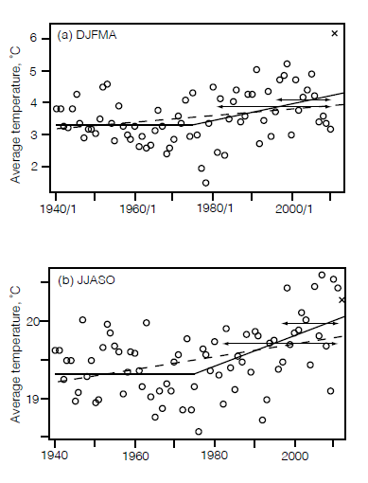
Independent Tests of OCNs, Full-Period Trend and Hinges
WL13

Slide 16
Independent Tests of OCNs, Full-Period Trend and Hinges (2006-12)
15-year OCN remains best overall
Impact of stations vs megadivisions as expected
Homogenization improves performance for 9/11 methods!
1975 1-phase hinge gets even stronger validation!

Slide 17
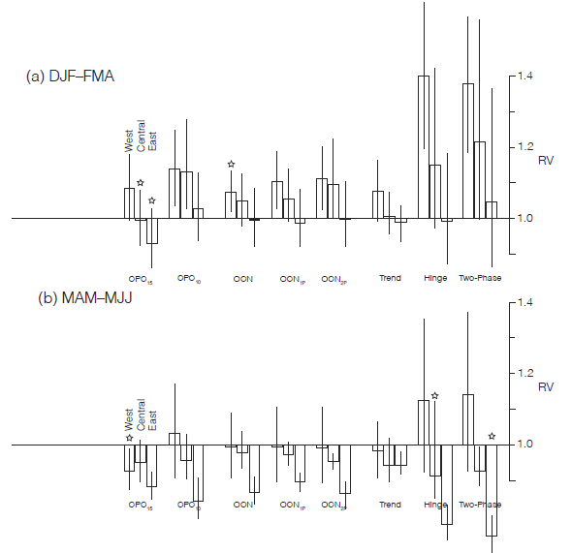
Homogenized Data Results (2006-12)
Winter: No method outperformed 30-yr average in West; 15-year average best in Central and East
Spring: 1975 hinges best 2 in Central & East; 15-year average in West
Overall advantage of 15-year average over 1975 hinges largely accounted for by winter and spring West

Slide 18
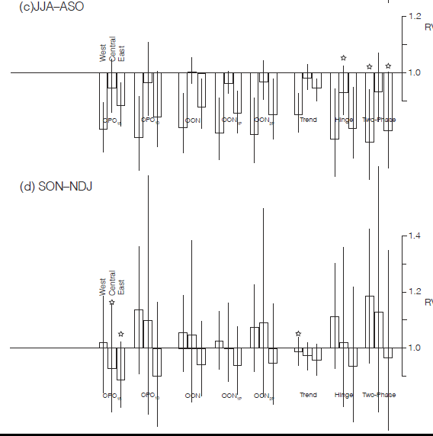
Homogenized Data Results (2006-12)
Summer: 1975 hinges best 2 everywhere
Fall: 15-year average best in Central & East; only trend beats 30-year average in West

Slide 19
Homogenized Data Results (2006-12)
Alternatives to 30-year averages performed better in 11/12 regions/seasons: the winter West was the only exception
15-year fixed OCNs were best 5/12 times, fall and winter East and Central and spring West
1975 hinges were best 5/12 times, spring and summer East and Central and summer West
The advantage of the fixed 15-year average over the 1975 hinges is dominantly a consequence of unusually cold halves of the year (especially in the West) during the almost 7-year test period
1975 hinges had the best two overall biases in 6/12 cases and 2nd and 3rd in another, no other method had more than 2

Slide 20
Conclusions and Discussion
Warming is so ubiquitous that relevant current normals are dominantly best estimated with alternatives to 30-year averages except under extreme departures from this warming:
We don’t know in advance when the exceptions will occur
15-year averages have been the most resilient for all data sets, the 1975 hinges otherwise
The 1975 hinges are the best choice if bias reduction is more important than reduction of variance with respect to 30-year averages
For detrending or signal separation (when relevant estimates of warming trends, or current interannual variability, probabilities and conditional probabilities are needed):
The changing climate needs to be tracked smoothly and reasonably and the preferred methodology is the 1975 hinge
When possible, tracking and distribution estimation should be based on homogenized records
If uniformity is not a requirement, the best methodology depends on your objectives

Slide 21
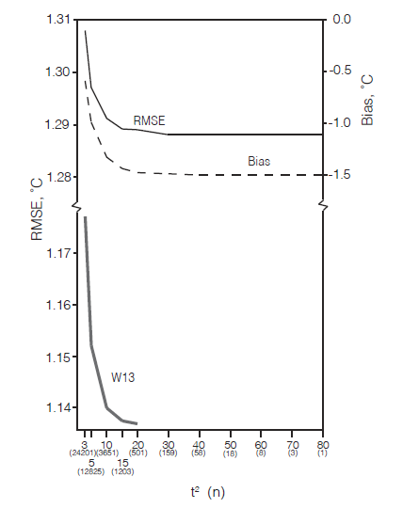
Conclusions and Discussion
WL13 Hybrid
15-year average used unless 1975 hinge slope exceeds significance threshold
Horizontal axis shows increasing use of hinge from right to left
Using the 1975 hinge in 14% of all cases reduces the average bias by 1/3 but increases the RMSE by less than 1%

Slide 22
Recommendations
All retrospective work on climate variability and change should leverage the best homogenization science available; CPC should work with NCDC on this
Noisy methods with artificial boundary conditions or methods that don’t reflect ubiquitous features of climate change should not be used for detrending or signal separation; why not use the hinge, it now has an even solider basis
The 10-(11-?)year OCN for forecasting should immediately be replaced with a 15-year version, the hinge, or a hybrid approach

